Slide 1
Don Berman Co-Founder, VP of Sales & Marketing & JD “Xpert”
Today’s Speaker
Don Berman has spearheaded the adoption of HR and talent management applications and technology driven best practices at large and mid-sized companies throughout the U.S and abroad. As co-founder and VP of Client Services, Don was instrumental in evolving the focus of JDXpert’s Talent Management platform toward a job description-centric model that resulted in JDXpert becoming a market leader in job description management solutions. Today, Don leads the company’s sales, marketing and partner efforts.

Slide 2
Are Job Descriptions Your Achilles Heel?

Slide 3
Job data is the cornerstone of what we do
JOB
DESCRIPTION
Human Resources
Talent Management
Compensation
Where do we keep this critical dataset?
THE JOB DESCRIPTION

Slide 4
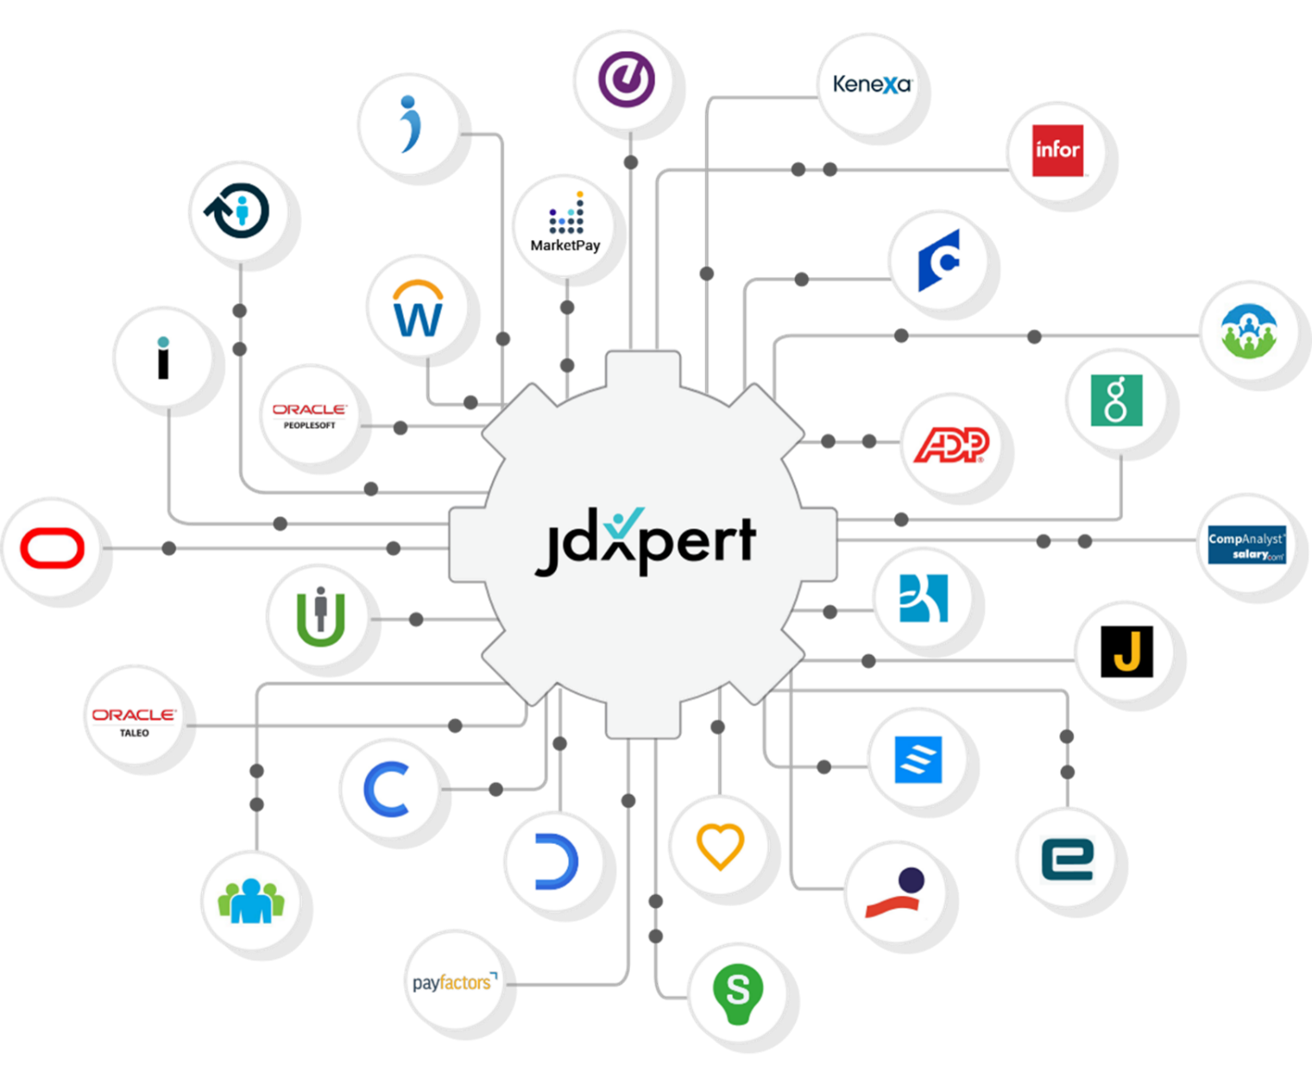
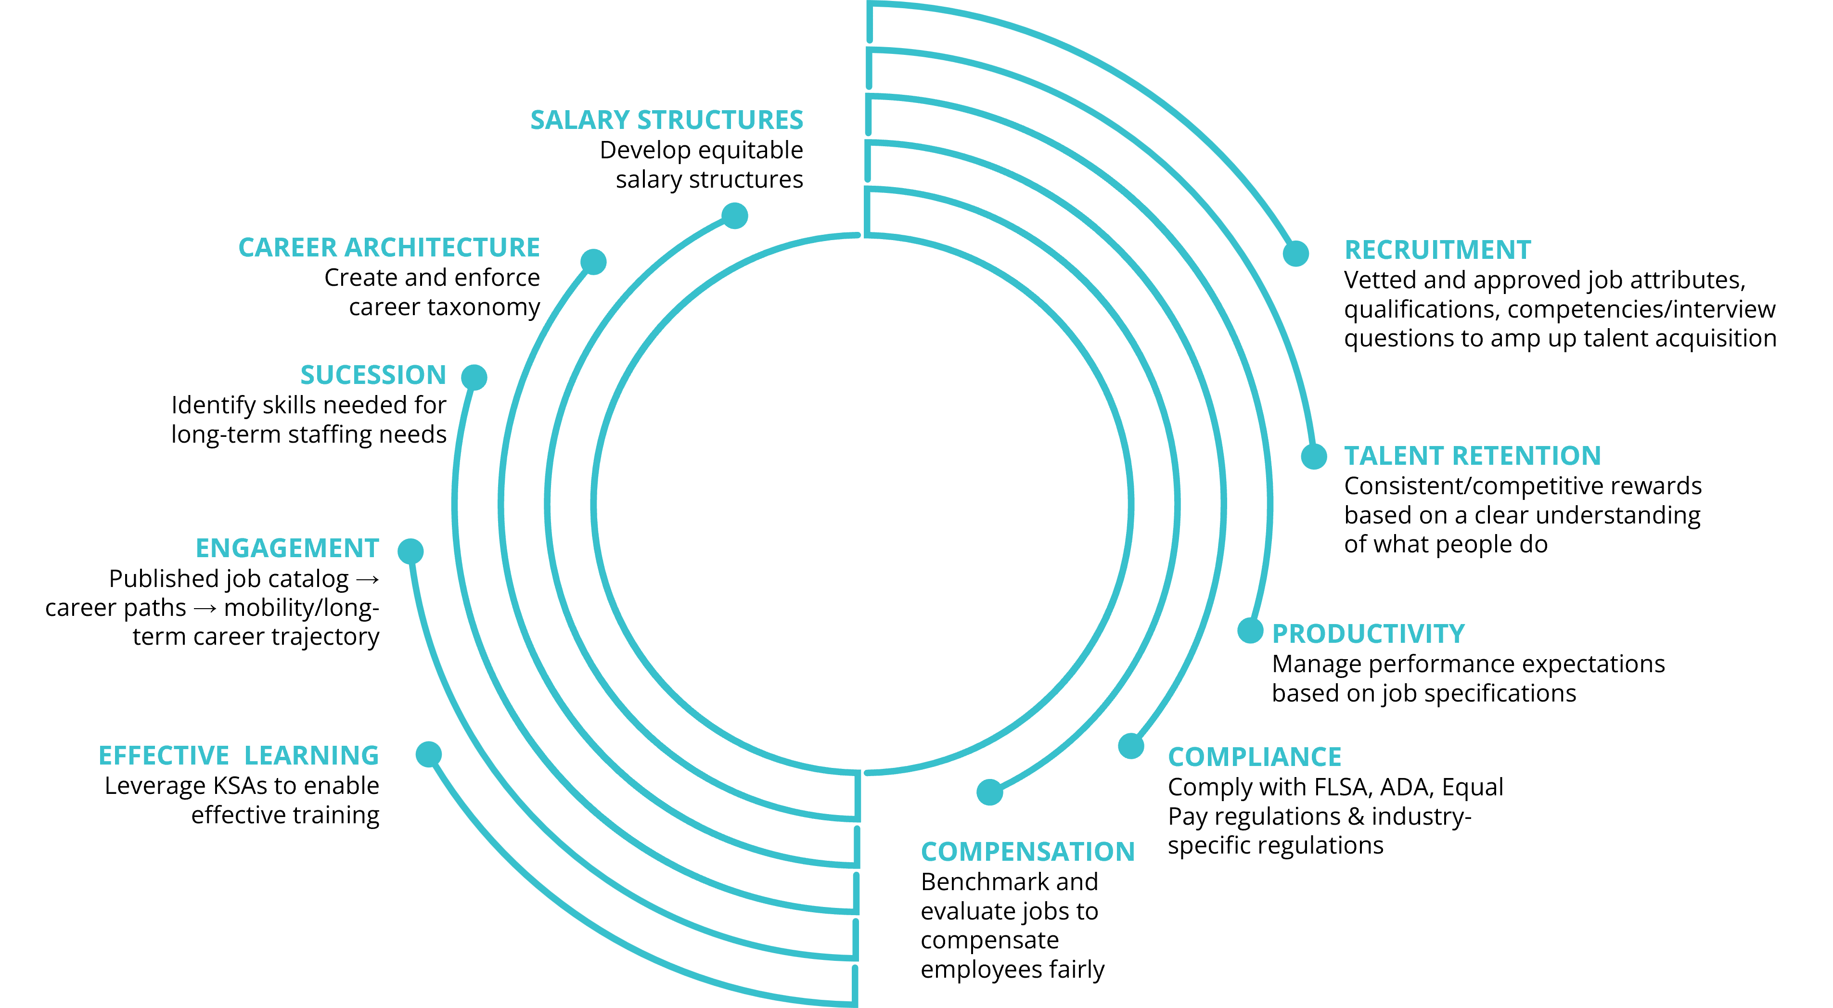
Powering HR
A robust up-to-date job description repository can ensure that all aspects of your HR and Talent Management activities are reading from the same playbook.
Optional Interfaces:
HRMS
Job Data Feed
Employee Data Feed
Applicant Tracking System
…and even Workday
Notes:
A job description management system allows you to create robust job descriptions that power your most critical HR and Talent management activities
When all your systems are reading from the same playbook, your systems and processes will run more efficiently and will strengthen each other.
For that reason, In almost all implementations, we set up an interface with your HRMS system as well as your Applicant Tracking system (both of these are included with JDXpert PRO and Enterprise ) Optionally we’ll set up interfaces with Talent Management System, Compensation Tools, and we Even have an API connection to Workday.
JDXpert is very integration friendly. We can interface and share with any other system or application that support import/export of excel or csv files.
In organizations talent management system solutions typically take care of the following:
Performance Management
Goal Management
Talent acquisition
Learning management
Succession planning
Learning management
Compensation management

Slide 5
Customers Include

Slide 6
HR Technology Expenditures
Fortune Business Insights projects that global human resource technology market spending will rise from $23.98 billion in 2022 to $39.9 billion by 2029.
Estimated Expenses for a 5,000 Employee Company
System | PEPM PUPM | Annual License | Implementation Vendor | Implementation Internal | Total 1st Year
HRMS | $ 8 | $ 480,000 | $ 240,000 | $ 240,000 | $ 960,000
Performance | $ 3 | $ 180,000 | $ 45,000 | $ 11,250 | $ 236,250
Applicant Tracking | $500 | $ 10,000 |  |  | $ 10,000
Succession Planning | $ 3 | $ 180,000 | $ 45,000 | $ 11,250 | $ 236,250
Market Pricing Data/Tools |  | $ 45,000 | $ 15,000 | $ 20,000 | $ 80,000
Career Architecture (Career Ladders, Banding Projects) | NA | $ - | $ 150,000 | $ 120,000 | $ 270,000
Total |  |  |  |  | $ 1,792,500
Maintaining Job Descriptions in Word |  | 0 | 0 | ??? | ???
What is the potential cost of not Managing Job Information?
Fortune
Notes:
Managing Job Descriptions in Word =???—Well maybe your spending a ton of time wrestling with this bear or maybe you’re giving up.
From what we’ve seen from our clients, I can tell you that for the majority it’s the latter…

Slide 7
What's The Risk?
Companies invest in other HR areas but very little, if anything, on the foundation.
A clear understanding of each job is required to do just about everything we do in HR.
Weak job descriptions = compromised HR initiatives
Recruit the right people
Evaluate employee productivity & performance
Identify and retain top performers
Identify and manage bottom performers
Motivate employees with engaging Career Paths
Identify Employee Training Gaps
Benchmark/Evaluate jobs to compensate employees fairly
Develop an equitable salary structure
Bottom Line: The days of managing Job Descriptions in Word docs via email are over!
Protect your company from regulatory sanction FLSA, ADA, Equal Pay
Protect your future with effective succession plans
Notes:
- Companies invest in other HR areas but very little, if anything, on the foundation –Job Information
- A clear understanding of each job is required to do just about everything we do in HR.
.
.
.
By having a weak foundation (weak job descriptions/information), the HR initiatives that rely on accurate job data are being compromised.
Bottom line: The days of managing Job Descriptions in Word docs via email are over!

Slide 8
What’s The Risk?
What is the real cost of executing these poorly?
Talent Acquisition
Employee Engagement/Retention
Compensation
Compliance

Slide 9
What’s The Risk?
For each area we will describe:
01
02
WHAT’S THE RISK
WHY JOB DESCRIPTIONS ARE IMPORTANT
03
04
WHAT TO DO
WHAT JDXPERT CUSTOMERS ARE DOING
Notes:
For today’s presentation, I will go over each area and cover the risk, why job descriptions are important, what you can do, and what JDXpert clients are doing.

Slide 10
Talent Acquisition

Slide 11
What’s The Risk: Talent Acquisition
Businesses rely on people
Total human capital costs nearly 60% of operating expenses
And accord to SHRM cost of labor is up 4.6% in 2023
So it is important that we are hiring the right people!
Deloitte , SHRM
Notes:
- We rely heavily on our employees, so much so that we have a whole department/industry dedicated to people.
- In most organizations, total human capital costs nearly 60% (and with the cost of labor increasing about 4.6% in 2023 according to SHRM) of operating expenses so it is important that we are hiring the right people!

Slide 12
What’s the Risk: Talent Acquisition
Human capital costs nearly
60%
Cost of labor
Up 4.6%
of operating expenses
Lever | Go Remotely
Notes:
- We rely heavily on our employees, so much so that we have a whole department/industry dedicated to people.
- In most organizations, total human capital costs nearly 60% (and with the cost of labor increasing about 4.6% in 2023 according to SHRM) of operating expenses so it is important that we are hiring the right people!

Slide 13
What’s The Risk: Talent Acquisition
Bad Hires
Average
cost-per-hire
Average time to fill a position
30%
$4,700
44 days
of new hires leave within 90 days
SHRM, , Josh Bersin Company, Forbes
Notes:
Making Bad Hires
The average cost-per-hire is nearly $4,700
Average time to fill a position is 44 days*
30% of new hires leave within 90 days

Slide 14
What’s The Risk: Talent Acquisition
Long Term Vacancies
5.84 million
2.5 million
8.8 million
Unemployed
Open positions
Fewer students in college now than in 2015
BLS NYT The Daily
Notes:
Long Term Vacancies
There are 5.84M unemployed for 8.8M open positions
2.5 Million fewer college students now than in 2015 (18+M) to fill the jobs of the future.

Slide 15
Talent Acquisition: Calculating The True Cost Of A Bad Hire
The cost of a bad hire can range from 33-500% of an employee’s annual salary
Tangible costs of a bad hire:
The cost of hiring a new employee (advertising, interviewing, screening)
Cost of onboarding (again)
Training cost (again)
Intangible costs of a bad hire:
Lost productivity
Customer service and errors
Lost engagement
Cultural impact
Notes:
The reason for so many varying opinions on the cost of a bad hire is due to many factors, including the complexity of the role and tangible and intangible costs.
Some of the tangible costs you have to account for are:
The cost of hiring a new employee including the advertising, interviewing, screening, and hiring.
Cost of onboarding a new person, including training and management time
Training cost—for example, over two to three years, a business likely invests 10 to 20 percent of an employee's salary or more in training
Intangible cost include.
Lost productivity—it may take a new employee one to two years to reach the productivity of an existing person while at the same time impacting valuable resources.
Customer service and errors—for example; new employees take longer and are often less adept at solving problems
Lost engagement—other employees who see high turnover tend to disengage and lose productivity.
.Cultural impact—whenever someone leaves, others take time to ask why, negatively affecting corporate culture.

Slide 16
Why Job Descriptions Are Important: Talent Acquisition
Why People Leave
43%
34%
32%
role doesn’t meet their expectations
a specific incident
company culture is a bad fit
Forbes
Notes:
The reasons employees leave aren’t a shocker: 43% say the role doesn’t meet their expectations, 34% leave because of a specific incident and 32% don’t think the company culture is a good fit.

Slide 17
What To Do: Talent Acquisition
03
01
SKILLS BASED RECRUITING
JOB DESCRIPTIONS
Remove education and experience and focus on skills
Your job descriptions need to be accurate, up-to-date, and reflect what people actually do
05
DISTRIBUTE DATA
Automate interface between your job Information and your ATS
02
04
DEBIAS JOBS
JOB POSTINGS
Remove bias from job description to prevent applicants for self-eliminating
Capture marketing summaries, organizational summaries, and vetted job data to construct job postings
Notes:
Your job descriptions need to be accurate, up-to-date, and reflect what people actually do
Capture marketing summaries, organizational summaries, and vetted job data to construct job postings
Automate interface between your job Information and your ATS
Debiasing: Remove bias from job description to prevent applicants for self-eliminating
Skills-based Recruiting: Remove education and experience and focus on skills

Slide 18
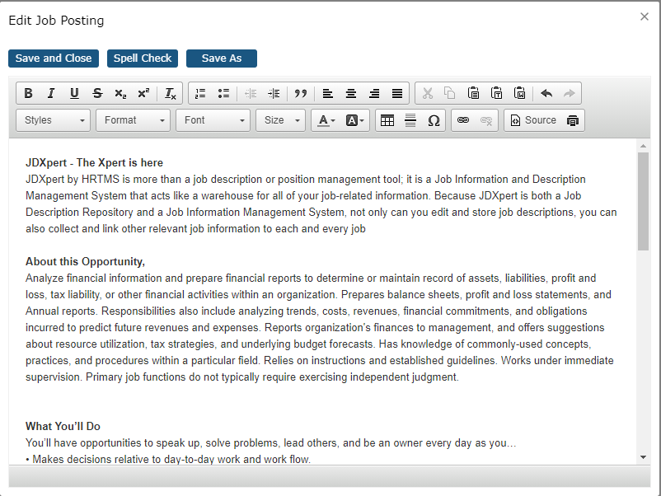
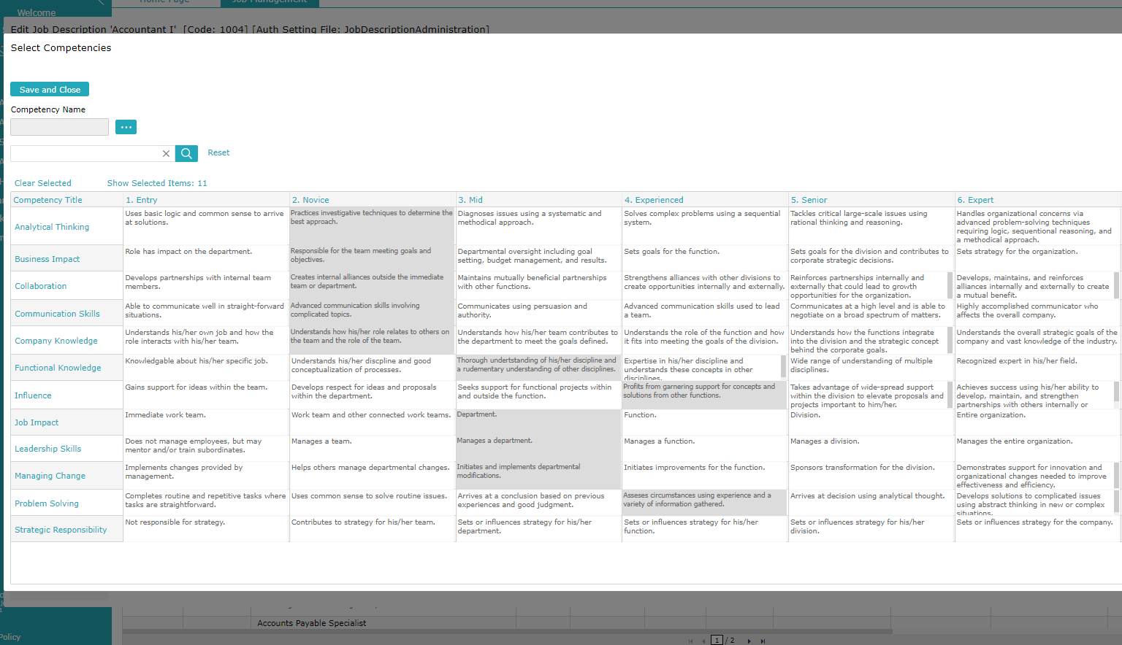
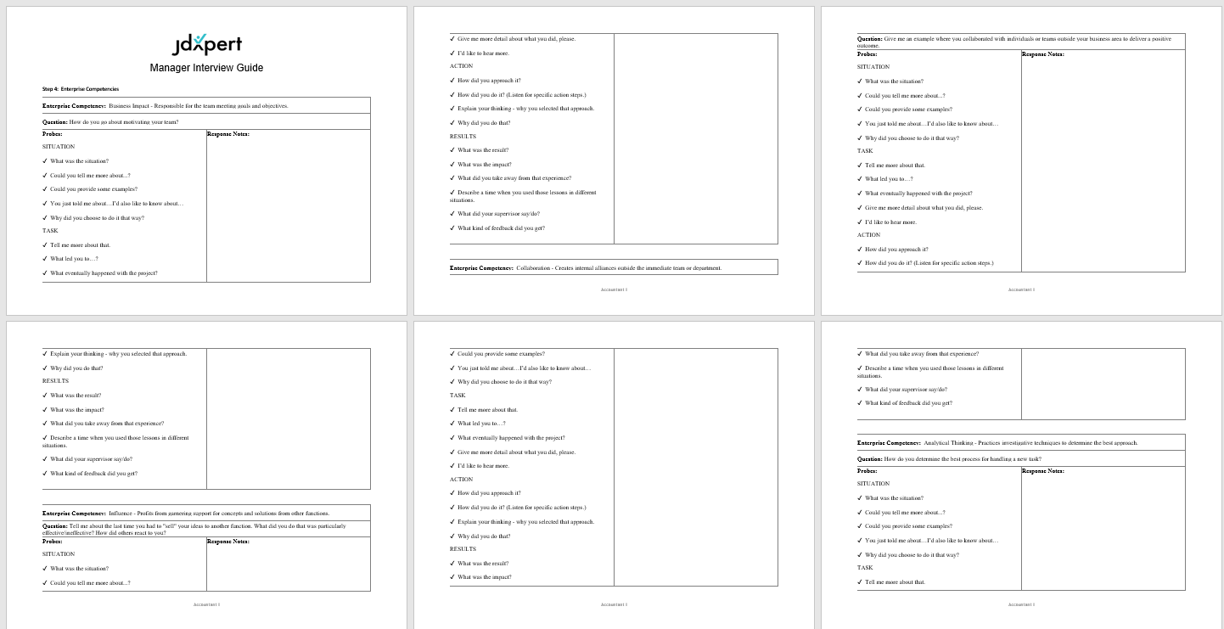
What JDXpert Clients Are Doing: Talent Acquisition
Over 80% of JDX clients have implemented an automated interface with top ATSs.
Competencies
Interview Guides
Notes:
Over 80% of JDX clients have implemented an automated interface.
Taleo, Workday, iCims, PeopleFluent, ADP, Infor, CSOD, BrassRing, Oracle, PeopleSoft, SilkRoad and many more
Competencies
Interview Guides – Downloaded Word docs that managers can take with them into interviews that weave competencies and other Job information into a structured rubric for conducting interview and even provides spaces for managers to take notes along the way.

Slide 19
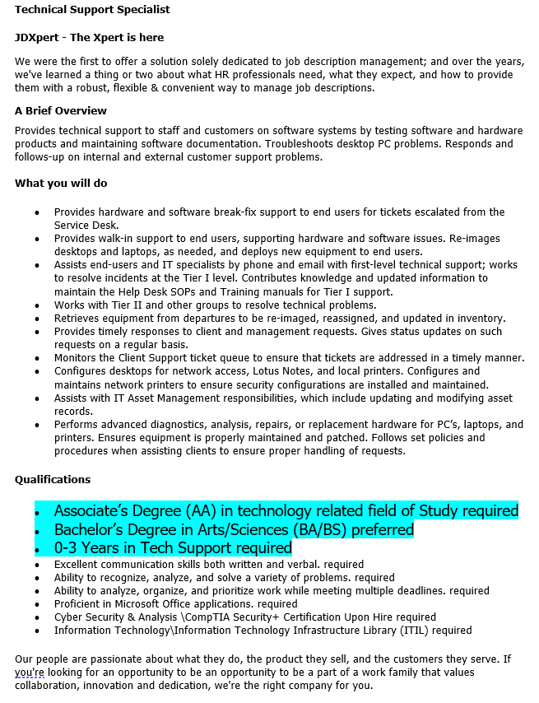
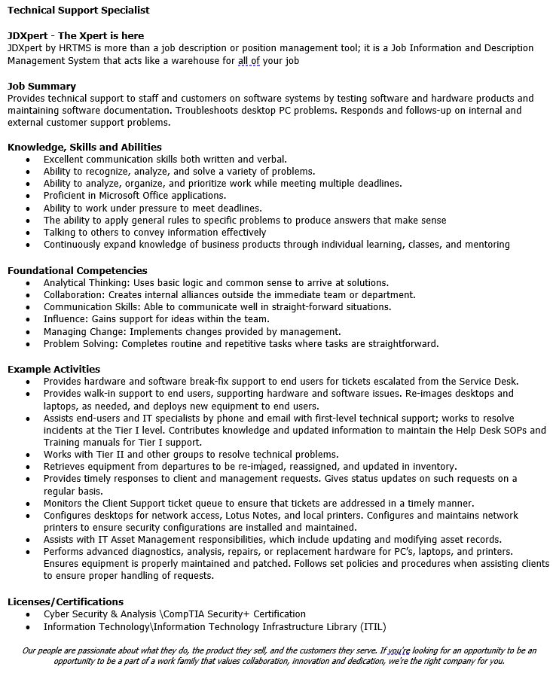
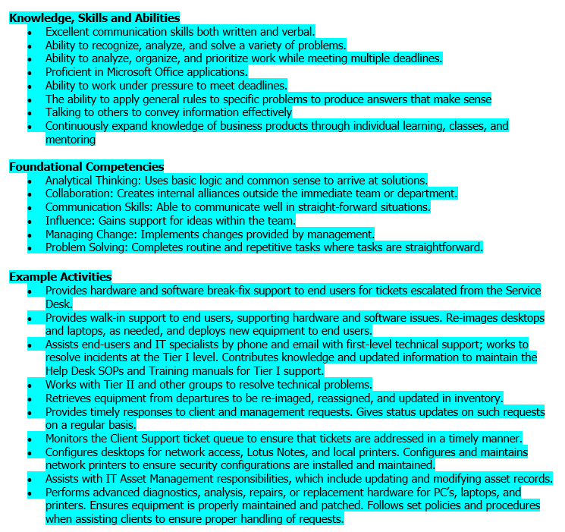
Pedigree vs Skills-Focused
Postings
Notes:
DON
Compare
According to a recent Recruiting Dailey Article. Why Skills Base Hiring in on the rise and Should remain that way
For years, companies have practiced “degree inflation,” demanding four-year college degrees for positions that didn’t require them. This kept many skilled workers out of the talent pool due to the high cost of higher education. This disproportionately impacted those in lower-income communities, especially people of color, leading to a lack of diversity in the workforce in upwardly-mobile positions.
Also in that article:
A review of job descriptions by the Harvard Business Review showed that employers have started to reduce degree requirements by more than 45% for mid-level employees and about a third for high-skilled positions.

Slide 20
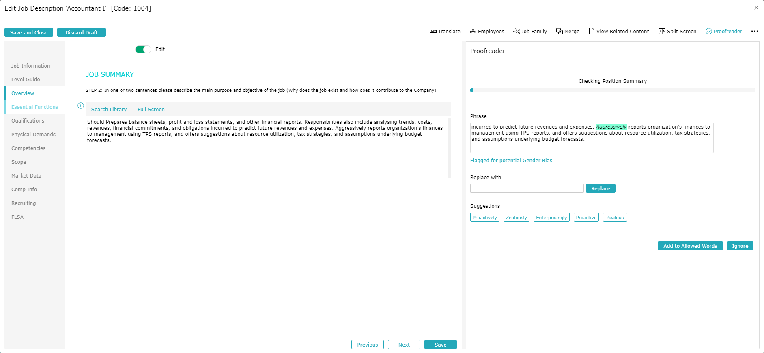
Debiasing in Action
Notes:
Debiasing is difficult to do in a manual way so we’re really discussing an automated process
In our tool we apply debiasing as the Job Description is being edited.
Also:
Lexicon of biased words, Jargon etc. comes populated but is editable so companies and tailor terms to their needs
Ability to generate a bias score allow you to report globally on you Job Description library to identify targets for debiasing effort.

Slide 21
Engagement/Retention

Slide 22
Engagement/Retention
Avoid Burnout
Career Growth
Flexibility
Compensation
Lever
Notes:
The relationship between employer and Employee has changed due to the labor market.
What are applicants looking for.

Slide 23
What’s the Risk: Burnout
40%
#1
of workers have left their jobs due to burnout
reason why employees in the US leave their jobs
Zippia

Slide 24
What’s the Risk: Career Growth
44%
1 in 4
of companies do not provide compelling career paths
feels confident about their current role, which has led 75% to browse new roles at other companies.
Forbes
Notes:
Job descriptions play an important role in showing career growth opportunities because there are a prerequisite for Career Ladders. and career pathing as well as methodologies like Job Architecture that enable them..

Slide 25
What’s the Risk: Flexibility
65%
76%
of candidates want remote work options even after the pandemic
of employees see flex work as a top reason for staying with their current employer
Lever | Go Remotely
Notes:
During the Pandemic WFH was about surviving Business disruption.
Now it’s Flexibility
The Ability to WFH is now table stakes for many employee considering staying or looking for new job
According to our most recent JDXpert poll we asked people what percentage of jobs that went remote would remain remote or hybrid permanently– only 12% of respondents said that they predict less than 10% of formerly on-site jobs will remain remote or hybrid permanently. And 37% stated that 50% or more would remain remote or hybrid.

Slide 26
What’s the Risk: Compensation
5%
66%
salary underpayment is enough to send your key talent to the competition, but not enough to motivate your marginal employees to leave
of people would quit their jobs due to money
Zippia
Notes:
Overpaying by even a small percentage wrecks havoc on budgets which then reduce your ability to hire qualified
Yet, a 5% salary underpayment is enough to send your key talent to the competition, but not enough to motivate your marginal employees to leave.

Slide 27
Why Employees Leave
Why Job Descriptions Are Important: Retention Overall
Turnover factors | Rank
Opportunities for career advancement | 1
Satisfaction with my role and responsibilities | 2
Base pay | 3
Opportunities for career-related skill development | 4
The degree to which my skills were used in my job | 5
4 out of 5
Are directly dependent upon job descriptions
McLean & Company
Notes:
When examining retention, it’s critical to understand why people leave. According to McClean and Company 4 out of the 5 of these reasons,, are directly dependent upon a clear understanding of the work people do as provided by an accurate job description:
Opportunities for career advancement
Satisfaction with role and responsibilities
Base pay
Opportunities for career-related skill development
The degree to which their skills were used in their job

Slide 28
Causes of Burnout?
Why Job Descriptions Are Important: Burnout
Workload
Control
Reward
Community
Fairness
Values
3 out of 6
Causes of burnout are related to the job description
Harvard Business Review
Notes:
Beyond those reasons Burnout is one of the most important causes of Turnover
Causes of Burnout
Workload: Unclear or overly demanding job expectations
Control: Feeling like you have little or no control over your work
Reward: Lack of recognition or reward for good work
Community: A lack of support from supervisors and coworkers
Fairness: Unfair treatment when compared to other team members
Values: When a company’s values and motives do not match your own
3 out of 6 Causes of Burnout are directly related to Job Descriptions:
Workload : Can provide a clear definition of work to be done
Control: Delineates what is and is not part of the job
Reward: Defines what success looks like for the position

Slide 29
Why Job Descriptions Are Important: Career Growth
Millennials/Gen Z are focused on a rewarding career path
Defining Career Architecture – Enables a coherent taxonomy, salary structure and career ladders
Career architecture and career ladders require a clear understanding of all roles
Accurate job descriptions are critical
Managing the process in Word is virtually impossible
Notes:
Millennials, more than others, are focused on a rewarding career path
Defining Career Architecture – Enables a coherent taxonomy, salary structure and career ladders
Career architecture and career ladders require a clear understanding of all roles
Accurate job descriptions are critical content for the process
Trying to manage the process using Word documents is virtually impossible
A Job Description Management System:
Helps organize jobs
Routes job descriptions/career ladders to appropriate stakeholders for revision and approval
Allows career ladder matrixes to be published online

Slide 30
Why Job Descriptions Are Important: Flexibility
Jobs went remote during the pandemic
Failure to do task level audits at that time:
Resulted in inaccurate physical demands and working condition impacting ADA compliance
Caused missed tasks and inaccurate job descriptions
Job description that are inaccurate become useless in compliance hearings and employee litigation

Slide 31
Why Job Descriptions Are Important: Compensation
Salary structures begin with career ladders/career architecture
Benchmarking, grading, leveling jobs, requires a clear understanding of the work people do
For each job, a detailed job description is critically import for market pricing
Inaccurate job descriptions = Inaccurate results
Notes:
Salary Structures begin with Career Ladders/Career architecture
Benchmarking, grading, leveling jobs, requires a clear understanding of the work people do.
For each job, a detailed Job Description is critically import for market pricing.
Inaccurate Job Descriptions = Inaccurate Results

Slide 32
What To Do: Burnout
01
02
CONSISTENCY
CLARITY
Make sure that your job descriptions are consistent with the actual duties and responsibilities of the job
Include what needs to be done to be successful in the position and allow employees to view, acknowledge, and comment on their job description
03
04
GUIDANCE
Utilize your job descriptions to develop career paths that layout growth opportunities in your organization
PLANNING
Provide tools for employees to plan their careers
Notes:
Job descriptions must be consistent with the actual duties and responsibilities of the job
Allow employees to view acknowledge and comment on their job description
Develop career paths to provide a guide for employee growth in your organization
Provide tools for employees to plan their careers

Slide 33
What To Do: Career Growth
01
02
ORGANIZE JOBS BY FAMILY
GRADE/LEVEL JOBS
Organize jobs into families/sub-families
Organize jobs into a grade/level structure so that there is a clear hierarchy within a job family
03
SHARE WITH EMPLOYEES
Share this information with employees so they are aware of their career path, how their contribution fits into the organization and what career opportunities are available
Notes:
Organize Jobs into Families/sub-families
Organize Jobs into a grade/level structure so that there is a clear hierarchy within a job family
Share this information with employees so they are aware of their career path, how their contribution fits into the organization and what their career options are

Slide 34
What To Do: Flexibility
01
02
CONSISTENCY
AUDIT TASKS
Make sure your have Job Descriptions for all remote positions
Make sure all tasks previously performed are accounted for in remote and in person jobs.
03
CHECK ADA COMPLIANCE
Make sure that physical demands and working conditions are accurate for in person and remote jobs.
Notes:
Job descriptions must be consistent with the actual duties and responsibilities of the job
Allow employees to view acknowledge and comment on their job description
Develop career paths to provide a guide for employee growth in your organization
Provide tools for employees to plan their careers

Slide 35
What To Do: Compensation
01
02
BUILD A FOUNDATION
MARKET PRICE JOBS
Make sure job descriptions are detailed, accurate, and up-to-date
Have job descriptions at hand to help ensure accurate market pricing
03
VALIDATE DECISIONS
Collate job information with market pricing results to help validate compensation decisions
Notes:
Make sure job descriptions are detailed, accurate, and up-to-date
Have job descriptions at hand to help ensure accurate market pricing
Collate job information with market pricing results to help validate compensation decisions

Slide 36
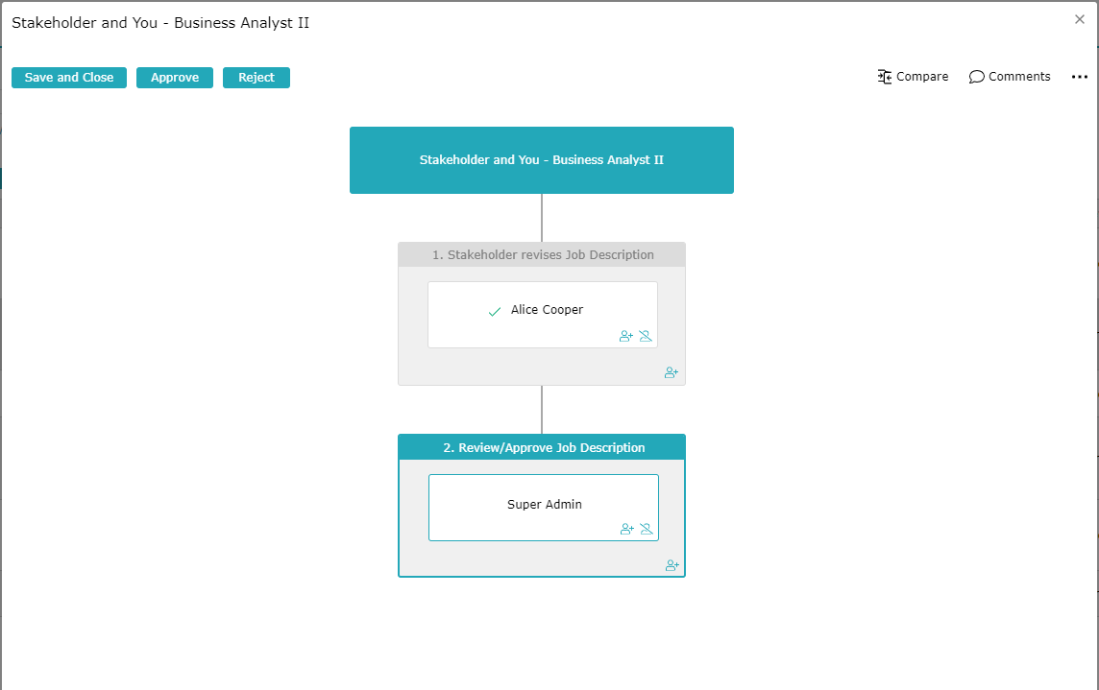
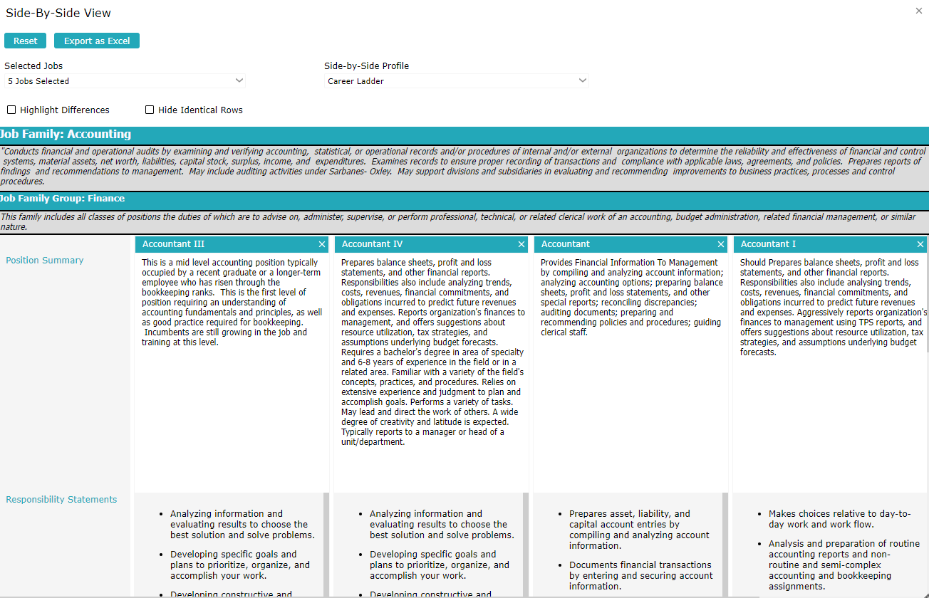
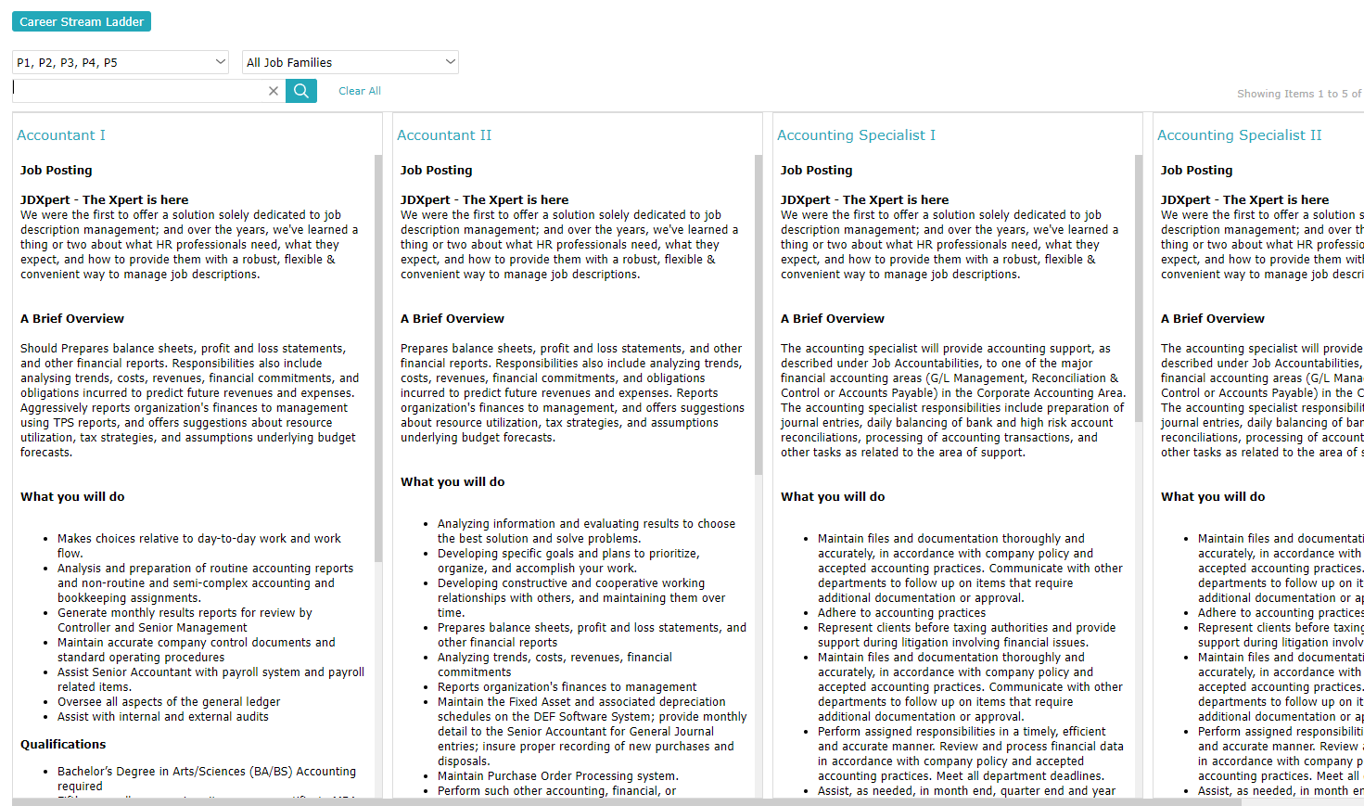
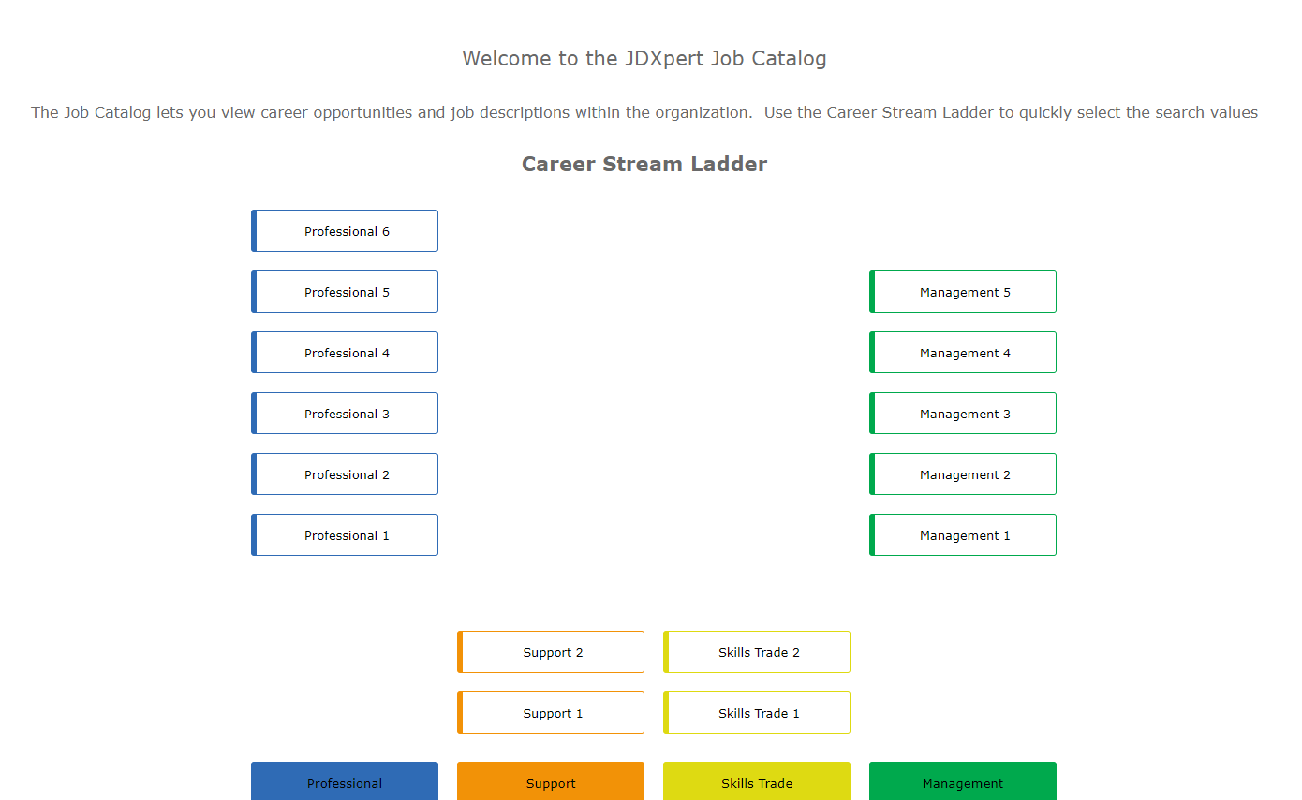
What JDXpert Clients Are Doing: Drive Consistency
Many client start with Career Architecture projects
Top-down approach ensures coherence
Most use JDX to publish career ladders online
Use revision process to ensure coherent hierarchies
Route JDs/Career ladders to stakeholders for revision and approval
Notes:
Many client start with Career Architecture projects
Provides a common framework to define work, Support EE mobility, coherent compensation strategies, enables workforce analytics and valuable for Re-orgs and M&A event
Most Use JDX to publish career ladders online
Use career ladders in revision process to ensure coherent hierarchies as jobs evolve in context
Route Job Descriptions or even entire career ladders to appropriate stakeholders for revision and approval

Slide 37
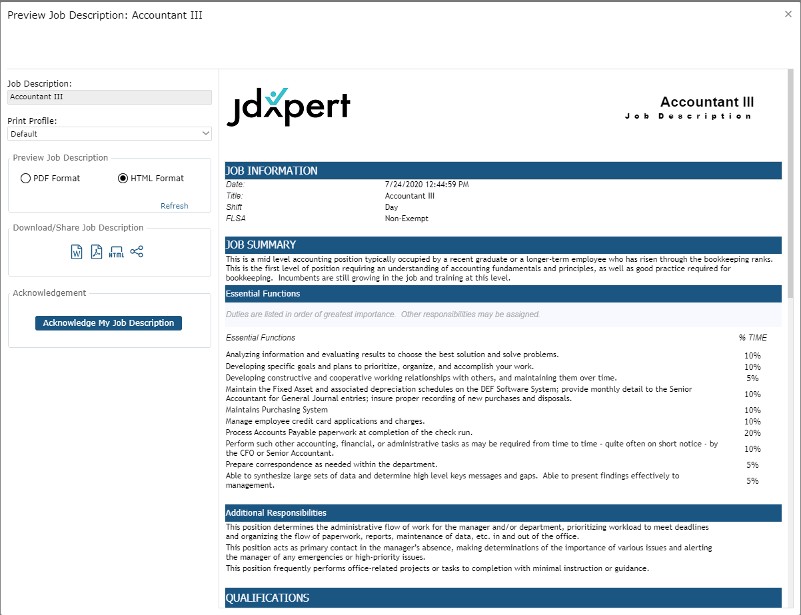
What JDXpert Clients Are Doing: Drive Engagement
About 30% of clients roll out the job description repository to all employees
About 15% of client implement acknowledgements
Data integration between JDX/HRMS/ATS/PR/TM
Notes:
About 30% of JDXpert clients roll out the Job Description Repository to all Employees
About 15% of client implement Employee Job Description acknowledgements
Employee Job Description Contributions/PDQs
JDX Portal Access from Performance Review Apps
Data integration between JDX/PR Apps

Slide 38
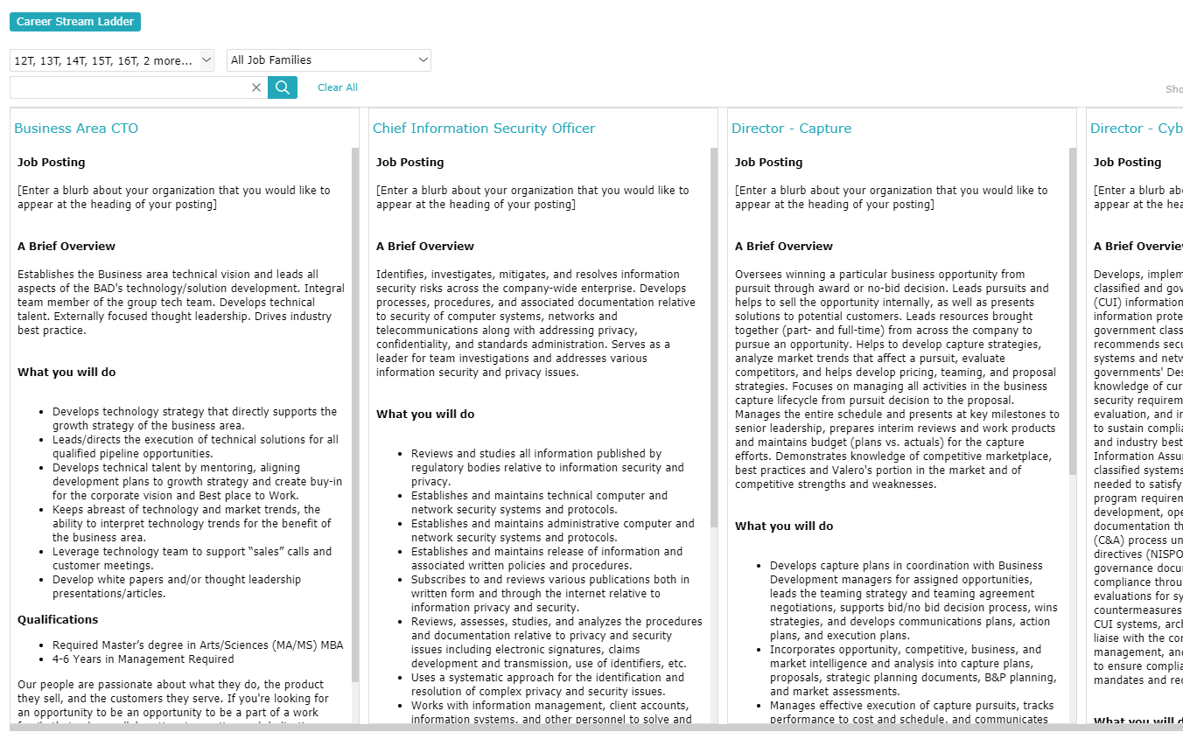
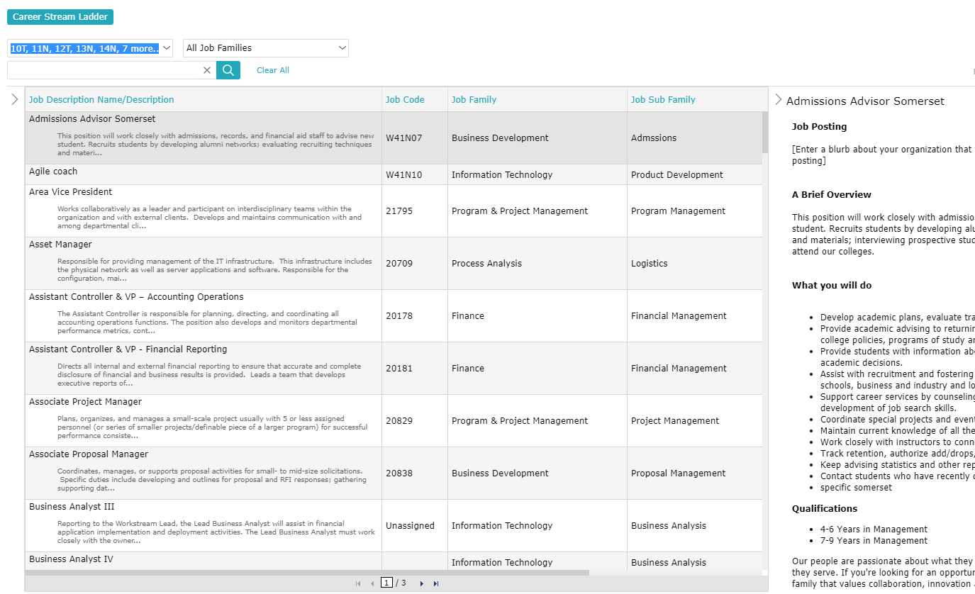
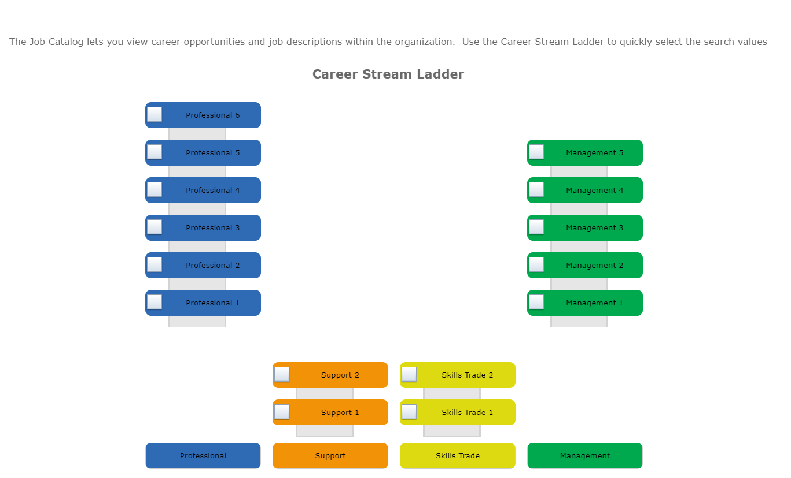
What JDXpert Clients Are Doing: Drive Retention
Allow employees to view jobs
In their current path
Other relevant paths in the organization
Explore side-by-side
Notes:
Tuning Fork – (Resulting from Job Architecture) Illustrates Career opportunities across Career Streams in your organization providing more career options for EEs

Slide 39
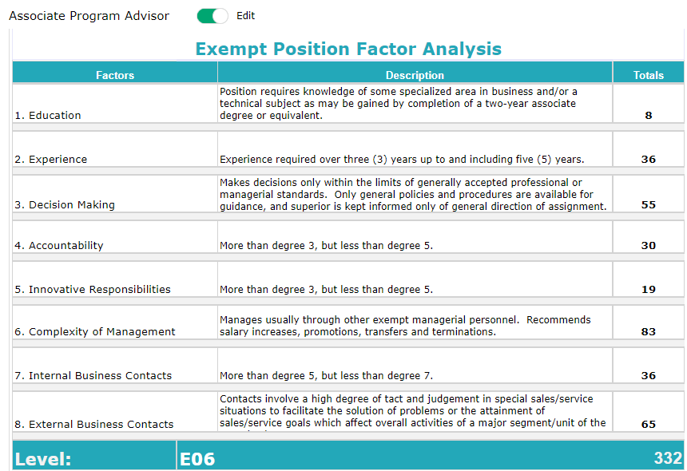
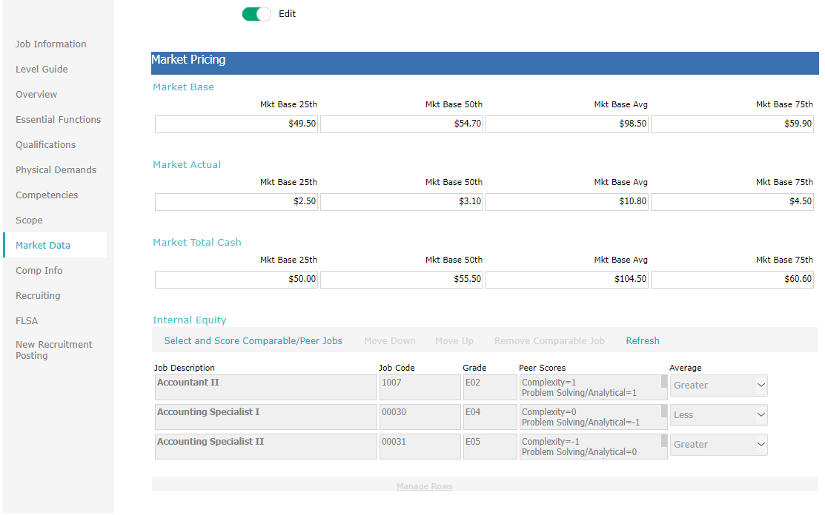
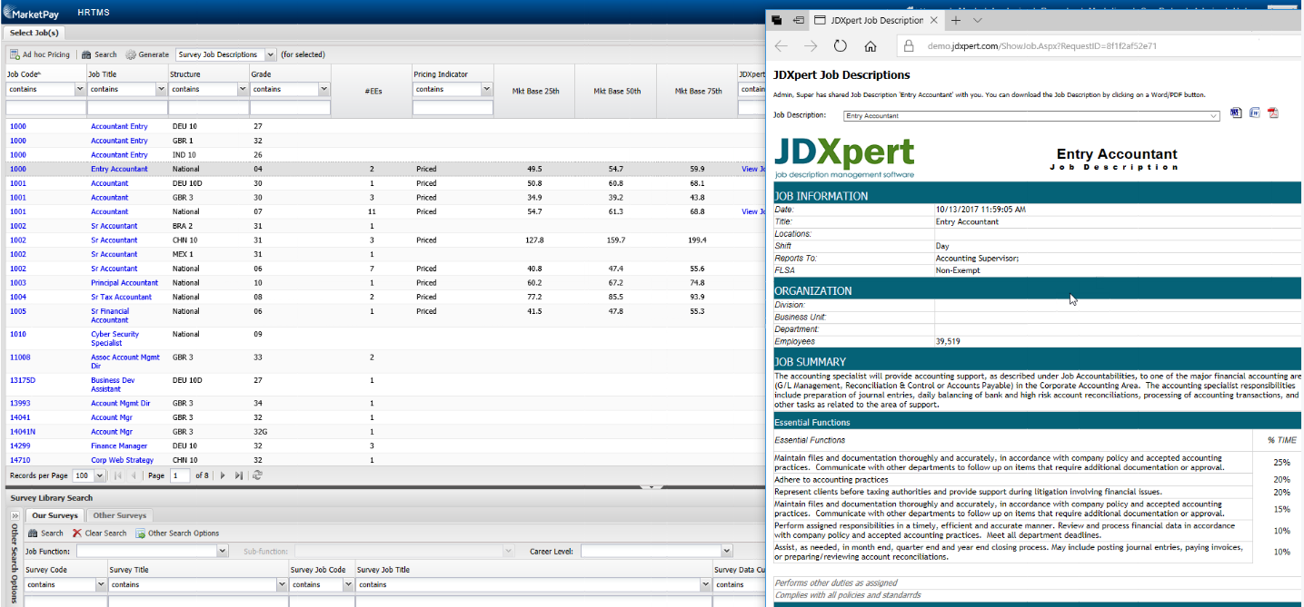
What JDXpert Clients Are Doing: Drive Effective Comp
Integration between JDX and Market Pricing tools ensure accurate market pricing
Market pricing results and job info synchronized between JDX and Market Pricing tools to validate compensation decisions
Built-in point-factor calculations and internal equity provide context
Notes:
As partners, we do offer an integration between PayScale MarketPay & JDXpert
In MarketPay you can view a live link to the job description
This link helps during benchmarking process by removing the bulky task of reviewing the job description in a separate system or document. You can view the job description right in MarketPay.
This also helps ensure more accurate market pricing because you are able to draw information from the job description of record
Market pricing results and job info synchronized between JDX and MarketPay to validate compensation decisions
And built-in internal equity and point-factor calculations provide context

Slide 40
Compliance

Slide 41
Compliance
FLSA
Pay Equity
ADA
Pay Transparency
Lever
Notes:
The relationship between employer and Employee has changed due to the labor market.
What are applicants looking for.

Slide 42
What’s the Risk: Compliance (FLSA)
$134 million
5905
overtime lawsuits filed under the FLSA in 2022
in wages owned to workers in 2022 due to overtime violations
DOL
Notes:
FLSA
There were 5905 overtime lawsuits filed under the FLSA in 2022
AND the DOL recovered over $134 million in wages owned to workers in 2022 due to overtime violations

Slide 43
What’s the Risk: Compliance (Pay Equity)
Goldman Sachs
US Women’s National Soccer
Top 10 settlements
of those were gender-based
$215 million
$24 million
$600 million
9/10
Bloomberg, Reuters, Dorsey
Notes:
In May of this year, Goldman Sachs Group Inc. agreed to pay $215 million to settle a class action alleging widespread bias against women in pay and promotions,
Last year, U.S. Soccer has agreed to pay a lump sum of $24 million in back pay to Women’s national soccer team
Other high-profile cases over the past year or two include Google, HP and Disney
For class-based-employment-discrimination cases settled in 2022, the total of the top-ten settlements soared to nearly $600 million—an increase of nearly 100% from the previous year.
Nine out of the ten highest settlements involving class-based-employment claims in 2022 involved sex-bias claims.

Slide 44
What’s the Risk: Compliance (ADA)
Link
Resolved Cases
Secured for Victims
65,000+
$381.7 million
Link
Link
EEOC
Notes:
Overall, EEOC resolved over 65,000 cases in 2022
Secured more than over $381 million for victims of discrimination in the workplace

Slide 45
What’s the Risk: Compliance (Transparency)
50%
18
of candidates become frustrated with the lack of transparency in job postings and interviews
states currently have some sort of pay transparency law
Glass Door, Payscale

Slide 46
Why Job Descriptions Are Important: Compliance (FLSA)
Job descriptions can be used to back classification decisions during a claim
Accurate classification requires a true understanding of the job
Essential function AND percent of time are critical
Notes:
Although not a requirement, the job description is a central exhibit to back classification decisions during a claim.
To accurately classify jobs you truly need to know what your employees do.
Essential function AND percent of time are critical

Slide 47
Why Job Descriptions Are Important: Compliance (ADA)
Essential functions are critical
Physical demands/working conditions provide the physical details and help determine accommodations
Job descriptions written before an employer advertises to fill a job opening can help defend claims
Notes:
Essential functions are critical to determining if an employee/candidate can perform the job
Physical demands/working conditions provide the physical details behind essential functions and help determine accommodations
The EEOC has said that one of the documents the agency will look at when determining essential functions are job descriptions written before an employer advertises to fill a job opening.

Slide 48
Why Job Descriptions Are Important: Compliance (Equal Pay)
Imprecise standards require detailed job descriptions in order to make equal pay decisions
Accurate and up-to-date job descriptions justify and potentially defend decisions
Notes:
Imprecise standards require detailed job descriptions in order to make equal pay decisions.
A Job Description Management System enables you to:)

Slide 49
What To Do: Compliance
01
03
ALL
05
Make sure your job descriptions are accurate
FLSA
Be vigilant in applying DOL: Salary Level, Basis and Job Duties test
07
ADA
Try using more ADA-friendly terminology ​
ALL
02
Ensure that your job descriptions reflect the job, not the person doing the job
04
FLSA
06
Have employees signoff on their job descriptions
FLSA
08
Periodically audit your job descriptions
ALL
Verify that everything you list as an essential function, is in fact, essential to the job
HEALTHCARE
Have signed off job descriptions available for Joint Commission visits
Notes:
Job descriptions must be consistent with the actual duties and responsibilities of the job
Allow employees to view acknowledge and comment on their job description
Develop career paths to provide a guide for employee growth in your organization
Provide tools for employees to plan their careers

Slide 50
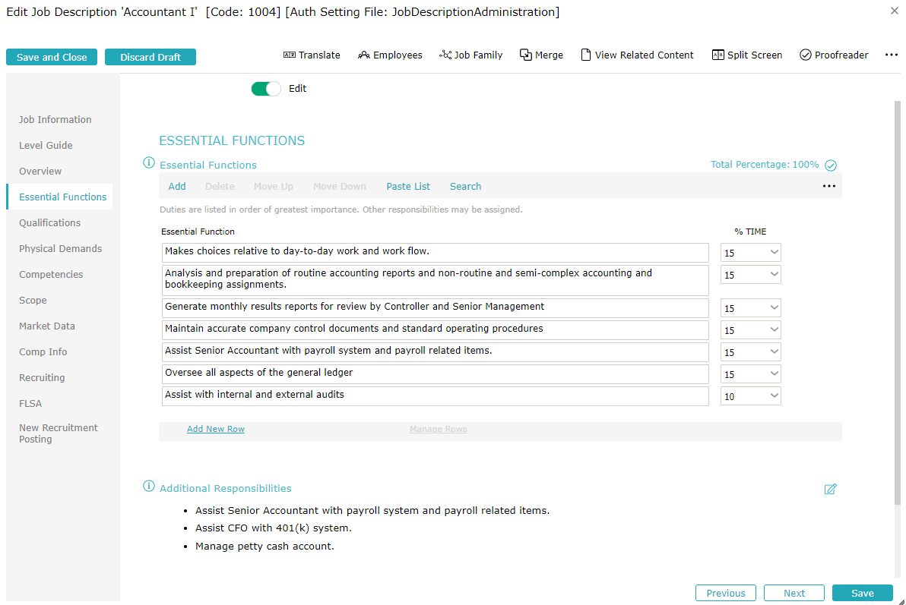
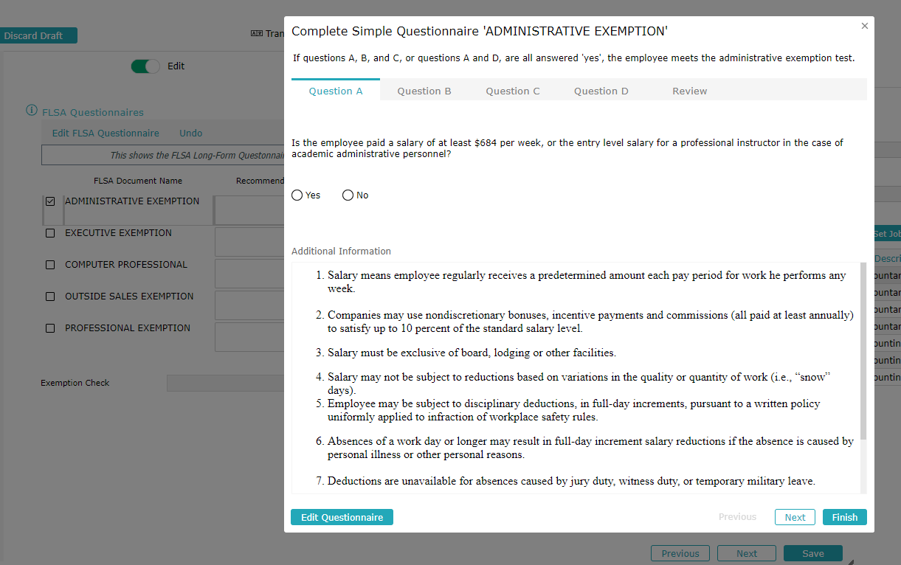
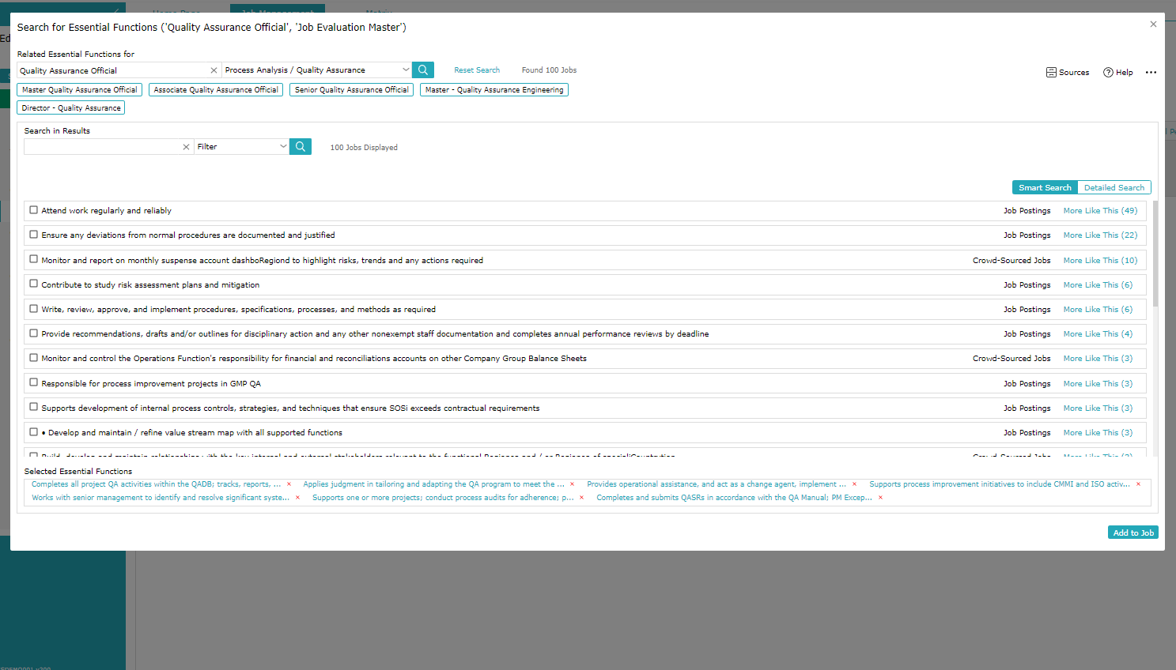
What JDXpert Clients Are Doing: Compliance (FLSA)
Ensure that job descriptions are accurate and up-to-date
Validate Essential Functions and Percent of Time with stakeholders
Guide stakeholders in determining Essential Functions/supply compliant content
Have employees signoff on job descriptions
Use online FLSA Determination assistance

Slide 51
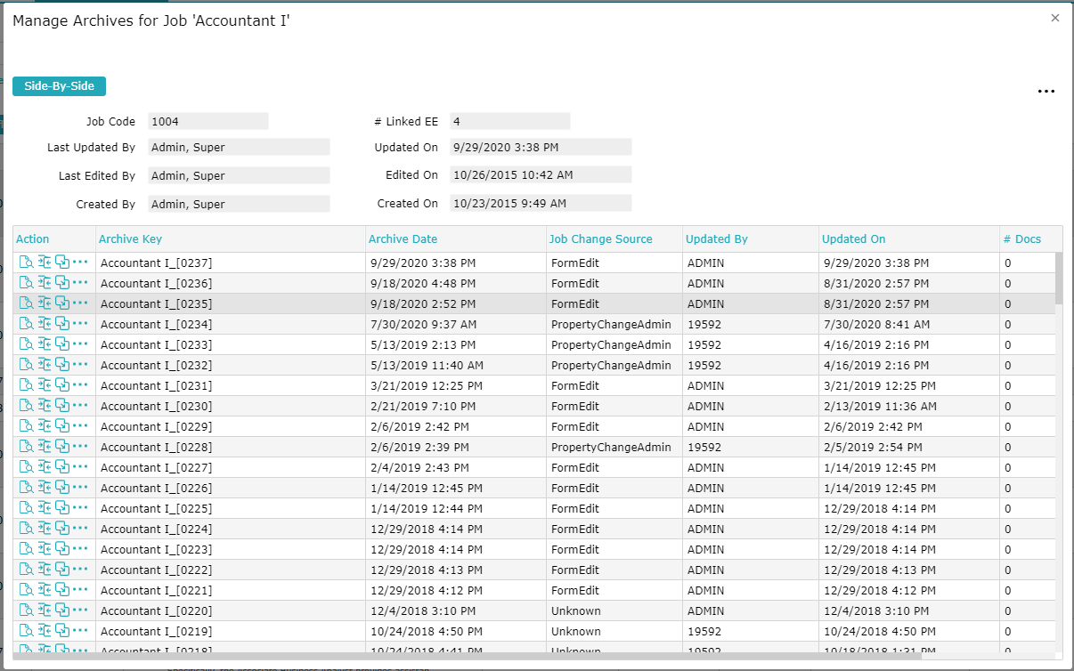
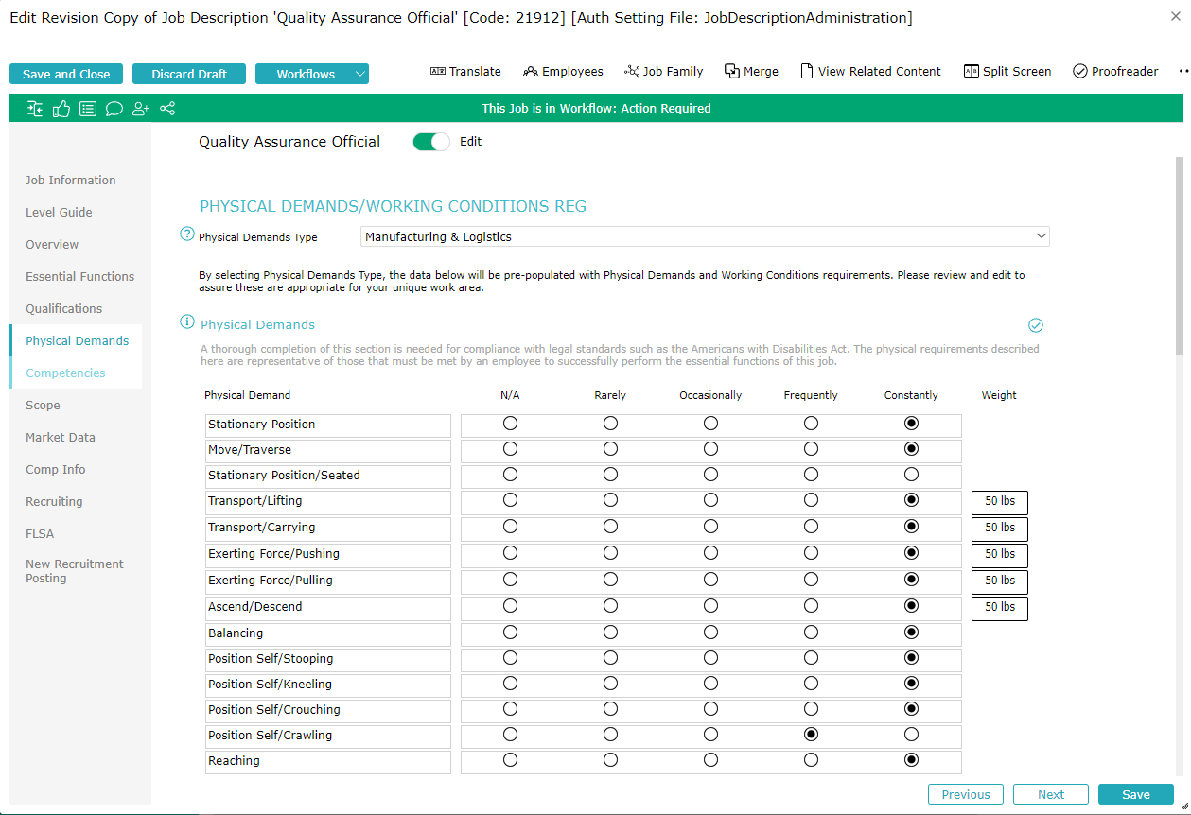
What JDXpert Clients Are Doing: Compliance (ADA)
Validate essential functions and percent of time with stakeholders
Capture physical demands and working conditions
Capture job description history
Notes:
For ADA, clients:
Validate Essential functions and percent of time with stakeholders
Capture physical demands and working conditions needed for determining accommodations.
Capture job description history - prove vintage of job descriptions to the EEOC. EEOC will accept JDs if you can show it preceded your posting.

Slide 52
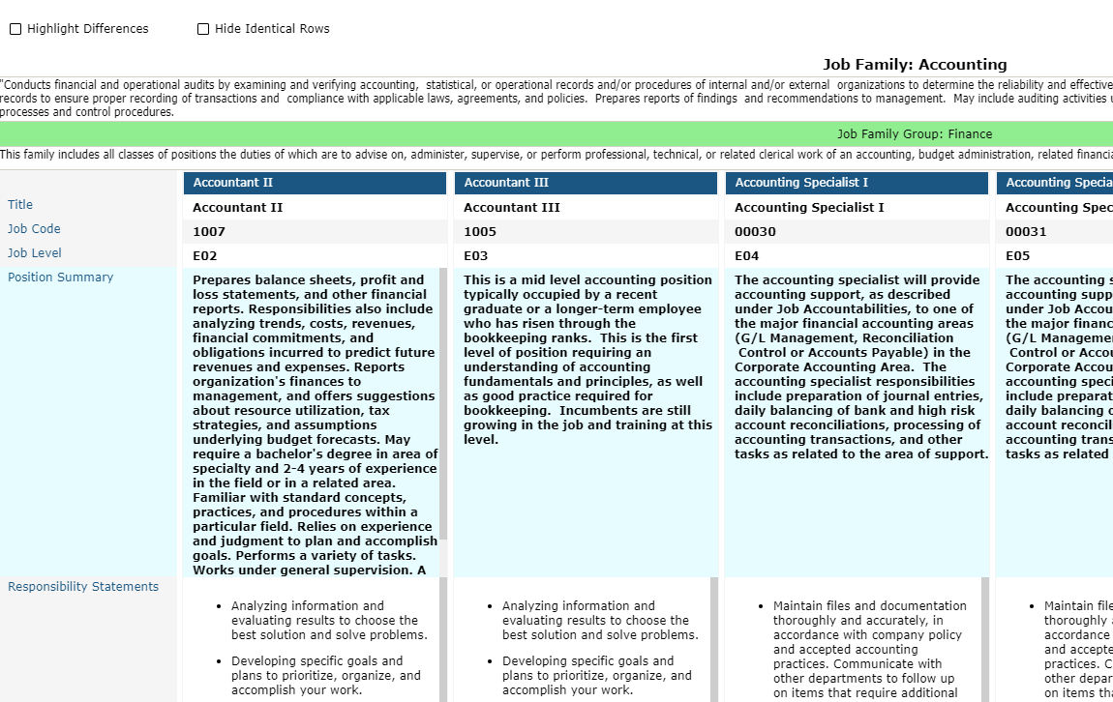
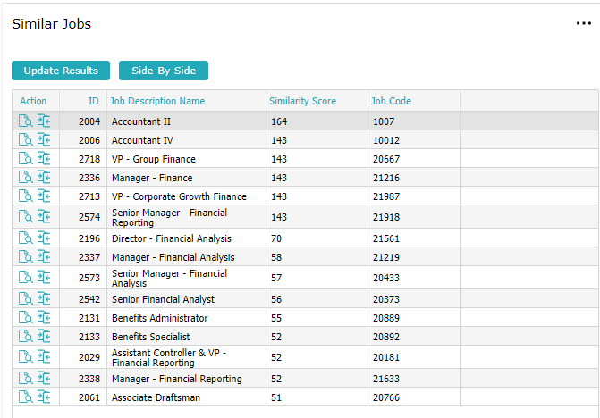
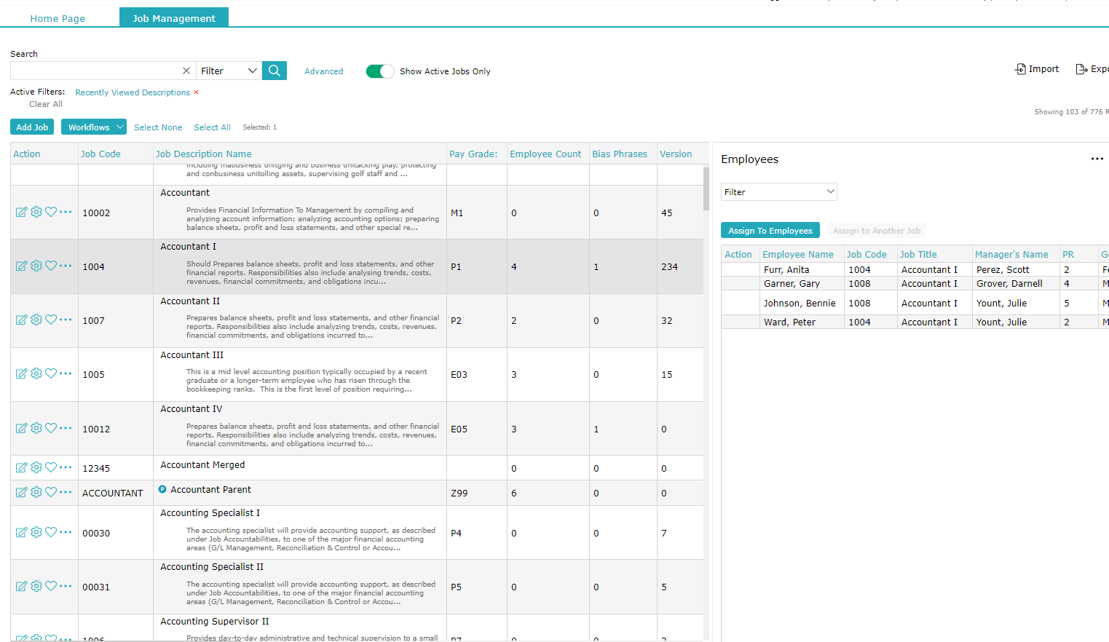
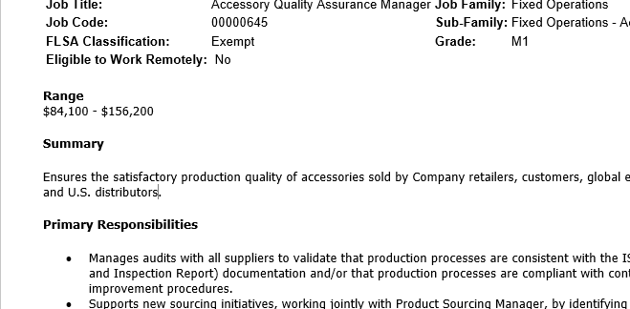
What JDXpert Clients Are Doing: Compliance (Pay)
Equal Pay
Produce job descriptions that justify and potentially defend decisions
Categorize jobs to enable comparisons
Use Similarity Scoring or other reporting to identify pay equity issues
Implement point factor job evaluation (Canada)
Pay Transparency
Include good faith pay ranges on postings
Notes:
For Equal Pay, Clients:
Produce accurate and up to date job descriptions to justify and potentially defend decisions
Categorize jobs to enable comparisons
Use Similarity Scoring
Use reporting to identify pay equity issues
Implement point factor job evaluation(Canada)

Slide 53
Conclusion
Weak job descriptions equal a weak foundation other HR initiatives
Are you risking your company’s business objectives by executing these processes poorly?
Don’t let your job descriptions be your Achilles Heel!
Establish a job description audit process
Collaborate with those who understand the job
Use a technology partner to help manage job descriptions and integrate with other systems
Take full advantage of your job information and let it drive your HR and processes and systems
Notes:
If you have weak job descriptions, then you have an ineffective foundation for other HR initiatives (talent acquisition, performance, engagement, retention, compliance, compensation).
Are you risking your company’s business objectives by executing these processes poorly?
Don’t let your job descriptions be your Achilles heel!
Establish a job description audit process.
Collaborate with those who understand the job.
Use a technology partner to help manage Job Descriptions and integrate with other systems.
Take full advantage of your job information and let it drive your HR and processes and systems.

Slide 54
Thank You!
For more information about JDXpert, visit jdxpert.com
As a thank you for joining us today, click here to download a free copy of our eBook, How To Beat The Talent Shortage One Job Description At A Time

