Slide 1
Best Practices for Compliant Job Descriptions
About Jennifer Peacock President, Innovative Consulting Services, LLC (ICS)
icshumancapital.com
Jennifer Peacock has more than 25 years of diverse experience in human resources ranging from consulting to corporate HR leadership. Specific fields of expertise include compensation, benefits, recruitment, compliance, HRIS, performance management, data analytics, reporting, and employee relations. Jennifer has implemented both small and large scale HR projects and has established HR functions. Peacock has held positions of chief human capital officer, corporate director of compensation, vice president-compensation, benefits and HRIS and assistant vice president-HR. During her career, she has been involved with the Chesapeake Human Resources Association and the Society for Human Resources Management. She has also hosted webinars on relevant HR related topics. Peacock earned a bachelor’s degree in communications from Towson University, MD, and a master’s degree in business administration from The Johns Hopkins University, Baltimore.

Slide 2
Best Practices for Compliant Job Descriptions presented by Jennifer Peacock

Slide 3
Why Managing Job Descriptions A Critical Issue for Strategic HR/Compensation
Protect your company from regulatory sanction FLSA, ADA, Equal Pay
Benchmark/Evaluate jobs to compensate employees fairly
Identify and manage bottom performers
Develop an equitable salary structure
Identify and retain top performers
Protect your future with
effective succession plans
Evaluate employee productivity & performance
Motivate employees with engaging Career Paths
Recruit the right people
A clear understanding of the Job is Required to:
Identify Employee Training Gaps
Notes:
Focus for today is compliance.

Slide 4
ROI of Knowing Your Jobs
https://zdoc.site/managing-an-organizations-largest-cost-the-saba-software.html
In most organizations, total human capital costs, average nearly 70% of operating expenses.
Yet in a 2018 Conduent (Now Buck Consultants) survey NOT one company surveyed was completely satisfied with their job description and only 28% said they were some-what satisfied.
http://www.hrtms.com/blog/survey-says
Other
Outdated
Duplication
Inconsistent Format
Inconsistent w/ actual duties of job
Somewhat Satisfied w/ JDs
Notes:
In most organizations, total human capital costs, also known as total cost of workforce, average nearly 70% of operating expenses. While an organization’s total cost of workforce percentage may vary, these costs remain the single biggest organizational expense.

Slide 5
Job Data Central to HR/Talent Management
Your Systems
Your Processes
Compliance
FLSA, ADA, FDA, Joint Commission
A Robust up-to-date job description repository can ensure that all aspects of your HR and talent management activities are reading from the same play book.
Career Pathing
Succession
Training
Performance Management System/
Process
Compensation Plans &
Salary Structure
Job Description
ATS/Recruiting Process
Corporate Culture
Future Plans

Slide 6
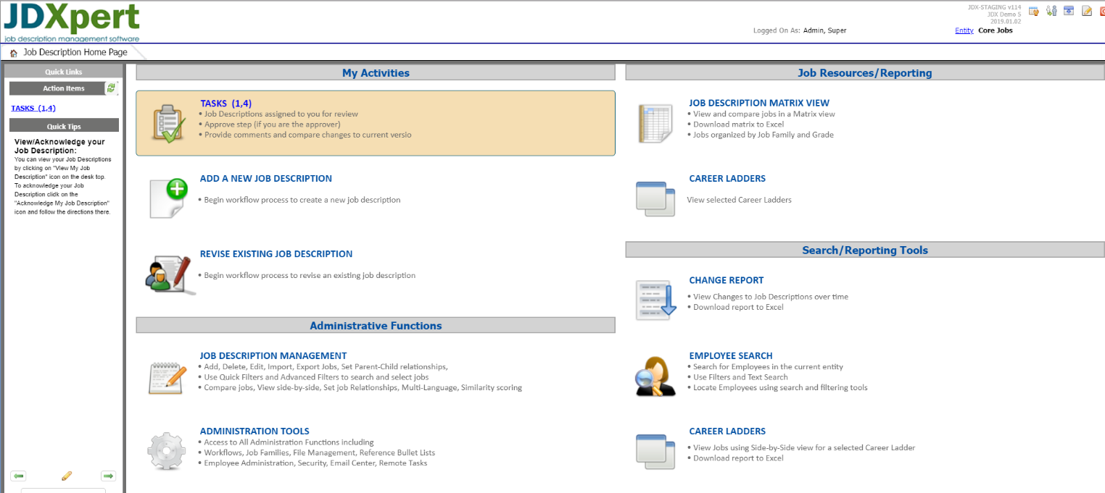
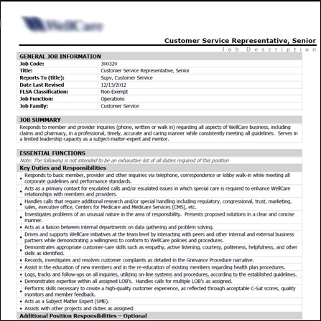
Compliance - About This Presentation
Identify the Regulation Involved
Discuss how the regulation affects Job Descriptions
Provide recommendations and Identify best practices
Screenshots/document snippets for context
Notes:
Don’t be limited by the document.

Slide 7
Agenda
General guidelines – apply across all compliance areas
ADA
FLSA
Wrap up and Questions

Slide 8
Language/Legal Considerations
It’s about the Job
Everything in your JD must be about the Job
Resist using JD to describe an individual or personality traits
Clear
Avoid flowery overwritten and vague verbiage:
Vague, Confusing, Does not describe what the person will actually do
Don’t undermine at will employment
“This is a permanent Position” Don’t Mention unless Temp
“…prides itself on employee retention” Omit. Implies ongoing employment
Don’t create FLSA Classification Problems
Wording (Later)
Consider omitting FLSA from Employee View
Notes:
Changes is Classification can raise red flags for employees, causing them to believe they previously misclassified.
Managers like to write jobs based on an employee – need to look at JOB

Slide 9
Legal Considerations
Job Descriptions need to be Accurate, and up-to-date!
Job Descriptions can be dismissed in litigation if they fail to measure up to what Employees actually do
Job Descriptions need to be Detailed and Consistent
Your position can be undermined if Employees in similar Jobs have very different Job Descriptions
Conversely, if you use one Job Description for more than one job you risk compliance litigation painting them all with the same brush
Notes:
In a case involving the exempt status of store managers, the company argued that the job duties of a store manager differed between locations and types of stores. But since they used one JD for all jobs, the assertion was dismissed.
Up-to-date: best practice – have JD reviewed each time job is posted.

Slide 10
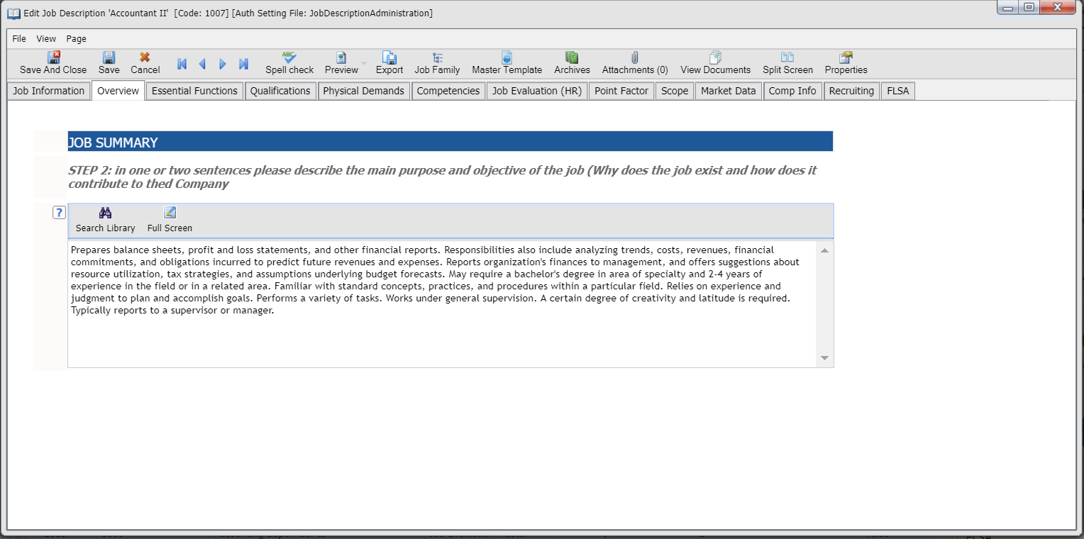
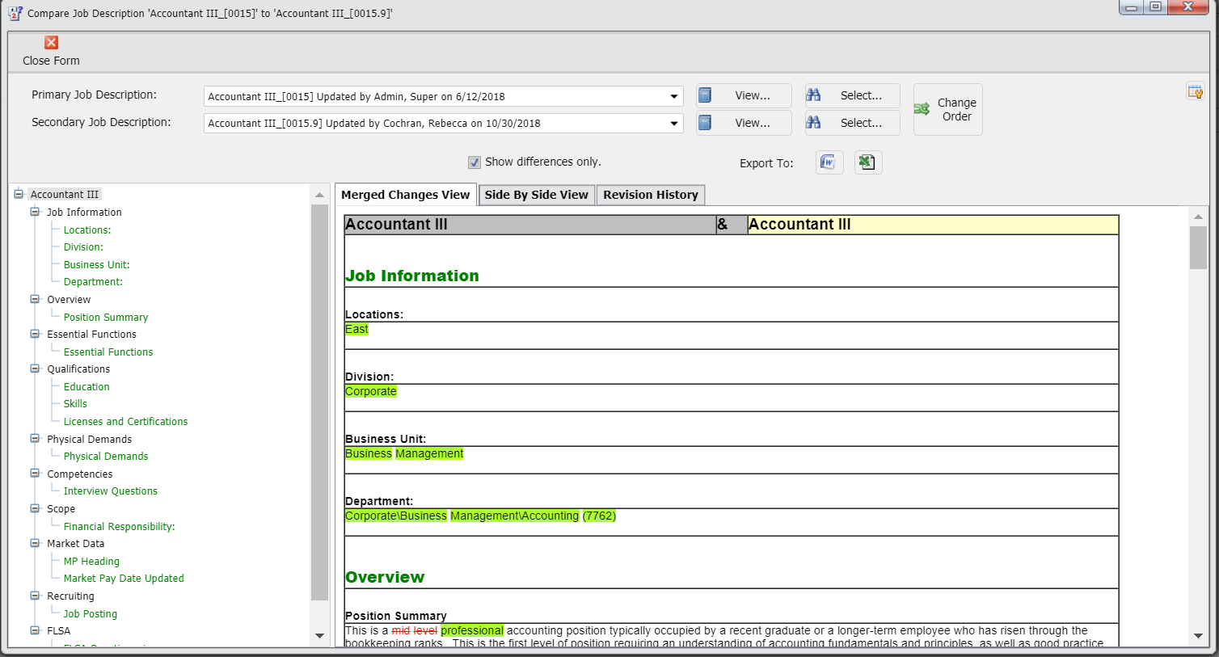
JD Accuracy: Collaboration
Collaboration is the key to effective job descriptions because the knowledge needed is embedded with multiple Stakeholders.
Typical participants are:
Hiring Manager
HR Generalists
Compensation
Track changes model
Updated annually or when job changes
Notes:
Give employees access to JDs to provide input. Give litigation example.

Slide 11
Collaboration Best Practice - Oversight
Collaboration is the key to effective job descriptions because the knowledge needed is embedded in multiple Stakeholders.
Hiring Manager(s)
HR Business Partner
Compensation
Final Approval

Slide 12
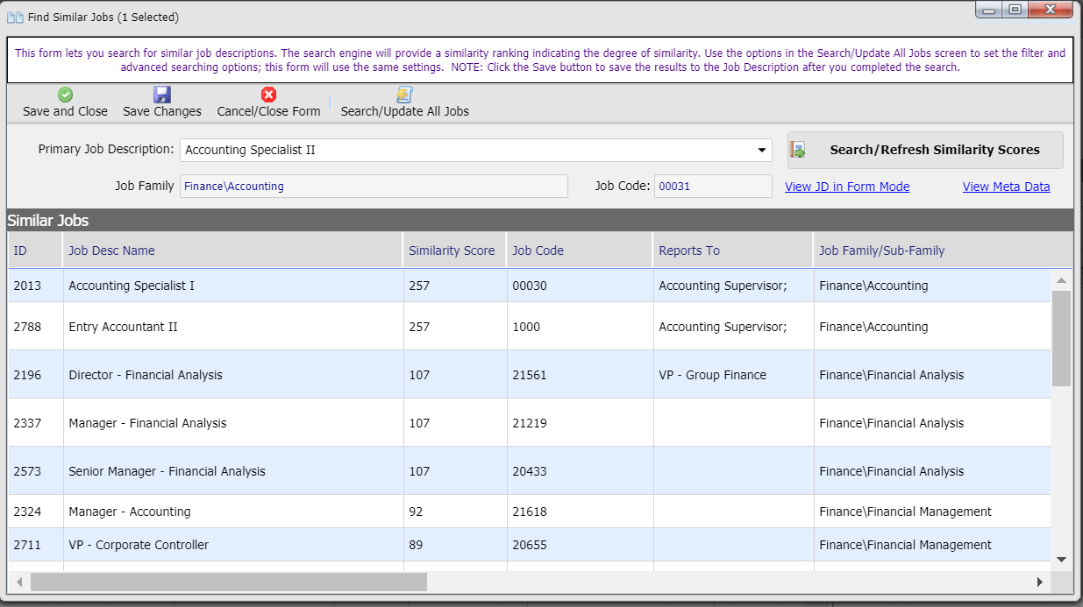
JD Consistency: Content
Leverage content that Is known to be compliant
Gain consistency by leveraging content from
Job Descriptions of Similar Jobs
Content Library/Standard Statements
Repository allows for Intelligent content searching

Slide 13
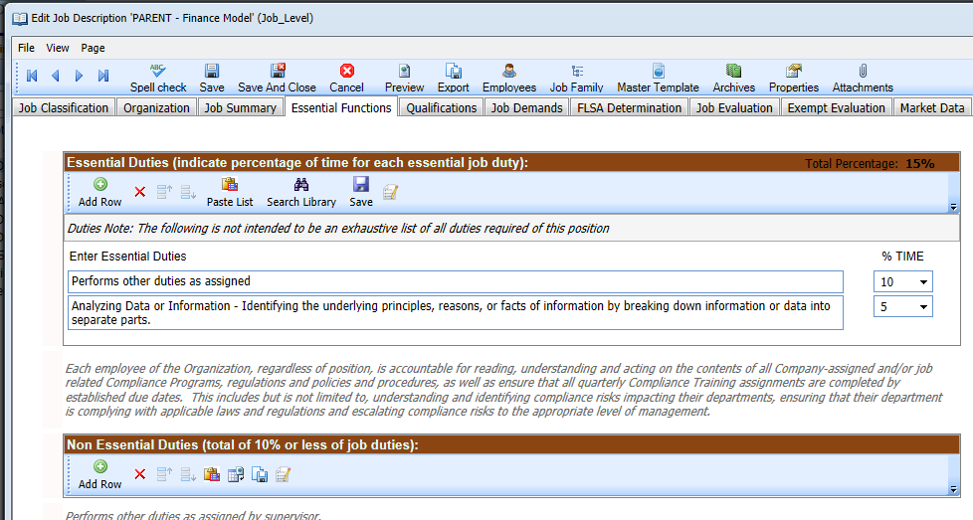
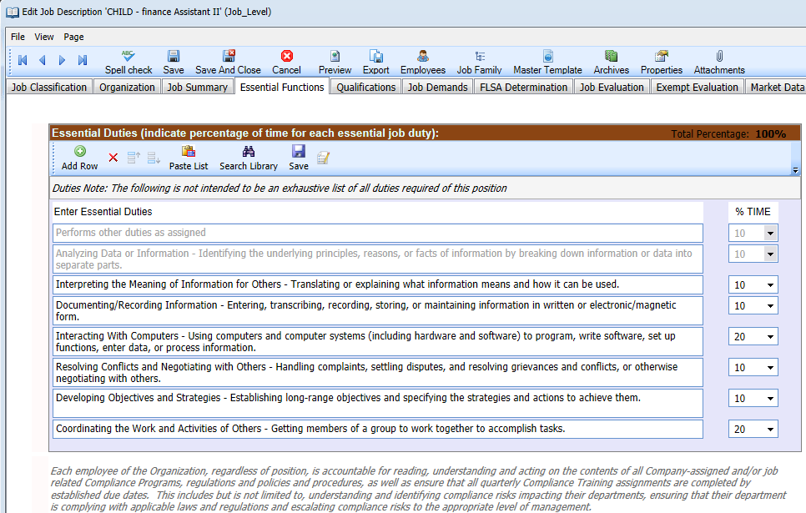
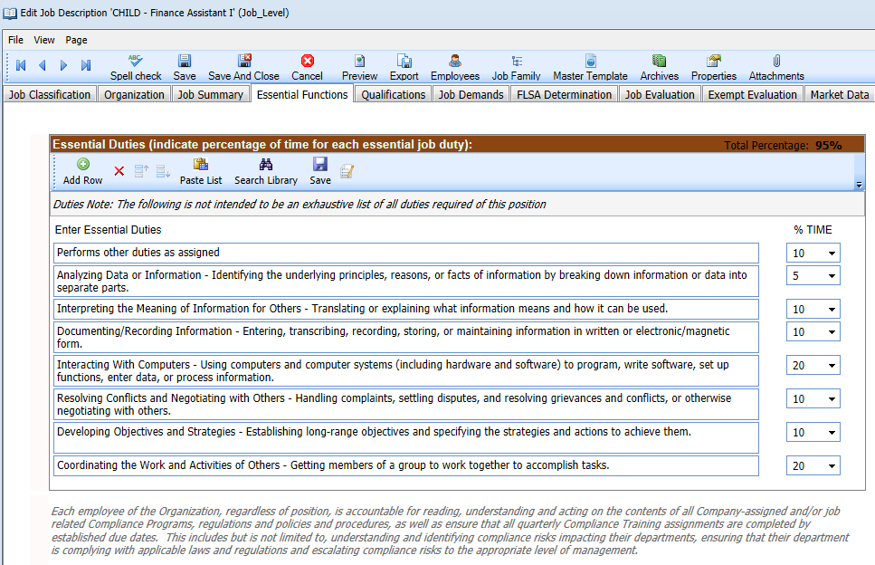
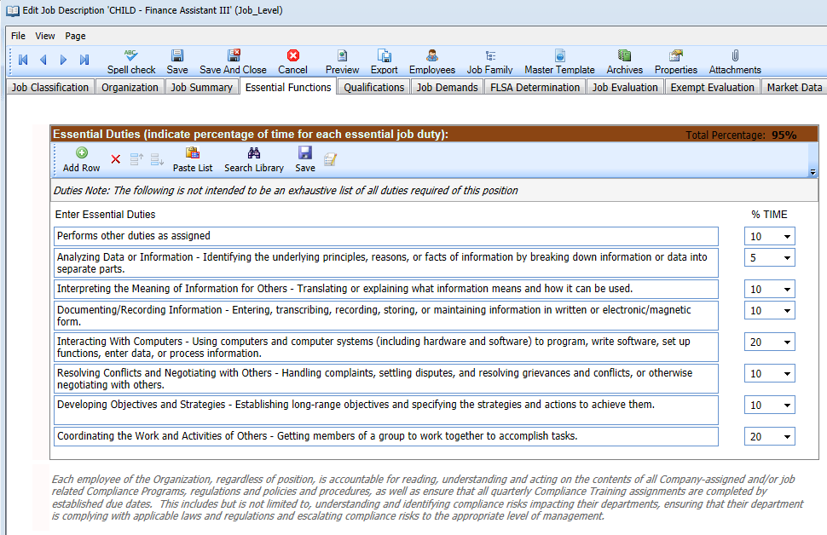
JD Consistency: Parent/Child
Level Jobs become Parent Job Description
Scope/Functions / Qualifications / Competencies Cascade to Children
Children represent Positons that incumbents occupy
Consistency is insured
Notes:
Changes made to Career Architecture automatically cascade to incumbent position Description.
This model melds nicely with Job Profiles and Positions in workday and similar constructs in PeopleSoft and other HRMS

Slide 14
JD Consistency: Career Architecture
Top Down Approach
Define Groups of Jobs Hierarchically
Job Family
Sub Family
Level
Notes:
Job Family and Sub Family descriptions are developed.
Attributes are gathered by level:
Scope
Competencies
Job Functions
Qualifications/Licenses/Certifications

Slide 15
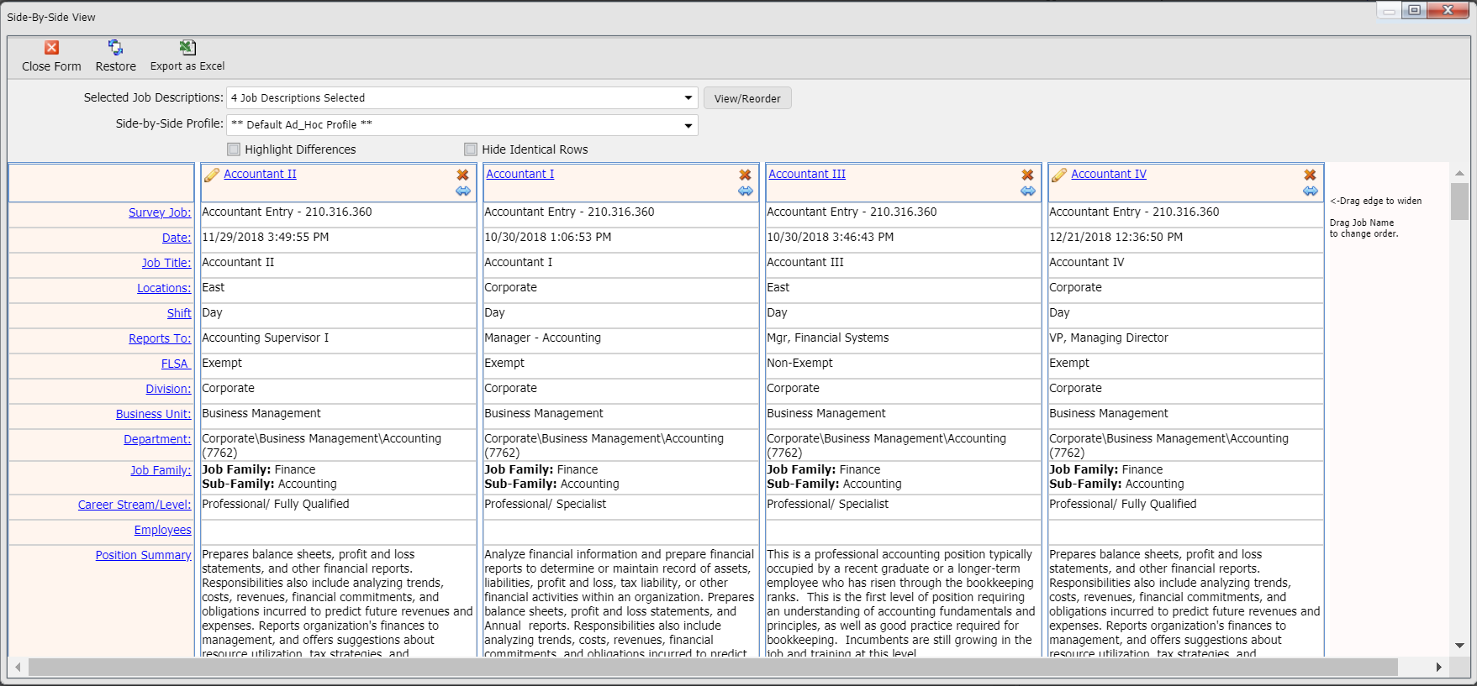
JD Consistency: Evaluating Jobs Together as Groups
Make decisions based on consistent job data across level instead of relying on the verbiage populated in individual Job Descriptions
Notes:
Notes:

Slide 16
ADA: The Regulation
Titles I of the Americans with Disabilities Act of 1990
Addresses the rights of individuals with disabilities in employment settings
Title I is to ensure that qualified individuals with disabilities are protected from discrimination based on their disability
SUBCHAPTER I – EMPLOYMENT, Sec. 12111. Definitions
(8) Qualified individual The term "qualified individual " means an individual who, with or without reasonable accommodation, can perform the essential functions of the employment position that such individual holds or desires. For the purposes of this subchapter, consideration shall be given to the employer's judgment as to what functions of a job are essential, and if an employer has prepared a written description before advertising or interviewing applicants for the job, this description shall be considered evidence of the essential functions of the job.
Notes:
Title I of the ADA addresses the rights of individuals with disabilities in employment settings. According to the Americans with Disabilities Act Handbook , the purpose of Title I is to ensure that qualified individuals with disabilities are protected from discrimination on the basis of disability. The law defines qualified individuals as an individual who, with or without reasonable accommodation, can perform the essential functions of the employment position that such individual holds or desires. For the purposes of this subchapter, consideration shall be given to the employer's judgment as to what functions of a job are essential.

Slide 17
ADA: An Overview
The Americans with Disabilities Act (ADA) was established to help protect those with disabilities from being discriminated against in the workplace
Enforced By the EEOC
Under the ADA it is unlawful for any employer with 15 or more employees to discriminate against a qualified applicant or employee because of a disability
The ADA defines an individual with a disability as a person with a “physical or mental impairment that substantially limits one or more major life activities.”
Those “associated with a person with a disability” are also protected under the ADA but employers are not required to provide reasonable accommodations to a person without a disability due to that person's association with someone with a disability.
Notes:
EEOC – Equal Employment Opportunity commission

Slide 18
The ADA & Job Descriptions
Although the ADA does not require job descriptions, it does require that applicants and employees are able to perform the “essential functions” of the job, with or without reasonable accommodation.
The Equal Employment Opportunity Commission (EEOC) has said that one of the documents the agency will look at when determining essential functions are job descriptions written before an employer advertises to fill a job opening.

Slide 19
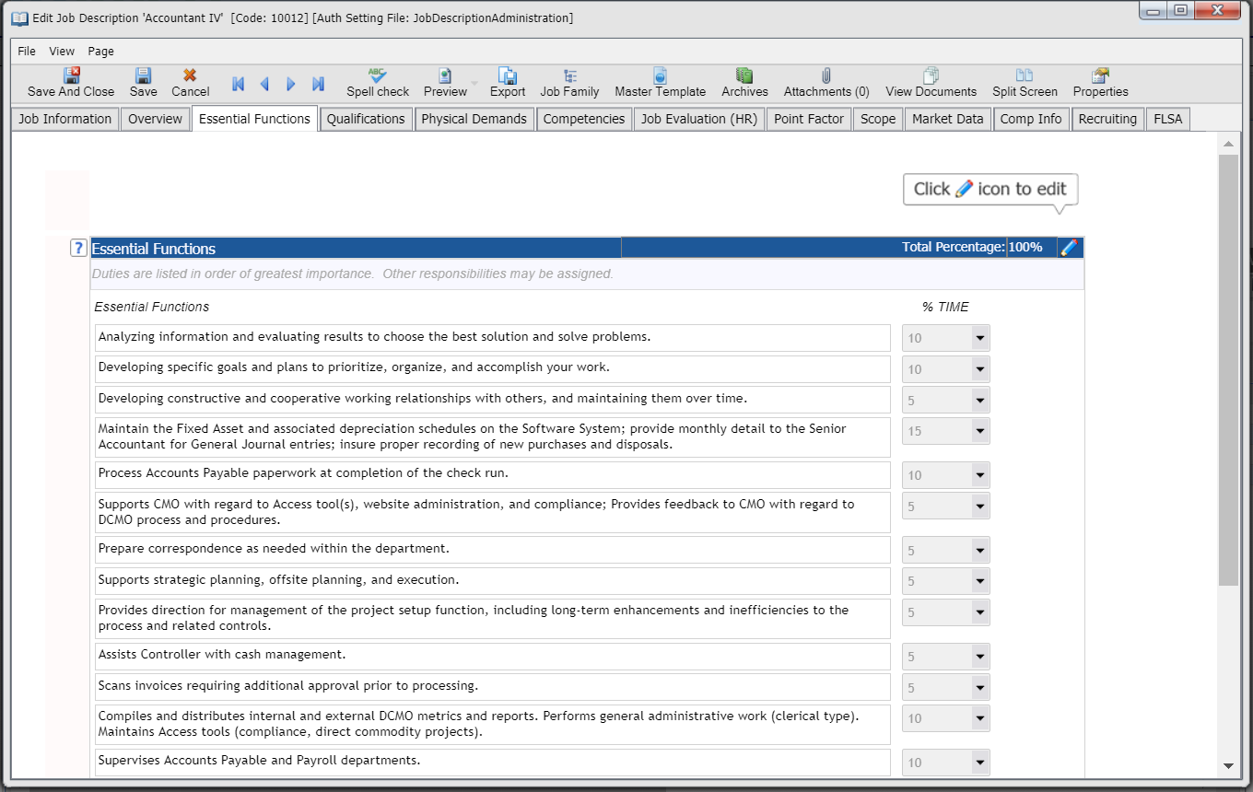
The ADA & Job Descriptions
You will use job descriptions to:
Determine whether an employee/applicant will be able to perform in the job
Arrive at acceptable accommodations
Defend a claim of disability discrimination
Notes:
Impacted Areas
Essential Functions (and Job Summaries)
AKA Duties, Responsibilities, Accountabilities
These are the High level tasks role holders will perform
Clients often limit these (7-10)
For ADA need: Essential Function Desc & % of time
Physical Demands and working conditions
Qualifications

Slide 20
Writing Essential Functions
Employer decides what the job is and what functions are required
Employers can set standards and do not have to justify them
Why a function could be considered Essential
The position exists to perform the function.
There are a limited number of other employees available to perform the function, or among whom the function can be distributed.
A function is highly specialized, and the person in the position is hired for special expertise or ability to perform it.
A large percent of time is spent performing the function.
Serious consequences if a function is not performed.
Functions are listed in a collective bargaining agreement
Nature and scope of work.
Notes:
No forbidden words, but it’s important that the language in your job descriptions is not prejudicial to a qualified individual with a disability.
Focus on the essential functions of the job, not the ways they are currently or customarily performed.
E.g. an employee does not necessarily have to “walk” in order to move about the office; an individual in a wheelchair can accomplish the task even if he/she cannot walk.
For ADA Include only relevant necessary requirements
If the item is not absolutely necessary to do the job
Leave it out
Include it as a Non-Essential function
Employer Justification
if an employer requires its typists to be able to accurately type 75 words per minute, as "essential." If a person with a disability is disqualified by this standard, the employer should be prepared to show that it does i require other employees to perform at this level
The position exists to perform the function.
For example, a person is hired to proofread documents. The ability to proofread accurately is an essential function, because this is the reason that this position exists.
There are a limited number of other employees available to perform the function, or among whom the function can be distributed.
For example, it may be an essential function for a file clerk to answer the telephone if there are only three employees in a very busy office and each employee has to perform many different tasks.
A function is highly specialized
For example, a company wishes to expand its business with Japan. For a new sales position, in addition to sales experience, it requires a person who can communicate fluently in the Japanese language. Fluent communication in the Japanese language is an essential function of the job (EEOC, 1992).
serious consequences if it is not performed.
For example, an airline pilot spends only a few minutes of a flight landing a plane
Nature and scope of work
For instance in one facility, if a variety of orders for a manufacturer come I intermittently under tight deadlines, this might require a greater number of essential functions than in a facility where the same item is manufactured continually (EEOC, 1992).

Slide 21
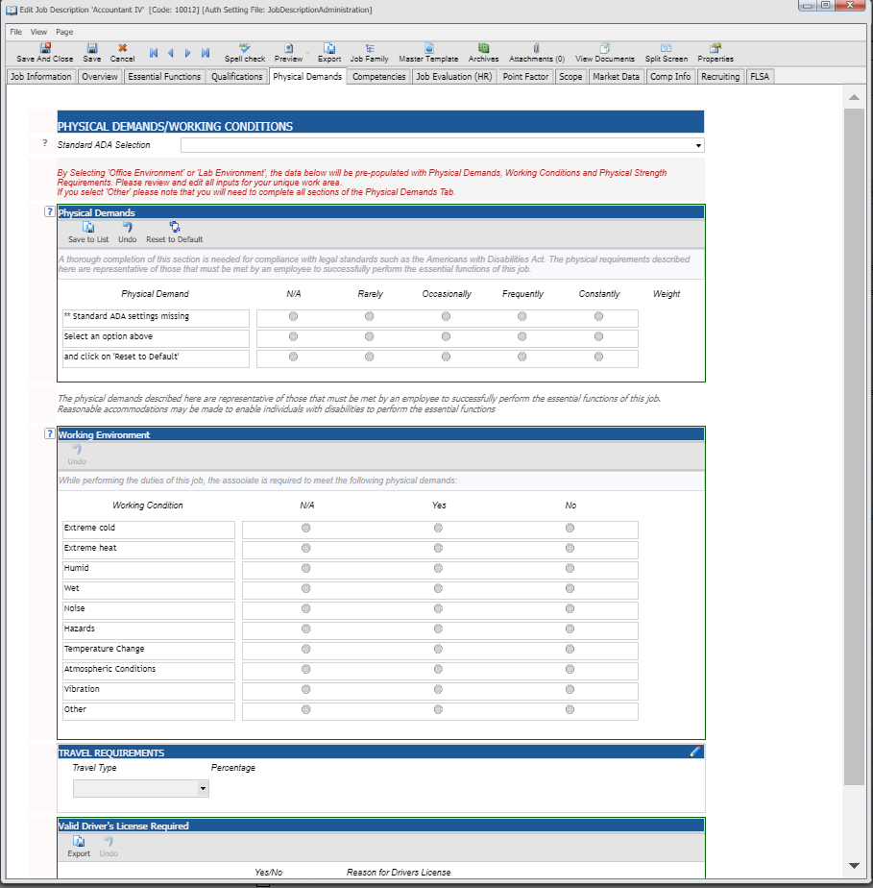
Physical Demands/Working Conditions
Used for ADA situations to determine if an employee is capable of performing in the job
Provides the physical details for Essential Functions
Used to determine what accommodations can be made
For ADA Need:
Physical Demand/Working Condition Description
Frequency
Weight (for weight related items)

Slide 22
Physical Demands: ADA Wording
Physical Demand | ADA-Compliance Words | Job Description Language Example
Stand or Sit | Stationary position | Must be able to remain in a stationary position 50% of the time.
Walk | Move, Traverse | The person in this position needs to occasionally move about inside the office to access file cabinets, office machinery, etc.
Use hands/fingers to handle or feel | Operation, Activate, Use, Prepare, Inspect, Place, Detect, Position | Constantly operates a computer and other office machinery such as a calculator, copy machine, and printer.
Climb (stairs/ladders) or balance | Ascend/Descend, Work atop, Traverse | Occasionally ascends/descends a ladder to service the lights and ceiling fans.
Stoop, kneel, crouch, or crawl | Position self (to), Move | Constantly positions self to maintain computers in the lab, including under the desks and in the server closet.
Talk/hear | Communicate, Detect, Converse with, Express oneself, Exchange information | The person in this position frequently communicates with students who have inquires about their tuition bill. Must be able to exchange accurate information in these situations.
See | Detect, Determine, Perceive, Identify, Recognize, Judge, Observe, Inspect, Estimate, Assess | Must be able to detect funnel clouds from long distances.
Taste/Smell | Detect, Distinguish, Determine | Occasionally must be able to distinguish sweet and bitter flavors when creating desserts for customers.
Carry weight, lift | Move, Transport, Position, Put, Install, Remove | Frequently moves Audio/Visual equipment weighing up to 50 pounds across campus for various classroom and event needs
Exposure to work | Exposed, Work around | Constantly works in outdoor weather conditions.
http://hrdailyadvisor.blr.com/2009/03/18/non-prejudicial-language-for-ada-job-descriptions/#

Slide 23
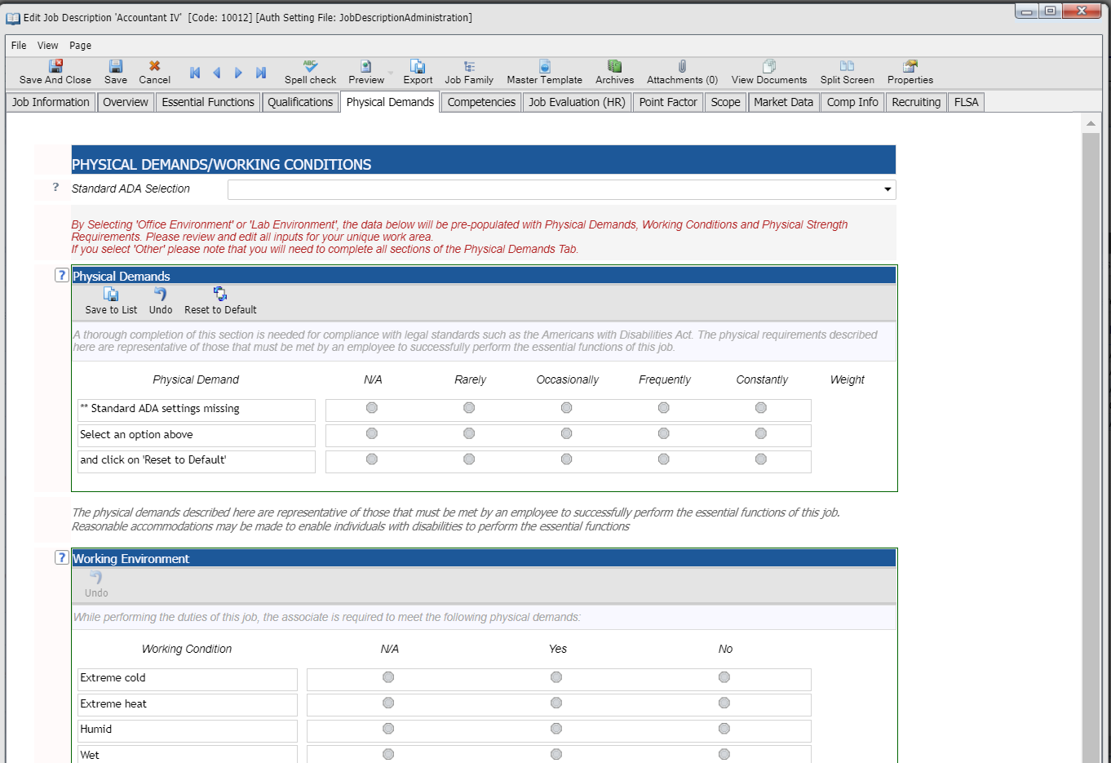
Physical Demands/Working Conditions
Best practice is to select from List
Lists of physical demand/working conditions may vary depending on the environment in which the job is performed.
Notes:
Legislation somewhat vague as to what is “reasonable accommodation” – Apprio new hire example with medical condition
Process for determining physical demands/working conditions Items:
Often pulled from disability claims over time
Reviewed periodically to evolve over time with changes in job equipment and regulations
Standard Lists
Industry specific
Corporate/Healthcare/Manufacturing
Working Conditions: Rules and regulations such as state disability and federal and state safety and health laws

Slide 24
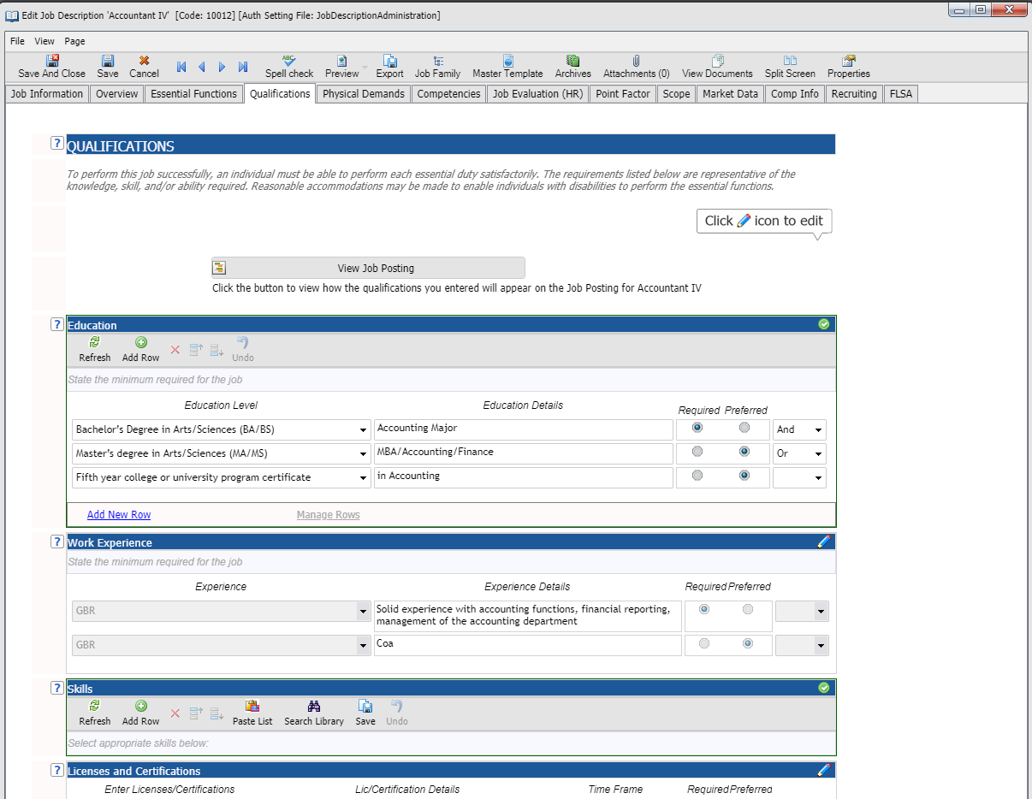
Qualifications
Education
Experience
Skills
Licenses/Certifications
Avoid “Driver’s license” If not necessary
Include Lic/Certifications required by disability, safety and health laws
Notes:
Education, Experience, Skills
Employers should remember that these qualifications might be gained in a number of ways. For example, knowledge may be gained through education, training, or experience.
Driver’s license
could be considered discriminatory. For example, it may be necessary to specify that an individual must be "available to attend evening meetings throughout the community" and "possess a driver’s license” but an employer should distinguish between need and convenience and consider any discriminatory effects. An employee with a disability may be able to attend a meeting via teleconference or access public transportation to attend the meeting on site
Licenses/Certifications
OSHA CDC Guidelines.

Slide 25
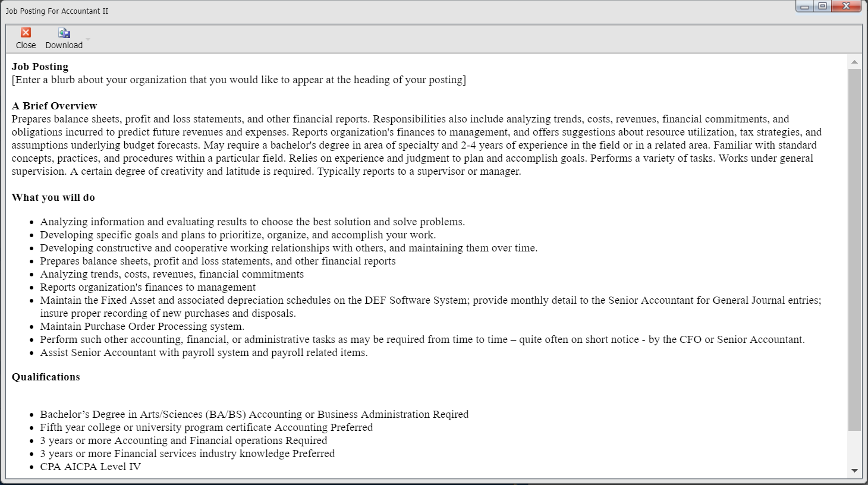
Job Descriptions and Job Posting
For ADA, Job Description and posting are both at issue
Automated Integration between JDs and ATS – easy win
Force consistency between JD and Posting
Notes:
Timing
Writing tips:
Include the percent of time the employee will spend on the job performing functions
If a position requires repetitive motions, use the word "repetitive”
Be specific regarding lifting and other physical requirements
Work with front-line supervisors to ensure that the job description accurately reflects the actual tasks being performed
Multiple Roles – Make sure employees are aware of multiple Job Descriptions
JD Must be Written before Advertising for the job; Content of posting should be consistent with the JD

Slide 26
ADA: Reasonable Accommodations
A reasonable accommodation is “any modification or adjustment to a job or the work environment that will enable a qualified applicant or employee with a disability to participate in the application process or to perform essential job functions.”
Common accommodations may include:
making a facility accessible to individuals with disabilities
restructure a job or work schedule
modify equipment, tools, training procedures or other programs
provide qualified readers or interpreters
An employer does not have to provide reasonable accommodations if it would impose an “undue hardship.”
Undue Hardship is defined as an “action requiring significant difficulty or expense when considered in light of factors such as an employer’s size, financial resources, and the nature and structure of its operation.”
Employers do not have to sacrifice quality or lower production standards to make accommodations; nor do they have to provide the individual with personal use items such as glasses, hearing aids, walkers, etc.

Slide 27
ADA: Accommodation Examples*
Computer Programmer with Diabetes
Food Services Manager with MS
A Sheet Metal Worker has a speech impairment.
*Job Accommodation Network http://Askjan.org
Notes:
Situation 1: An applicant is interviewing for a Computer Programmer position. Although not required to disclose, the applicant decides to tell the employer she has diabetes due to questions about a particular job requirement for which she may need an accommodation.
Essential function: “Responsibilities occasionally may require an adjusted work schedule, overtime, and evening/weekend hours in order to meet deadlines or to access the computer to perform program tests.”
Limitation: Person needs to eat at specific time each day. May need to test blood sugar and take insulin while at work. Prospective employee is happy to work adjusted hours provided that she can take the steps necessary to regulate her diabetes.
Accommodation Solution: Employer accommodates the employee by allowing her to adjust her lunch hour to 11-12 a.m. rather than the typical 12-1 p.m. lunch break and permits flexible break times. The employee was allowed to bring a small refrigerator to store food and medication in her office. When working evening hours, the employee could set her own dinner breaks accordingly.
Read more.
Situation 2: The new Food Service Manager is a person who has multiple sclerosis. She uses a cane for mobility assistance.
Essential function: "2% of time: Assists in production area during absence of primary kitchen staff.“
Limitation: Employee has difficulty standing for long periods of time.
Accommodation Solution: The employer and employee agree to use a sit/stand work stool and an anti-fatigue mat to accommodate rare occasions when she will need to assist in the kitchen.
Read more.
Situation 3: A Sheet Metal Worker has a speech impairment. He stutters and when nervous, the condition becomes much more prevalent.
Essential Function: “Makes recommendations to supervisor about the need for different materials, equipment, and parts.”
Limitation: Employee has difficulty with verbal communication.
Accommodation Solution: As needed, the employee makes recommendations in writing. When discussion or clarification is necessary, employer and employee meet one-to-one in a quiet environment to eliminate noise, distraction and alleviate the employee’s stress about speaking in group situations.
Read more.

Slide 28
ADA: Client Results
Provide written documentation of company’s efforts to be in compliance with ADA regulations
Assist with conducting legally defensible job analysis
Ensure completion of job description is consistent regardless of individual completing
Assist in writing accurate job descriptions by providing examples that meet compliance standards
Insure that all JDs are up to date and complete
Standard Checklists for Physical Demands and working conditions
Reporting to find missing data, gaps and/or outliers
Mass updates to ensure consistency if changes to documentation are required
Audit trail for changes and approvals
Notes:
JDXpert positive comments

Slide 29
FLSA: What’s The Risk
2016 had the second-highest number of wage and hour cases ever filed
AND the settlement valuation has more than tripled over the last two years.
The value of the top 10 settlements hit $695.5 million in 2016
Make sure you classify employees properly
Notes:
2016 had the second-highest number of wage and hour cases ever filed
AND the settlement valuation has more than tripled over the last two years.
The value of the top 10 settlements hit $695.5 million in 2016, a 50% increase over 2015's $463.6 million valuation, and more than triple the $215.3 million valuation in 2014.
To protect yourself, you need to make sure you classify employees properly.

Slide 30
FLSA: An Overview
The FLSA establishes minimum wage, overtime pay, recordkeeping, and youth employment standards affecting employees in the private sector and in Federal, State, and local governments.
The FLSA was designed to protect workers from being required to work long hours without extra payment.
Exempt and non-exempt simply refers to what employees are to receive overtime pay and which employees do not.
Exempt employees are exempt from overtime regulations as well as minimum wage laws
Non exempt employees must be paid for any overtime they work

Slide 31
FLSA: Exempt/Non Exempt
Employees classified as nonexempt:
Are paid for all hours worked, including overtime pay
Must be paid no less than the federal minimum wage (or a state’s minimum wage, whichever is greater) and at an overtime rate no less than one and one-half times his/her regular rate of pay if working beyond a certain number of hours in a day or week
Are paid more frequently
All employers covered by the FLSA must comply with the Act's break time for nursing mothers provision which requires employers provide nonexempt mothers with the time and space to express breast milk for one year after the birth of a child.
Employees classified as exempt:
Are paid to get the job done regardless of hours worked
Are paid an established salary
Are not eligible for overtime pay
Notes:
Notes:

Slide 32
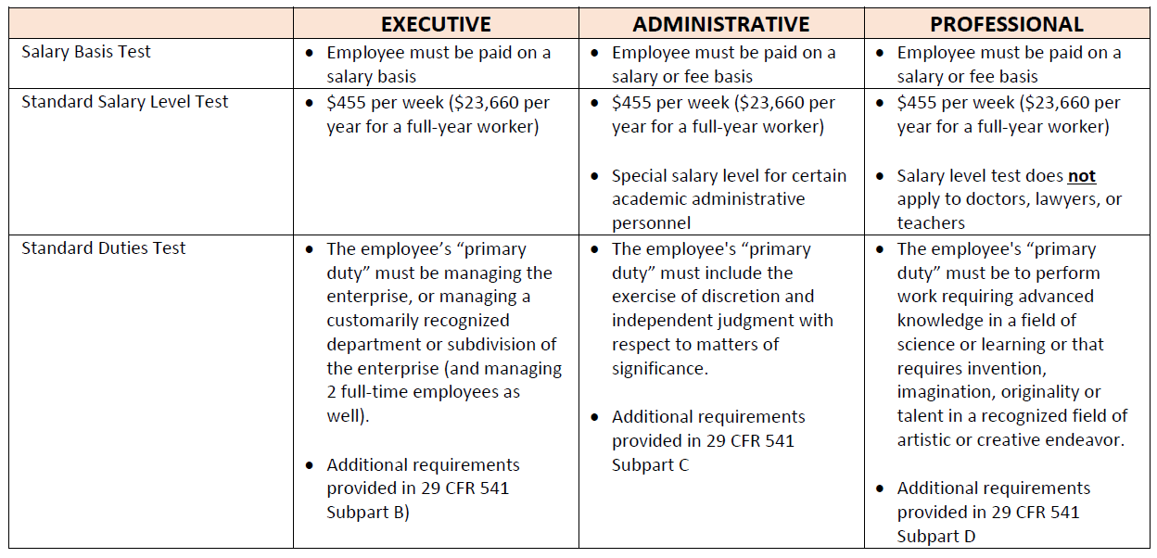
How To Determine Status
In general, there are three basic tests to help determine if an employee is exempt or nonexempt:
Salary level test
Salary basis test
Duties test
Read the Regs
Notes:
Notes:

Slide 33
Salary Level Test
If the employee makes less than $455 per week he/she is to be classified as nonexempt.
The employee is subject to FLSA regulations such as:
Paid an hourly rate no less than federal minimum wage (or a state’s minimum wage, whichever is greater)
No less than one and one-half times his/her regular rate of pay if working beyond 40 hours in a workweek
The employee makes $455/week or more, then move on to the salary basis test to see if they qualify for exempt status
NOTE: On September 24th, the DOL announced that the minimum salary level will increase to $684 per week (equivalent to $35,568 per year for a full-year worker) effective January 1, 2020
Notes:
OT must be 1 ½ times rate of pay

Slide 34
Salary Basis Test
Next, determine if the employee regularly receives a predetermined amount of compensation for each pay period in which the employee performs any work, regardless if there is a variation in the quality or quantity of work performed.
If the employee qualifies as exempt move on to the Job Duties Test
Notes:
An exempt employee must receive the full salary for any week in which the employee performs any work, regardless of the number of days or hours worked.
Exempt employees do not need to be paid for any workweek in which they perform no work.
If the employer makes deductions from an employee’s predetermined salary, i.e., because of the operating requirements of the business, that employee is not paid on a “salary basis.”
If the employee is ready, willing and able to work, deductions may not be made for time when work is not available.
Circumstances in Which the Employer May Make Deductions from Pay
Sick or personal days in accordance with a bona fide plan, policy or practice of providing compensation for salary lost due to illness;
To offset amounts employees receive as jury or witness fees, or for military pay;
Penalties imposed in good faith for:
infractions of safety rules
unpaid disciplinary suspensions
workplace conduct rule infractions
Initial or terminal week of employment

Slide 35
Job Duties Test
Categories of jobs that are typically, but not always, exempt:
Executives: supervisors, managers
Learned Professionals: registered nurses, lawyers
Creative Professionals: artists, actors
Administrative Professionals: accounting, marketing
Highly Compensated Employees
Outside sales representatives and certain computer employees may be exempt as well.
Help is available from the DOL: FLSA Overtime Security Advisor
And SHRM: FLSA Exemption Questionnaire
Notes:
Use reference material – not off top of head

Slide 36
Highly-Compensated Employees (HCE)
Special rule for workers who are paid total annual compensation of $100,000 or more are deemed exempt under Section 13(a)(1) if:
Employee earns total annual compensation of $100,000 or more (will increase to $107,432/year Jan 1, 2020) , which includes at least $455 per week ($684 as of Jan 1, 2020) paid on a salary basis;
Employee’s primary duty includes office or non-manual work
The employee customarily and regularly performs at least one of the exempt duties or responsibilities of an exempt executive, administrative or professional employee.
For example, an employee may qualify as an exempt highly-compensated executive if the employee customarily and regularly directs the work of two or more other employees, even though the employee does not meet all of the other requirements in the standard test for exemption as an executive.

Slide 37
The FLSA & Job Descriptions
Although job descriptions are not a requirement of the FLSA, they are the a widely accepted exhibit that can prove the essential functions of a job
Accurate job descriptions are essential when determining whether an employee is exempt or non-exempt
Don’t just look at an employee’s job title, but also look at their duties and day-to-day responsibilities
Since duties/responsibilities change often, it’s important to periodically review job descriptions to verify if they are still current
Keep diligent records about your employees’ status, hours worked, responsibilities, overtime paid, and more
Notes:
SRA deposition example
Are usually central in any dispute
Needed as input for Job Duties Test
Compensation uses these items in the Job Description to complete the Job Duties Test
Job Summary (Marginally)
Essential Functions
Scope

Slide 38
Essential Functions
Primary Input to Job Duties Test

Slide 39
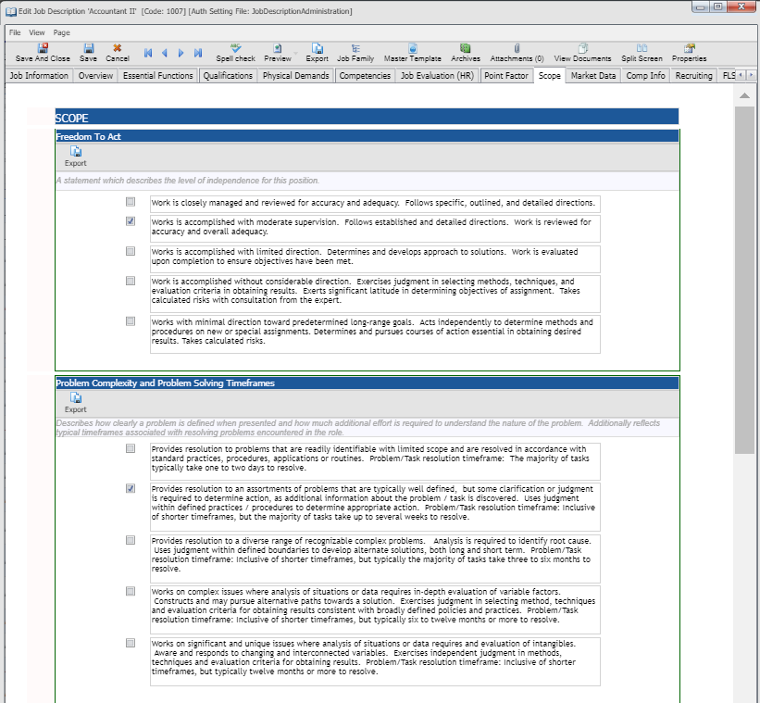
Scope
Additional factors
Freedom to Act
Problem Complexity
Impact
Supervision Exercised/ Received
Financial Responsibility
Budget Responsibility

Slide 40
FLSA: Wording Tips
Don’t create FLSA Classification Problems
“…Supervise 2 employees/can hire and fire” “…Will supervise department”
“Eligible for overtime pay” Omit.
“This is an exempt position”
“…Salaried position”
Mirroring Verbiage from the Regulation (Job Duties Test)
Will Aid Compliance
But can cause Job Descriptions to be inaccurate
Notes:
The words ‘primary duty’ and a description of the position should mirror, as close as possible, the language of the DOL [Department of Labor] regulations” under the FLSA,
However job descriptions which are ‘borrowed’ from other organizations, obtained from the Internet, generic or form descriptions, or which very closely track the wage-and-hour regulations, but cause Job Descriptions to be inaccurate. This Can be worse than no Job Description

Slide 41
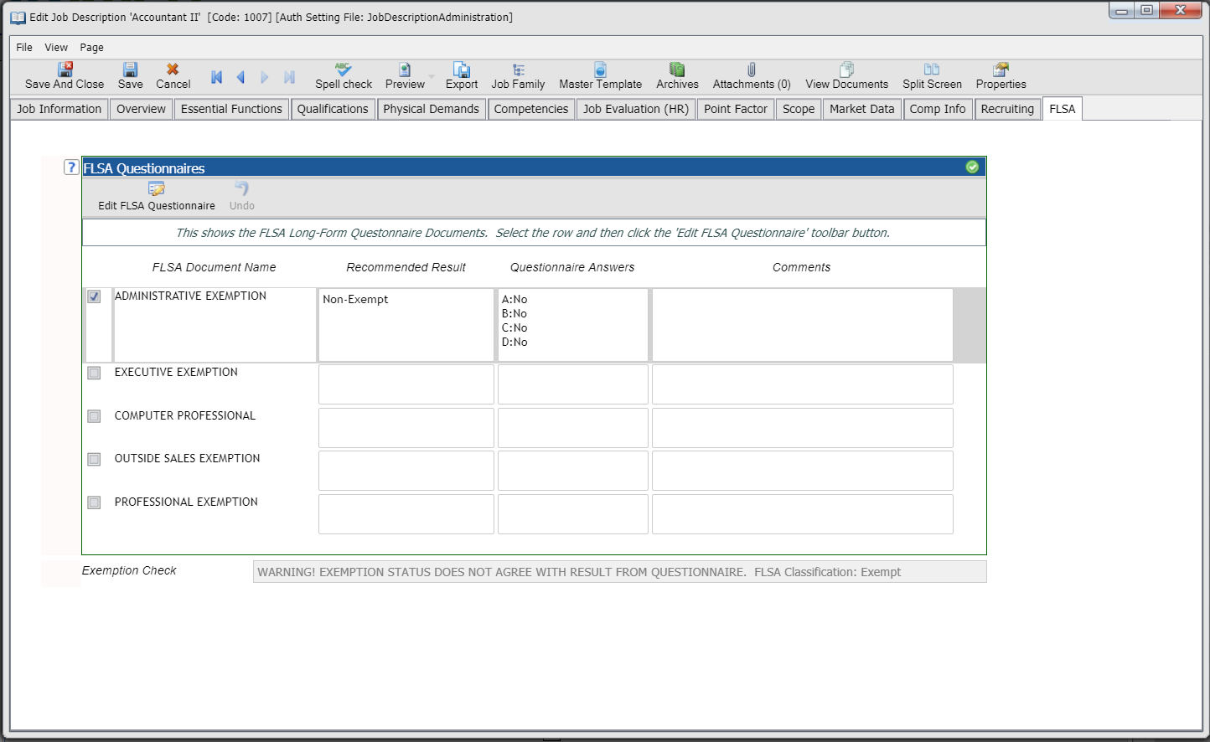
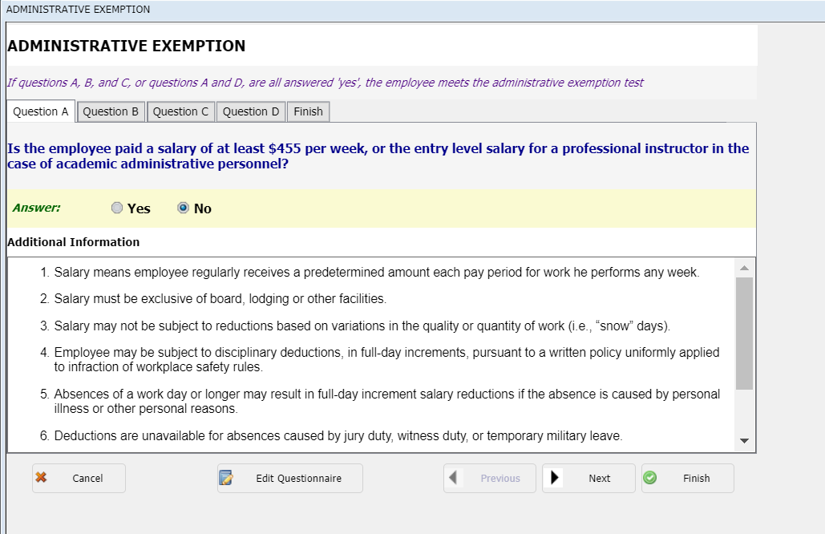
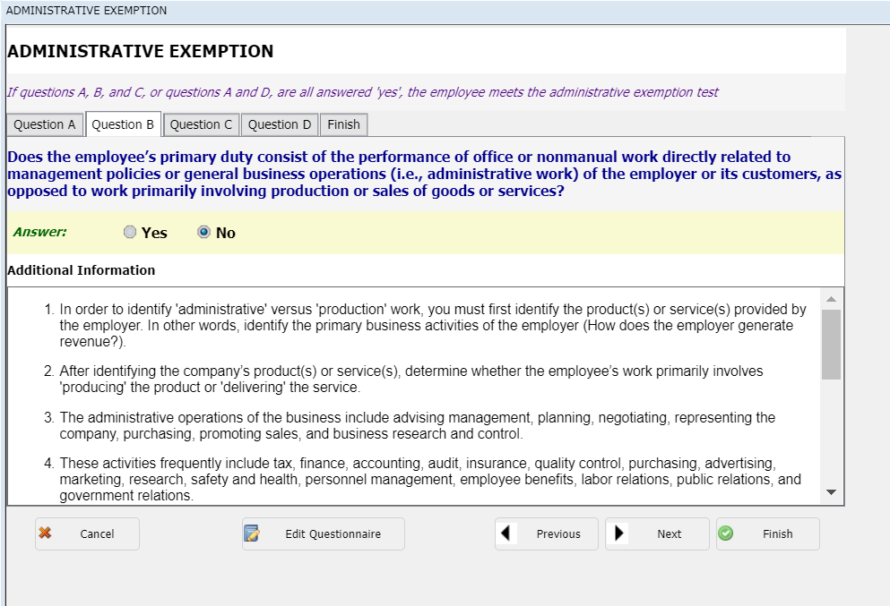
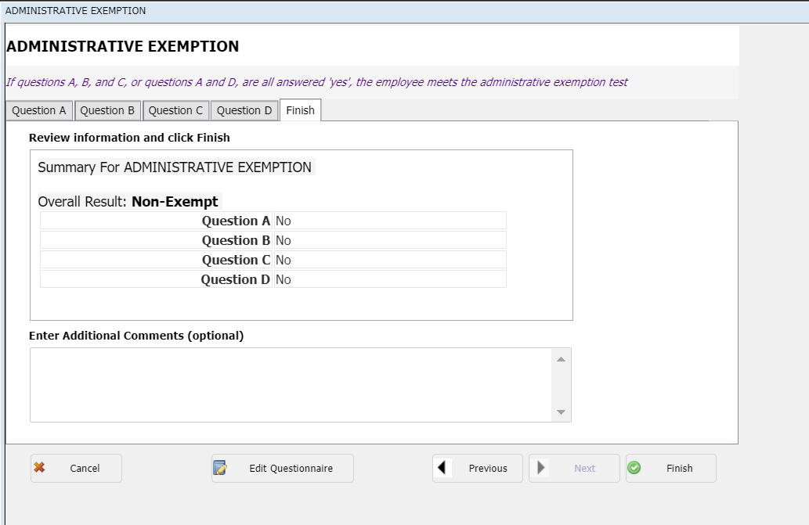
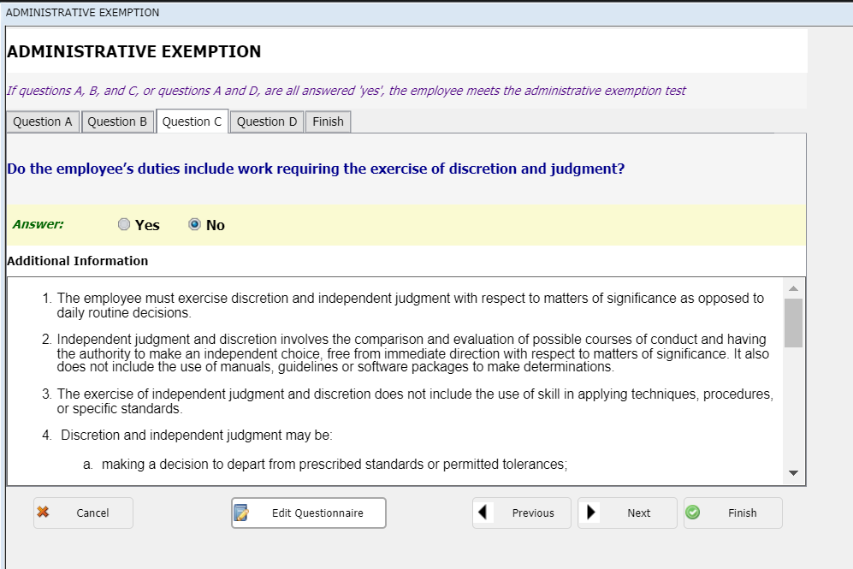
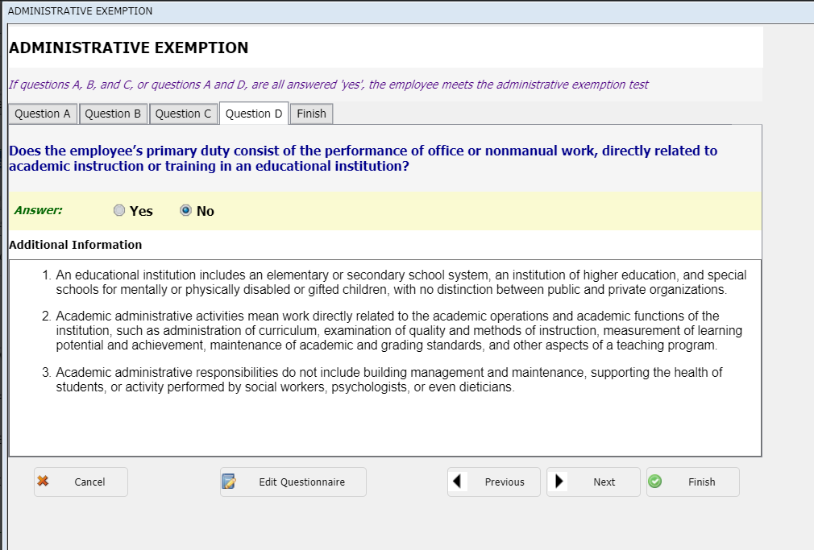
Interactive FLSA Questionnaire

Slide 42
Quiz: FLSA Exemption: Outside Sales
Primary duty must be making sales, obtaining orders or contracts for services or for the use of facilities for which the employee will be paid
Customarily and regularly working away from the company’s place of business
#1 - A field technician sells HVAC systems while on calls to fix customer’s heating system.
Does this position qualify for an exemption?
Notes:
ANSWER: HVAC – no – primary duty is to repair HVAC system. If they happen to sell one, doesn’t make it exempt.

Slide 43
Quiz: FLSA Exemption: Computer Employees
Engaged in systems analysis and consulting with users
Designing, analyzing, testing computer systems
Designing or testing computer programs
Or a combination of the above
#2 - A programmer analyst meets with internal clients to identify issues in their system and then programs a modification to rectify it.
Does this position qualify for an exemption?
Notes:
ANSWER: it depends….. on whether the individual is primarily a programmer who occasionally does system analysis work or a systems analyst who does some programming. Systems analysis is exempt work and programming work is nonexempt.

Slide 44
JD Accuracy: Employee Acknowledgment
Accurate up to date Job Descriptions should be readily available to employees
Employees should be given the ability to provide feedback
Employees should Acknowledge (Sign off) on their job descriptions:
Upon hire
When the JD changes
Annually

Slide 45
Job Description Acknowledgements
Protect against FLSA wage and hour lawsuit
In an article, Beware 'Misclassification Creep' in Employee Exemption, Littler Mendelson shareholder and co-chair of the firm’s wage-and-hour practice group, Lee Schreter states, “It’s easy enough for companies to ask their employees to sign off on their job descriptions during their periodic performance reviews, so there is both mutual understanding and, for the employer, well-documented proof that the employee knows where they stand. That kind of evidence, I believe even the courts will be hard-pressed to dismiss.”

Slide 46
Client Results
Provide written documentation of company’s efforts to be in compliance with FLSA regulations
Conduct legally defensible job analysis that is consistent regardless of individual conducting the review
Assist in writing accurate job descriptions by providing examples that meet compliance
Creates a central location for documentation for job description, including FLSA testing and scope
Database that is searchable and allows reporting to find missing data, gaps and/or overdue evaluations
Provides mass updates to ensure consistency
Provides an audit trail for changes and approvals
Explain FLSA decisions internally
Notes:
JDXpert uses

Slide 47
Equal Pay- Federal Level
The wage gap among men and women has narrowed, from women earning on average 59.8% of men’s pay in 1963 to a wage ratio at 77% today.
Lily Ledbetter Fair Pay Restoration Act (2009): allows victims of pay discrimination to file a complaint with the government against their employer within 180 days of their last paycheck.
National Equal Pay Task Force (2010): a committee made up of EEOC, DOJ, DOL, OPM reps for a coordinated effort to “improve compliance, public education, and enforcement of equal pay laws.”
Executive Orders (2014): 2 executive orders to help eliminate wage disparities among federal contract workers.
banning federal contractors from punishing workers who discuss salaries with co-workers
calls on the DOL to create rules that require federal contractors to submit salary information, broken down by race and gender, to the department
Notes:
Next we will talk very briefly about Equal Pay and what our country is doing to combat unequal pay. Although the wage gap among men and women has narrowed, women are still only earning on average 77% of men’s pay today.
In an attempt to close the wage gap, President Obama signed the Lily Ledbetter Fair Pay Restoration Act in 2009, which allows victims of pay discrimination to file a complaint with the government against their employer within 180 days of their last paycheck. Previously, victims were only allowed 180 days from the date of the first unfair paycheck.
In 2010, the President pledged to “crack down on violations of equal pay laws” and, that same year, established the National Equal Pay Task Force. The Task Force, which consists of professionals at the U.S. Equal Employment Opportunity Commission, the Department of Justice, the Department of Labor and the Office of Personnel Management, was created to better enforce equal pay laws and promote efficiency and efficacy by enhancing federal interagency collaboration.
April 2014, he signed two executive orders to help eliminate wage disparities among federal contract workers. One order bans federal contractors from punishing workers who discuss salaries with co-workers, and the other calls on the Labor Department to create rules that require federal contractors to submit salary information, broken down by race and gender, to the department.
Actions such as these demonstrate the focus on Equal Pay

Slide 48
Equal Pay - State Level
California
Fair Pay Act (SB 358): went into effect Jan. 1, 2016:
Employers are required to pay employees equally for doing “substantially similar work" and eliminates the “same establishment” requirement.
Increased burden of proof on an employer to explain pay differential.
Pay differentials must proven to be based on seniority, merit and other bona fide factors & must be applied reasonably & account for the entire pay differential.
Prohibits retaliation or discrimination against employees who disclose, discuss, or inquire about their own or co-workers’ wages.
New York
Achieve Pay Equity bill: strengthens the state’s Equal Pay Act and went into effect on Jan. 1st, 2016:
Employers must show that pay differential is based on "a bona fide factor other than sex
Altered the definition of “same establishment” to include “workplaces located in the same geographical region, no larger than a county.”
Employers cannot prohibit employees from sharing wage information with other employees
Increased amount of liquidated damages
Massachusetts & Maryland have also passed similar legislation
Notes:
The topic of strengthening equal pay laws has also made it to the state level. Let’s start with state with the most sweeping changes, California.
California:
Since 1949, under the California Equal Pay Act (EPA), employers have been required to pay women and men equally for doing the same job.
However, on January 1st, 2016, SB 358, often referred to as the California Fair Pay Act, went into effect in order to strengthen the states Equal Pay laws.
SB 358 amends the California Equal Pay Act in the following ways:
- Employers are required to pay men and women equally who do “substantially similar work" and the it eliminates the “same establishment” requirement.
Increased the burden of proof on an employer to explain the pay differential between employees.
Still allows differences in pay based on things like seniority or merit or other bona fide factor. But the Fair Pay Act requires that the bona fide factor be consistent with business necessity and that the employer demonstrate that these factors account for the entire wage differential.
Employers must now keep records of employee wages “job classifications, and other terms and conditions of employment” 3 years, not 2 years, as it was previously.
Prohibits retaliation or discrimination against employees who disclose, discuss, or inquire about their own or co-workers’ wages for the purpose of enforcing their rights under equal pay.
New York:
Also going into effect this past January was New York’s amendment to their Equal Pay Act with the signing of the Achieve Pay Equity bill.
The Equal Pay Act already requires equal pay for equal work but the amendment clarifies a few points:
First, the employer can no longer rely on "any factor other than sex" to justify pay differentials between a man and a woman doing the same job. Instead, the employer must show that the difference is based on "a bona fide factor other than sex, such as education, training and experience." The factors must be job-related and consistent with business necessity.
Second, the amended statute clarifies that differentials in pay are prohibited even if two employees whose pay rates are being compared work in different physical locations, provided the locations are in the same geographic region no larger than a county.
Third, employers can no longer prohibit employees from sharing wage information with other employees. Employers may have written policies that establish reasonable workplace and workday limitations on the time, place and manner for discussion about wages, including prohibiting an employee from disclosing the wages of another employee without such employee's permission.
Fourth, the amended statute increases the amount of liquidated damages from 100% of the amount of unpaid wages to 300%. So, individuals who were paid unequal wages will now entitled to liquidated damages of up to three times the amount of unpaid wages.
Other states like Massachusetts and Maryland have recently passed similar legislation to combat unequal pay.

Slide 49
Wrap up
Up-to-date job descriptions are needed to comply with FSLA and ADA
Tracking of essential function, physical demands and qualifications is essential for compliance
Historical job documentation and employee acknowledgement can provide protection
Automated repository highly advantageous in maintaining compliance in an evolving environment

Slide 50
Resources
ADA
http://www.eeoc.gov/laws/statutes/ada.cfm
https://adata.org/publication/disability-law-handbook
http://www.shrm.org/legalissues/federalresources/pages/job-descriptions.aspx
http://www.ada.gov/q&aeng02.htm
http://www.eeoc.gov/facts/ada17.html
http://hrdailyadvisor.blr.com/2009/03/18/non-prejudicial-language-for-ada-job-descriptions/#
http://www.tmhra.org/ADAToolkit/5-WriteADA-JobDescrip.pdf
http://askjan.org/media/jobdescriptions.html
http://www.lewiswagner.com
http://www.ncdhhs.gov/humanresources/forms/classification/c201-ada.pdf
http://publichealth.nc.gov/employees/hr/classification/ADA-Checklist.pdf
http://www.shrm.org/legalissues/federalresources/pages/job-descriptions.aspx
FLSA
http://www.dol.gov/whd/flsa/
http://www.hrtms.com/landing-flsa-avoiding-common-pitfalls--costly-mistakes.html
http://www.mvalaw.com/news-publications-304.html
http://www.uhnj.org/hrweb/compensation/competency-based_jd_guide.pdf
http://www.dol.gov/whd/overtime/NPRM2015/factsheet.htm
http://www.shrm.org/legalissues/federalresources/pages/job-descriptions.aspx
https://www.dol.gov/whd/overtime/final2016/faq.htm#8
https://www.dol.gov/whd/overtime/final2016/litigation.htm

Slide 51
Questions?

Slide 52
How To Contact Us
Jennifer Peacock
jenniferpeacock@icshumancapital.com
Ashley Johnston
ashley@hrtms.com
919.351.JOBS (5627) www.hrtms.com

