Slide 1
Don Berman Co-Founder, VP of Sales & Marketing & JD “Xpert”
Today’s Speaker
Don Berman has spearheaded the adoption of HR and talent management applications and technology driven best practices at large and mid-sized companies throughout the U.S and abroad. As co-founder and VP of Client Services, Don was instrumental in evolving the focus of JDXpert’s Talent Management platform toward a job description-centric model that resulted in JDXpert becoming a market leader in job description management solutions. Today, Don leads the company’s sales, marketing and partner efforts.

Slide 2
Recruiting and Retaining Talent Through Economic Uncertainty

Slide 3
Recession: Perception vs Reality
Recession
Significant, prolonged decline in:
Reality
Numbers are not indicating a recession
v
GDP
Employment
Consumer Spending
^
United States GDP +2.7%
US Unemployment rate 3.4%
v
^
^
US PCE increased by 0.1%
v
AIER | FRED | BEA | FRED | BEA
Notes:
PURPOSE: RECESION OR NOT RECESSION – THAT IS THE QUESTION
Slide title
A Recession is often defined as two consecutive quarters of economic contraction which includes a significant, prolonged decline in
GDP
Employment
Consumer spending.
Lighter wallets due to Inflation but Recession?. Consider
Gross domestic product rose 2.7% in the 4th quarter of 2022
Congressional Budget Office projects 2023-2028, real GDP to grow by about 1.7 percent each year
Unemployment is at a 50 year low at 3.4%, lower than before the pandemic
And consumer spending (Personal Consumption Expenditures (PCE) was down only 0.2% in December. Don’t want to see a decline but was:
Impacted by the rising cost of food, utilities and other commodities,
But Spending underpinned by the solid wage growth
And Personal income increased 0.1% in January compared to December 2022 and Personal Savings was 4.7% in January, compared to 4.5% in December
PCE decline is an actual recession indicator but overall
Are we in for more of an Emotional or Self-inflicted recession than a real recession? Spooking business leaders with over 90% of mid-market CEOs saying they are concerned about a recession
And 25% have begun layoffs or plan to
This is one of the rare cases where perception may be causing reality.
===============================================================================================================
We are living through a very interesting time in history. We’ve come through a global pandemic and experienced an unprecedented advances in digital transformation,
However, economists are predicting 2023 to be a year of continued economic hardship
Are we really heading towards a recession?
A Recession is often defined as two consecutive quarters of economic contraction which includes a significant, prolonged decline in
GDP
Employment
Consumer spending.
Though all of our wallets are seemingly lighter, the numbers that indicate a true recession are not adding up to that conclusion.
Gross domestic product rose 2.6% in the third quarter of 2022
With the Congressional Budget Office projecting that From 2023 to 2028, the real GDP is projected to grow by about 1.7 percent each year
Unemployment rate is still very low at 3.7%, mirroring levels seen before the pandemic
And consumer spending (Personal Consumption Expenditures (PCE) was up by 0.5% in October (the most recent month reported)
Impacted by the rising cost of food, utilities and other commodities,
But Spending underpinned by the solid wage growth
And Personal income increased by $155.3 billion (0.7 percent) in October
So are we in for more of an Emotional recession than a real recession? These sentiment is spooking business leaders with over 90% of mid-market CEOs responding to a recent survey saying that they are concerned about a recession and a quarter of them have begun to layoff workers or plan to do so within the next 12 months.
This is one of the rare cases where perception may be causing reality.

Slide 4
What’s Fueling Financial Discontent?
Short Term
Mid Term
Long Term
Inflation (Recession)
Supply Chain
Labor Shortage
Forbes | CNN Business | Trading Economics
Notes:
PURPOSE: LABOR SHORTAGE IS OUT #1 LONG TERM ISSUE
Inflation currently sits at 6.4%, down slightly from 6.5% in December and down significantly from 9% we saw in June. Cost of food and fuel prices.
However, Dr. Marci Rossell, World-renowned CNBC economist, recently spoke at Payscale’s Compference 2022 and stated that these are the Top Drivers of Economic Concern:
Inflation is short-term heightened by the pandemic and the war in Ukraine.
She also cited Supply Chain issues, also impacted greatly a by the pandemic, are working themselves out (medium term issue)
However, the most long-term issue facing our economy and you in HR are labor-market challenges

Slide 5
HR Challenges
Recover
Reflect
Retain
Recruit
Deloitte
Notes:
start
PUROSE: SET AGENDA:RECOVER/REFLECT/RETAIN/RECRUIT
Regardless of the Cause or severity of the coming downturn it falls into HR’s lap to Deal with it.
Leaders look at head count because:
human capital represents upwards of 60% of operating expenses
However, we are dealing with a very unique situation:
We just survived a global pandemic
Applicants are in the Driver’s seat due to 11m+ Job opening but <6M applicants (WSJ)
Resulting in prolonged job vacancies and trouble recruiting talent
Today’s session will dive into ways you can lead your organization to the other side of this downturn:
RECOVER –Take a look at what we’ve been through and where we are
REFLECT –Help you can chart a course for the short term
Weighing short term economic concerns against the more significant and longer-term labor shortage we’re going to examine the value of continued focus on Retention and recruiting.
RETAIN – Examine Burnout, Engagement, and Compensation strategies to retain current employees. We’ll also take a look at where retention really starts - in the recruiting process!
RECRUIT –We’ll discuss, Flexibility, Transparency, Career Growth. PE/DEI factors that are looming large with today’s applicants.

Slide 6
BEST IN CLASS
Job Description
Management Solution
Modern job description management for today’s HR pros
Notes:
PURPOSE: DISCLAIMER
We are JDXpert and we unabashedly believe that everything we do in HR starts with understanding the work that people do.
So, during today’s presentation, we will be coming at things from that perspective:
We’ll be sharing our perspective as well as what our client are doing or considering
Companies that have taken controls of their Job Descriptions and are taking advantage of:
Job Description content
Automating their Job Description Processes
Integrating accurate up-to-date Job Data throughout the enterprise.
Are their other factors that affect domains we’ll discuss today? – Absolutely
But any project in HR/Talent/ Compensation that is based on an incomplete or inaccurate understanding of the work people do is at best suspect if not outright flawed.
We recently came back from HR Tech:
Total focus on recruiting
Slick tools to:
Help you craft effective job posting to attract and advance qualified, diverse candidates
Other tools that improve your Applicant’s experience.
But virtually no focus on understanding the work people do – that empirical record of truth, the Job Description.
Even the slickest Job Posting, if it does not accurately reflect the work to be done will not help you.
Even if you fill the position what’s the likelihood of that hire sticking around.
It’s like building a skyscraper on a foundation of Styrofoam.

Slide 7
HR Challenges
Recover
Reflect
Retain
Recruit
Deloitte
Notes:
With the Pandemic in the rearview mirror, let’s look at the impact of the following factors on our big, long-term problem - the labor shortage.

Slide 8
Recover?
Labor Supply
Terrible
Moving to just awful?
Current Layoffs?
Unsurprising
Tech Firms playing catch up
In context: Layoffs are Very Low (WSJ)
Trading Economics | Federal Reserve Bank of St Louis | WSJ | Congressional Budget Office
Notes:
PURPOSE: WHAT DOES OUR RECOVERY LOOK LIKE. Labor supply Bad, Current layoffs not meaningful
Labor Supply
In the Pandemic:
US Personal savings rate skyrocketed to over 30% Up3X because:
People got Stimulus Checks
Student loans Paused
Business Relief like PPP
All this reduced dependency on Employers so:
Some gave up 2nd jobs because they didn’t need them
Paused or ended Two income households to take care of children who were out of school/daycare
Sought alternative employment that they perceived as more desirable.
In addition
4.2 million workers at or around retirement age left the workforce:
2.4 million of them retired early because of the pandemic
AND 300,000 fewer young people entering the workforce every year than there were 10 years ago
So Even if it’s starting for feel like things are retuning to normal In terms of the Labor supply they are not
Equation 11M+ openings <6M Applicants (5.3M)
Outlook:
The Congressional Budget Office predicts that unemployment will peak at 5.1% at the end of 2023 before gradually beginning in the second quarter of 2024, falling to 4.5 percent by the end of 2027.
Not enough to ease the labor shortage
But could put a Chill the great resignation
The long-term labor shortage needs to be our load star
Current Layoffs
During the Pandemic
People had a lot of money and stayed at home so online ordering spiked
And staffing in some areas spiked.
So now as things return to normal
Is it surprising that Amazon Just laid off 10K workers?
Layoff in tech are attributed to:
Compassionate retention – Companies didn’t want to layoff folks in the pandemic
Performance management processes were suspended during the pandemic
Unlike most companies Over-hiring was Endemic in tech firms for years.
The way to look at the layoffs in tech is that perhaps they are postponed cutbacks that would have occurred organically had the pandemic not happened.
For Context Overall Layoffs characterized as Extremely Low. (11/30 WSJ: Layoffs? What Layoffs?)

Slide 9
HR Challenges
Recover
Reflect
Retain
Recruit
Deloitte
Notes:
PURPOSE: WHAT HAVE WE BEEN DOING VS. WHAT ARE WE EXPECTED TO DO.
But because of the labor market and the difficulty hiring and retaining talent what have we been doing?:
Focusing on retaining the employees we’ve got
Expanding the talent pool we recruit from
Implementing technology to improve the applicant experience
Implementing Talent marketplaces to maximize our internal talent pool
Upskilling our workforce
Implementing Pay Equity and Transparency
All this to deal with a labor market with 11M+/<6M
And now we’re talking about layoffs?
Are you confused?
If you’re not, you should be.
Even if you’re considering layoffs, how do you Lay off workers when you know hiring them back will be so difficult?
Very Carefully!!
If this downturn is a “shallow” one, we don’t want to find ourselves trying to hire back the same people we recently laid off..

Slide 10
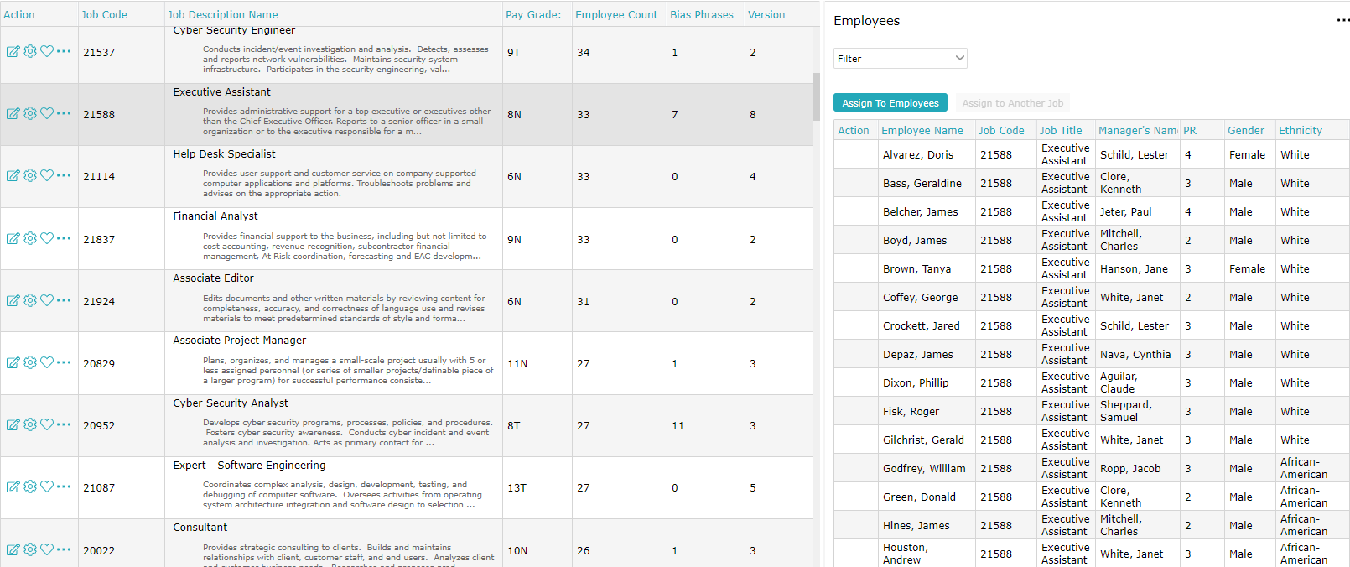
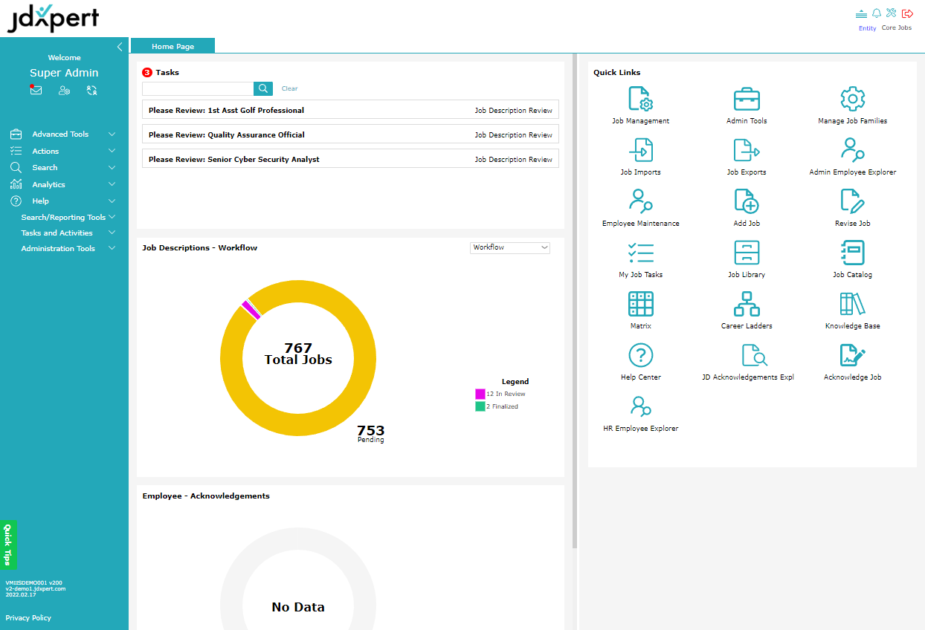
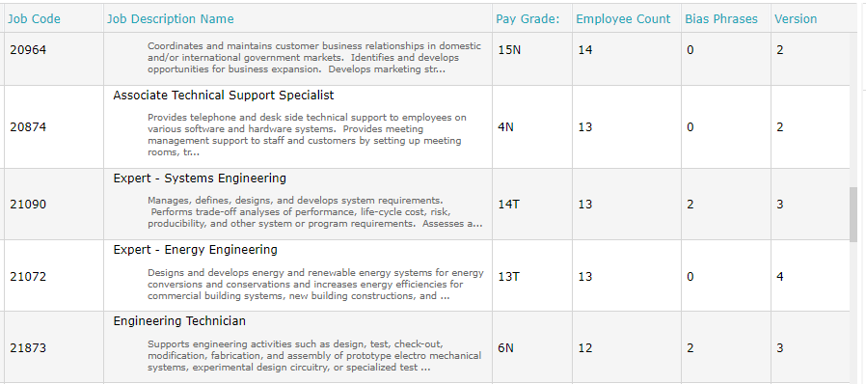
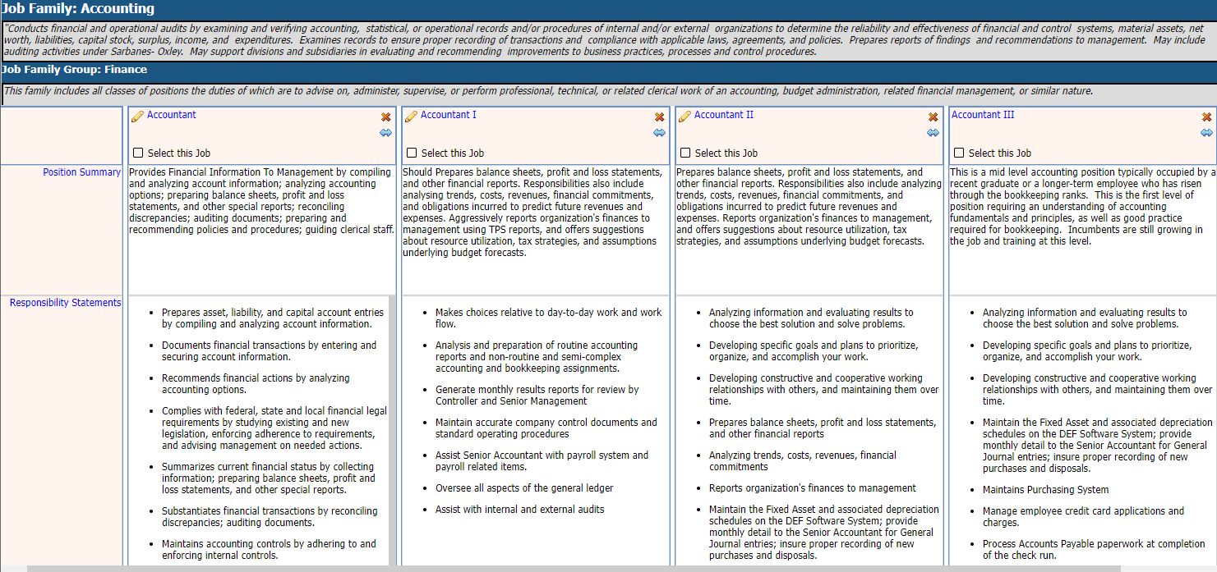
What To Do
05
04
03
06
01
02
CONSOLIDATE
BE PREDICTIVE
ASSESS HEADCOUNT
MEASURED ACTION
LOOK ELSEWHERE
REFINE JOB DATA
Combine responsibilities to form fewer roles
Using real-time data
Other than HC
Surgical approach
Plan to scale headcount for roles with many incumbents
Understand the work done at a granular level
Increase productivity
Minimize other costs
Delay planned investments
Expand revenue streams
Offer compelling promotions
Bring roles in house
America’s SBDC
Notes:
01
Minimize other costs
Delay Planned investments
Expand revenue streams
Offer compelling promotions
02 – If you don’t understand the work people are doing at a granular level it will be difficult to take action. This is where managing your job data becomes critical
So, before you can identify where you can restructure, or make adjustments, you must get your job descriptions in order.
03
Understand head count in highly populated Roles.
Understand the number of incumbents, and where the are
Make sure you have metrics to successfully track their utilization
Consider using remote work trend to reshuffle work from over utilized to under utilized incumbents
04
If you have an effective Job Architecture in place you may not find as much opportunity here as others. If not, overlaps and redundancies in roles may make consolidation an effective use of time.
Consider using tech like you see on the left to help analyze and restructure roles where possible.
You can redistribute employee responsibilities (Later)
Institute Job Sharing
05
Use Data do determine timing
Pipelines
Utilization
Managers estimation of Workload
06
Take a surgical approach
Remember Hiring people back in a tight labor market will be HARD
Before making those adjustments, ask yourself:
how will they impact long-term?
Can they be easily restored once the economy recovers?
How will they impact the people you want to keep.
According to the Insider: Industry experts said that most employers simply can't afford to lay off large swathes of workers if they want to make it out the other side. Ravin Jesuthasan, a global-transformation leader at Mercer, told Insider that even as costs rise for employers, layoffs are simply not an option for many businesses.
"I don't think companies got ahead of their skis in hiring because it was so difficult to find talent," he said.

Slide 11
HR Challenges
Recover
Reflect
Retain
Recruit
Deloitte
Notes:
Preston’s Next Question:
Bottom-line: Retaining the talent you have is the most coherent strategy for controlling costs when you consider cost of vacancies:
Recurring Recruiting costs
Diminished overall productivity
Decreased customer service
Increased error by inexperienced resources covering vacant slots
Cultural impact/lost engagement – employees feel put upon and frazzled covering vacant positions

Slide 12
Retain
Keep the workers you already have by
Addressing burnout
Boosting engagement
Strategic compensation
Re-recruit employees
Statista
Notes:
AGENDA FOR THIS SECTION
Keep the workers you already have by
Addressing burnout
Boosting engagement
Strategic compensation
Re-recruit employees

Slide 13
Why Employees Leave
Turnover factors | Rank
Opportunities for career advancement | 1
Satisfaction with my role and responsibilities | 2
Base pay | 3
Opportunities for career-related skill development | 4
The degree to which my skills were used in my job | 5
4 out of 5
Are directly dependent upon job descriptions
McLean & Company
Notes:
When examining retention, it’s critical to understand why people leave. According to McClean and Company 4 out of the 5 of these reasons,, are directly dependent upon a clear understanding of the work people do as provided by an accurate job description:
Opportunities for career advancement
Satisfaction with role and responsibilities
Base pay
Opportunities for career-related skill development
The degree to which their skills were used in their job

Slide 14
Causes of Burnout?
Workload
Control
Reward
Community
Fairness
Values
3 out of 6
Causes of burnout are related to the job description
Harvard Business Review
Notes:
Causes of Burnout
Workload: Unclear or overly demanding job expectations
Control: Feeling like you have little or no control over your work
Reward: Lack of recognition or reward for good work
Community: A lack of support from supervisors and coworkers
Fairness: Unfair treatment when compared to other team members
Values: When a company’s values and motives do not match your own
3 out of 6 Causes of Burnout are directly related to Job Descriptions:
Workload : Can provide a clear definition of work to be done
Control: Delineates what is and is not part of the job
Reward: Defines what success looks like for the position

Slide 15
Engagement: Why Job Descriptions Are Important
Employees are engaged when they are successful
Job Descriptions
Describe success
Amplify impact of regular check-ins
Impact training, succession, knowledge of responsibilities
Notes:
Now let’s look at the positive side of the equation: Engagement
Can amplify impact of manager check-ins when used as a guide.

Slide 16
Burnout & Engagement: What To Do
01
02
CONSISTENCY
CLARITY
Make sure that your job descriptions are consistent with the actual duties and responsibilities of the job
Include what needs to be done to be successful in the position and allow employees to view, acknowledge, and comment on their job description
03
04
GUIDANCE
Utilize your job descriptions to develop career paths that layout growth opportunities in your organization
PLANNING
Provide tools for employees to plan their careers
Notes:
Job descriptions must be consistent with the actual duties and responsibilities of the job
Allow employees to view acknowledge and comment on their job description
Develop career paths to provide a guide for employee growth in your organization
Provide tools for employees to plan their careers

Slide 17
Compensation: Why Job Descriptions Are Important
Foundational element
Salary structures, career ladders/architecture, benchmarking, grading, and levelling
Market pricing
Removes guesswork
Notes:
The Job description is the foundational element for strategic compensation.
It defines the work to be done so that you can properly:
create salary structures;
develop career ladders/architecture;
benchmark, grade and level jobs.
Understanding the work people do is also critical in market pricing
Guesswork doesn’t cut it – inaccurate job descriptions = inaccurate results

Slide 18
Compensation: What To Do
01
02
JOB DESCRIPTION MANAGEMENT
MARKET PRICING
Create and maintain detailed, accurate and up-to-date job descriptions
Ensure accurate market pricing results by having job descriptions at hand
03
STRATEGIC COMPENSATION
Collate market pricing results with Job Descriptions to help validate compensation decisions
Notes:
These steps will ensure more accurate Market Pricing
Mare sure job description are detailed, accurate, and up to date
Ensure accurate market pricing results by having job descriptions at hand
Collate job information with market pricing to help validate compensation decisions

Slide 19
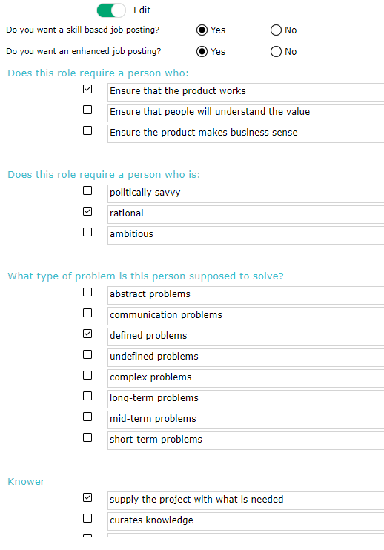
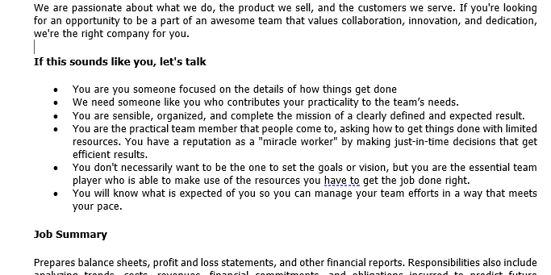
TeamScape Job Postings
Based on accurate, detailed, approved job descriptions
Query managers to describe:
Team contribution
Teaming style
Departmental culture
Job-to-be-done
Personal characteristics
Insert structured text to attract candidates who will be successful given those particular team dynamics.
Notes:
PURPOSE: INTRODUCE TEAMSCAPING.
Something we are working on for 2023.
TeamScaping is based on 20 years of research in Teaming Science.
Where does Retention Start?
Hiring the right people
What is the right person?
The one that will be successful in the role
Where do all your new hires land in your organization?
In Teams
Team dynamics are difficult to quantify
But are critically important in determining hire success
Based on

Slide 20
Re-Recruiting: Why Job Descriptions Are Important
Consider talent marketplace solutions
Provide personalized recognition and stretch assignments
Consider upskilling
Institute stay interviews and use Job Descriptions for:
Career pathing/advancement opportunities
Skills matching
Lever HRO Today Vector Technical
Notes:
PURPOSE: DEFINE AND GIVE EXAMPLES OF RERECRUITING (last topic in retain)
Definition: Re-recruit To confirm, to re-engage. To renew or restore the health, vitality, or intensity of employer-employee relationships.
Consider Talent Marketplace solutions
At HR Tech, industry leader and HR analyst, Josh Bersin said that “it is harder to find a new job at your current employer than outside of it
It’s also more expensive to recruit, train and ensure a cultural fit with new employees than to hire within
A talent marketplace can help strengthen the employee-employer relationships by providing opportunity and mobility.
Provide Personalized recognition and Stretch Assignments
Consider upskilling – employees can build their value and self-worth
InstituteStay interviews
Done right Job Descriptions provide:
Direction for career pathing and provide employees with a clear picture of advancement opportunities
For open position employees can see how their skills apply throughout the organization

Slide 21
HR Challenges
Recover
Reflect
Retain
Recruit
Deloitte
Notes:
WT:Question

Slide 22
Labor Market Expectations
Flexibility
Transparency
Career Growth
DE&I
Lever
Notes:
The relationship between employer and Employee has changed due to the labor market.
What are applicants looking for.

Slide 23
Flexibility: By The Numbers
65%
76%
of candidates want remote work options even after the pandemic
of employees see flex work as a top reason for staying with their current employer
Lever | Go Remotely
Notes:
During the Pandemic WFH was about surviving Business disruption.
Now it’s Flexibility
The Ability to WFH is now table stakes for many employee considering staying or looking for new job
According to our most recent JDXpert poll – only 12% of respondents said that they predict less than 10% of formerly on-site jobs will remain remote or hybrid permanently. And 37% stated that 50% or more would remain remote or hybrid.

Slide 24
Flexibility: What To Do
01
02
ASSESS VALIDITY
AUDIT TASKS
Keep job descriptions up to date in the context of the new work environment
Understand what tasks need to change or be done differently due to remote work
03
UPDATE COMPLIANCE INFORMATION
Document changes to physical demands and working conditions for ADA compliance
Notes:
PURPOSE: WHAT CAN YOU DO IN TERMS OF IMPLEMENTING RW
Job Descriptions can;
To keep employees focused on essential functions rather than working to satisfy perceived performance measures.
To monitor/evaluate/motivate remote workers
Defend against litigation (inaccurate Description of tasks or inaccurate Physical Demands and working conditions can make JDs useless in defending legal/compliance claims )
Understand what functions can be done remotely vs what needs to be done in the office
01 - Since WFH is growing, it’s critical that we Keep job descriptions accurate from the perspective of being performed remotely:
02
03

Slide 25
Transparency: By The Numbers
50%
20
of candidates become frustrated with the lack of transparency in job postings and interviews
states currently have some sort of pay transparency law
Lever | Zippa

Slide 26
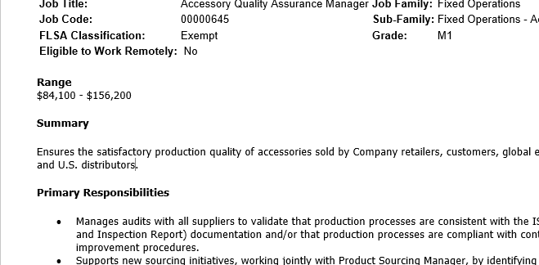
Pay Transparency vs Pay Equity
What is pay transparency
Why is it important
What’s the relation between PT/PE
Creates issues for:
Companies with PE issues
Companies posting a job in multiple locales
Notes:
PURPOSE: WHAT IS PAY TRANSPARENCY AND WHY IS IT IMPOTANT
Pay Equity involves paying people equitably who do substantially similar work regardless of Gender, Race, ethic background, age or disabilities
Pay transparency refers to companies being open about the compensation provided for current and prospective employees, as a step toward pay equity
It’s important because more and more states are requiring Salary Ranges on Job Postings:
Colorado, Connecticut, Maryland, Nevada, Rhode Island, Washington, New York and California.
even for very small companies.
Requiring good faith ranges Will become the norm if it hasn’t already
What’s the relation PT/PE
PT make it hard to hide PE issues
Increasing awareness of bias and pay inequities.
Posting ranges that are out of line with what you’re paying current employees will cause Issues
How do you handle Posting a job if you’re paying differently in different locales:
Some large platforms will flag the same role posted multiple times
Post a table of locales and ranges
Move to National Range – Supported by WFH

Slide 27
Career Growth: By The Numbers
33%
47%
of candidates view career growth as a motivational factor when choosing an employer
of U.S. employees rate career advancement opportunities as very important to their job satisfaction and job engagement rates.
Lever | Zippa
Notes:
Job descriptions play an important role in showing career growth opportunities because there are a prerequisite for Career Ladders. and career pathing as well as methodologies like Job Architecture that enable them..

Slide 28
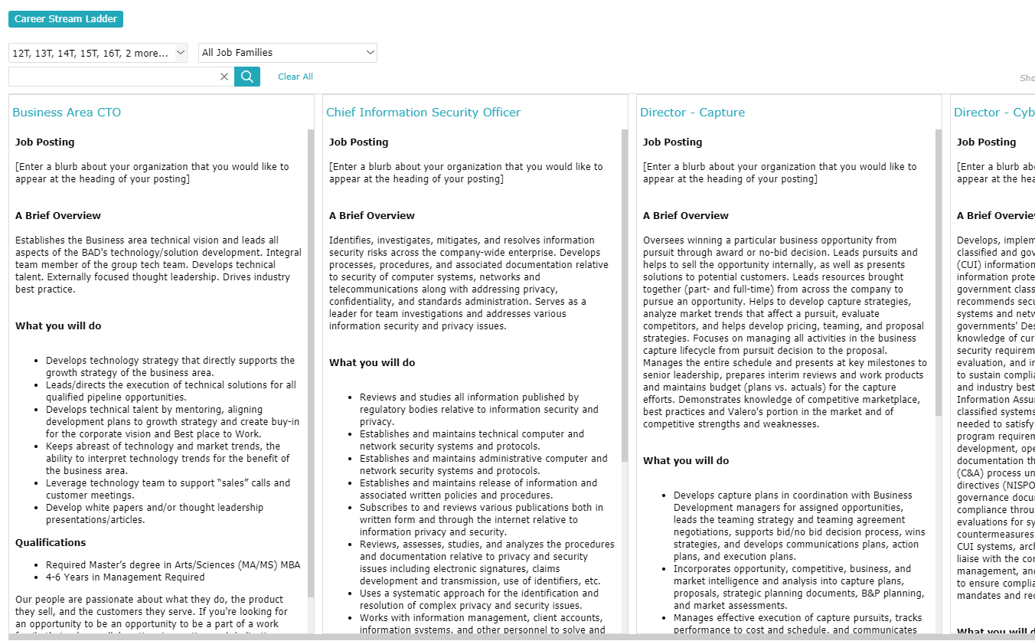
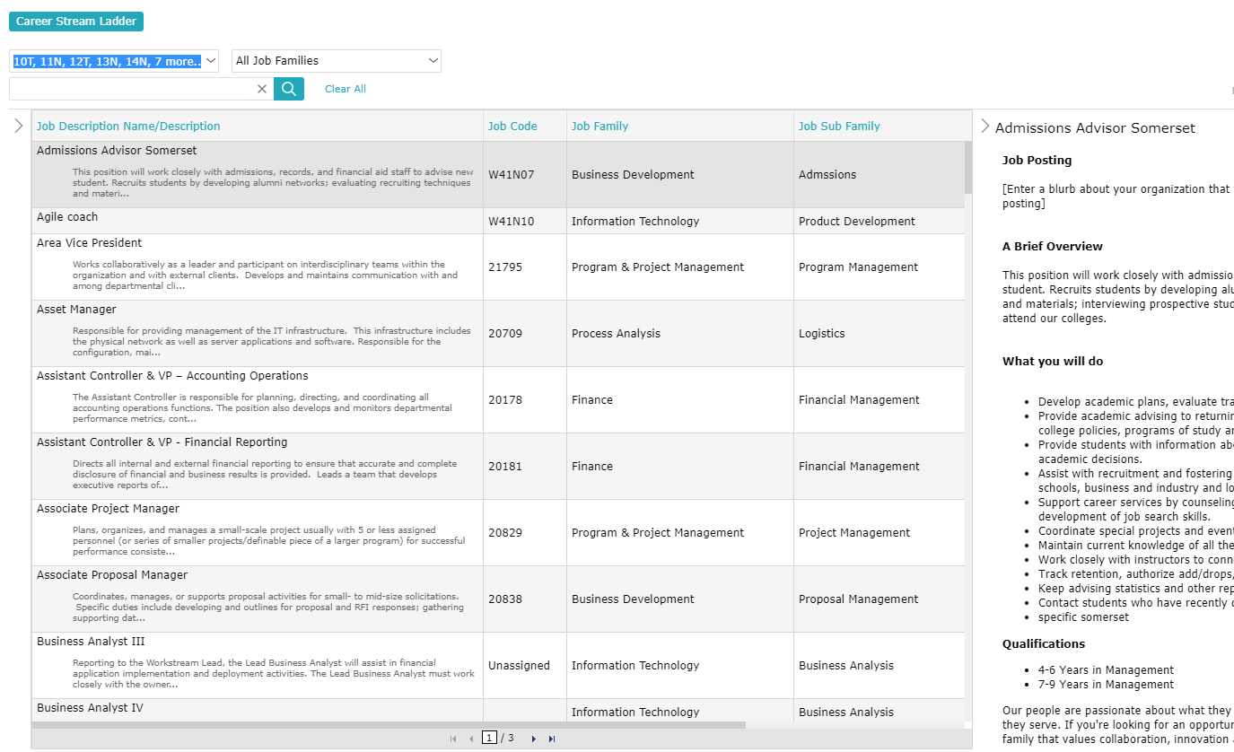
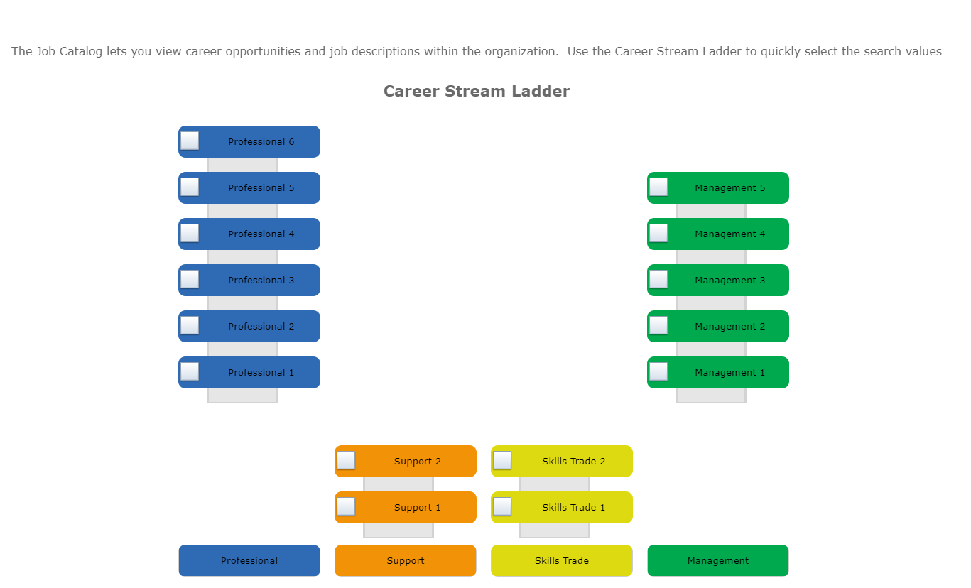
Career Path
Allow employees to view jobs
In their current path
Other relevant paths in the organization
Explore side-by-side
Notes:
Tuning Fork – (Resulting from Job Architecture) Illustrates Career opportunities across Career Streams in your organization providing more career options for EEs

Slide 29
Job Architecture
Consistent structure to describe work
Career development & succession
Coherent compensation strategy
Transparency and employee mobility
Workforce analytics & planning
Organizational changes & M&A events
Notes:
PURPOSE: WHY IS JOB ARCHITECTURE IMPORTANT
We talk about Career pathing as if all we have to do is provide a view into our Job Catalog.
But there is way more to it
Job Architecture methodologies and projects enables you to define coherent career progressions including skills and competencies and provides
-
-
-
-
-For M&A Job architecture is key component in allowing you to take a top down approach to coherently describe the new combined organization you’re creating.

Slide 30
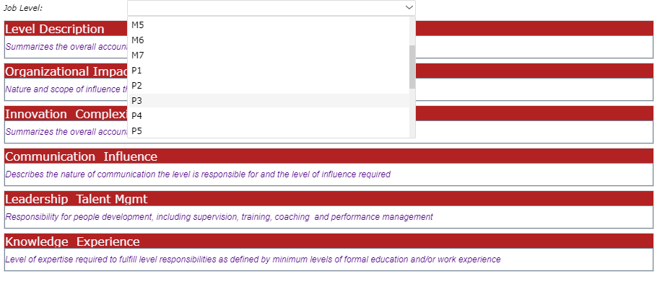
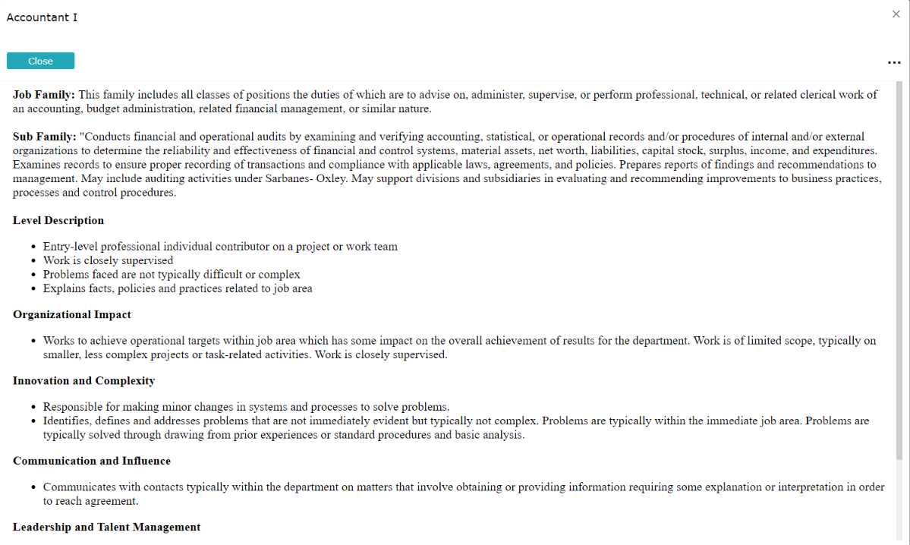
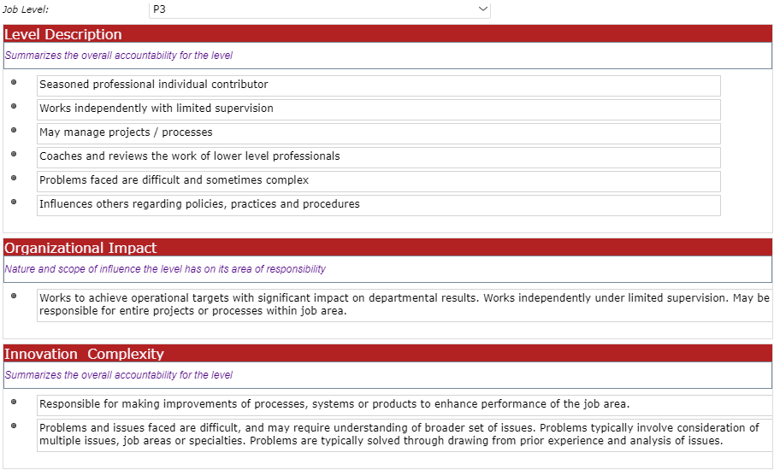
Job Architecture in Job Descriptions
Cascades architecture content into job descriptions
Creates guides for stakeholder that can be used for writing and revising job descriptions
Enforces job architecture structure
Supports competency and skills models
Insures coherent progressions
Notes:
PURPOSE: HOW JOB ARCHITECTURE FITS INTO JOB DESCRIPTIONS
BEFORE:
Job Architecture is the precursor of a Coherent Job Library
Job Descriptions are the logical endpoint of Job Architecture
This is how we see them working together:

Slide 31
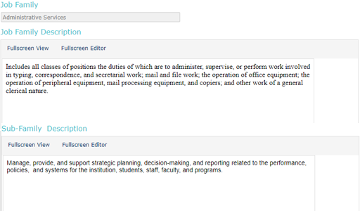
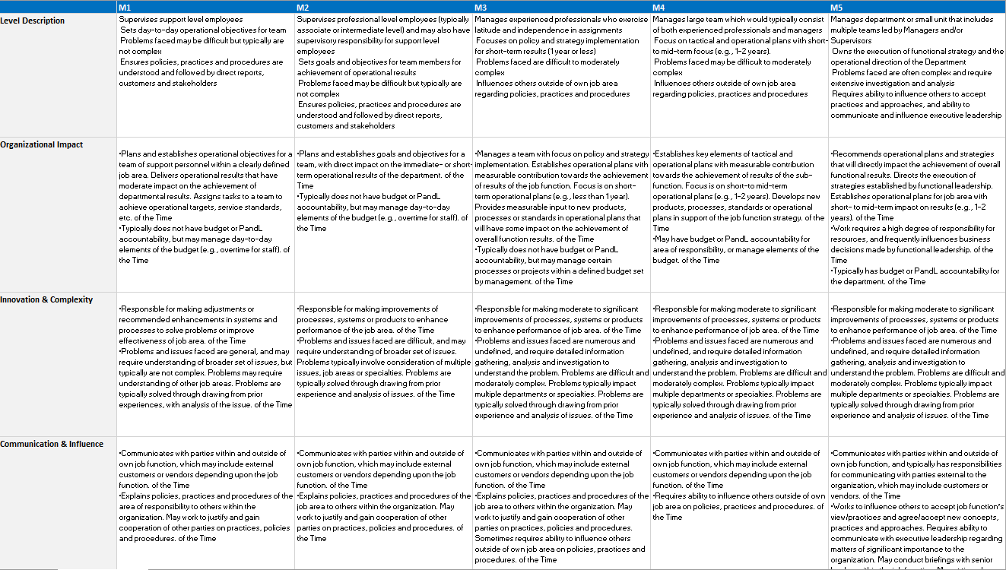
Tools for Job Architecture
Edit and collaborate with stakeholders on:
Job Families
Sub-Families
Career Stream/Levels
Map employees to the architecture

Slide 32
DE&I: By The Numbers
67%
+15% +35%
of job seekers consider workplace diversity an important factor
Better financial performance above national industry median ethnic/gender
McKinsey Bonus.ly
Notes:
According to McKinsey Diversity correlates with better financial performance
According to Bonusly…

Slide 33
DE&I and Job Descriptions
Pay Equity
Debiasing
Skills-Based
Recruiting
Notes:
When it comes to DE&I and Job Descriptions,
Equity is largely about Pay Equity
When it comes to Diversity and Inclusion
In many cases Applicants will self-eliminate based on the content of Job Postings
We’ll discuss two different ways of to prevent that:
Debiasing of Job Descriptions
Skills based recruiting.

Slide 34
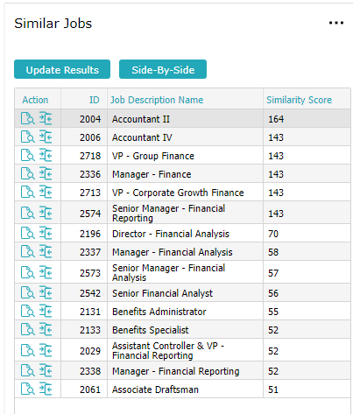
Pay Equity: Why Job Descriptions Are Important
Slow walk to pay equity because of missing first step – job descriptions
Exposes hidden pay gaps between jobs via:
Quantitative Analysis – Similarity Scoring
Qualitative Analysis – Side-by- side review of cohorts
Notes:
More companies are taking about equity Audits than are actually doing them b/c getting their Job Descriptions right is the critical first step and it is daunting.
JDX Exposes,,,

Slide 35
Pay Equity: Why Job Descriptions Are Important
Inaccurate job descriptions are an obstacle to pay equity
Substantially similar work is the standard based on a composite of:
Responsibilities/Essential Functions
Knowledge, Skills and Abilities
Effort
CA.gov
Notes:
Paying People Equitably is an important part of Equity
Remember, in the US, Pay Equity Legislation requires “Equal Pay for substantially Similar Work”. So the first step in any analysis around Pay Equity is creating groups of comparable jobs to analyze. This is not an easy task.
Substantially Similar work requires granular understanding of
Essential Functions
KSAs
Effort
Taxonomy is not enough:
You may have similar Jobs in different branches of your Job Family tree
Or your Library may be rife with many titles like “Program Managers” or “Project Managers” which may make some jobs seem similar when they are not.
Tools for PE

Slide 36
Debiasing-Impact of Bias in Job Descriptions
Discourages candidates who think the job is “not for them”
Narrows applicant pool
Notes:
Debiasing of Job Descriptions
-
-
The broadest applicant pool is achieved by using unbiased language and writing postings that appeal to all qualified candidates regardless of gender, ethnicity, age, etc.

Slide 37
Types of Bias
Gender Bias
Racial/Class Bias
Age Bias
Able Bias
Notes:
Gender bias – use of gendered pronouns or Job titles is the most overt, but this includes words with connotative bias, such as “forceful” or “dominate.
Racial/class bias –words or phrases that strongly skew towards members of a particular class or social group
Age bias – language that conveys a preference for a certain age group
Able bias – phrases that convey the desire for an able-bodied candidate outside of the specific physical demands required for the job.
Not Really bias but can have a similar effect on the talent pool so we take a similar approach with:
Incomprehensible Jargon can make applicants feel the job is not for them
Excessive superlatives like awesome or world-class – can be intimidating

Slide 38
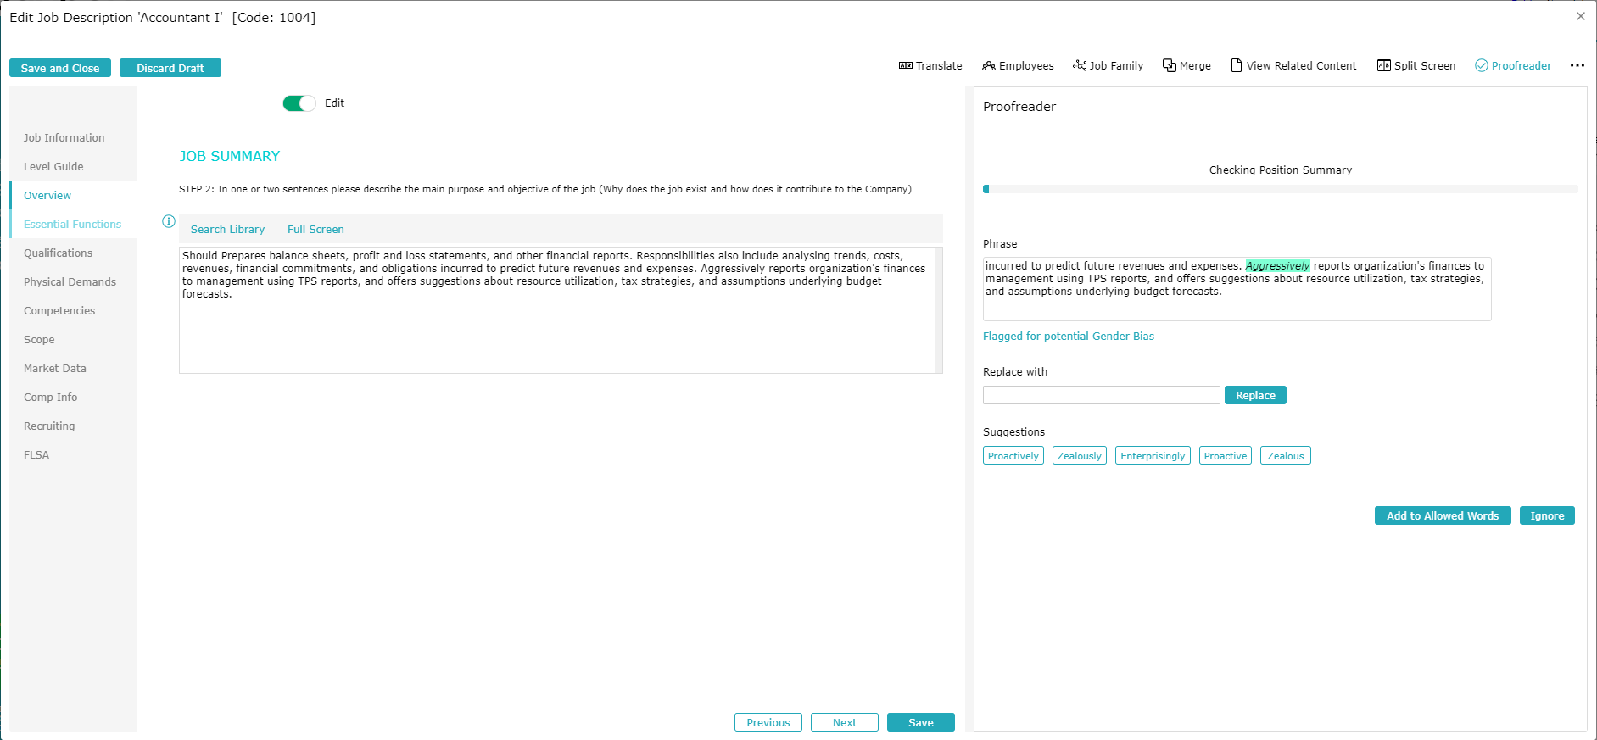
Debiasing in Action
Notes:
Debiasing is difficult to do in a manual way so we’re really discussing an automated process
In our tool we apply debiasing as the Job Description is being edited.
Also:
Lexicon of biased words, Jargon etc. comes populated but is editable so companies and tailor terms to their needs
Ability to generate a bias score allow you to report globally on you Job Description library to identify targets for debiasing effort.

Slide 39
Recruiting: Skills-Based Job Postings
Less weight on education and experience because doing so:
Drastically expands the talent pool
By including those without degrees
By adding in those with experience gaps or frequent job changes
Education level does not guarantee skills
Many ways to learn needed skills
Skillful, The Wall Street Journal
Notes:
Less weight on education and experience because doing so:
Drastically expands the talent pool
By including those without degrees
By adding in those with experience gaps or frequent job changes
Education level does not guarantee skills
Understand there are many ways to learn needed skills (internship/Externships/learn on your own)

Slide 40
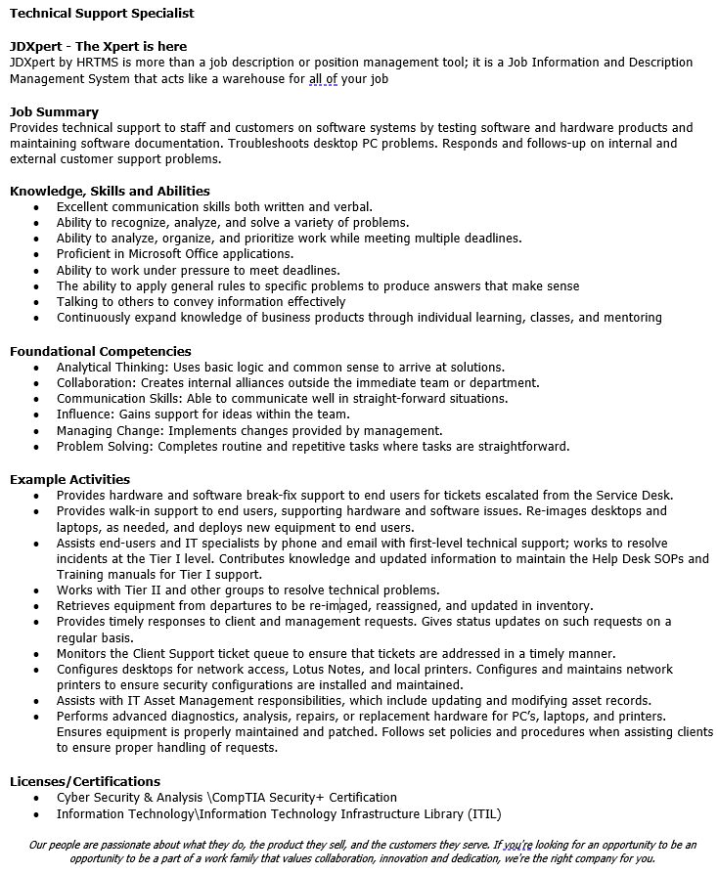
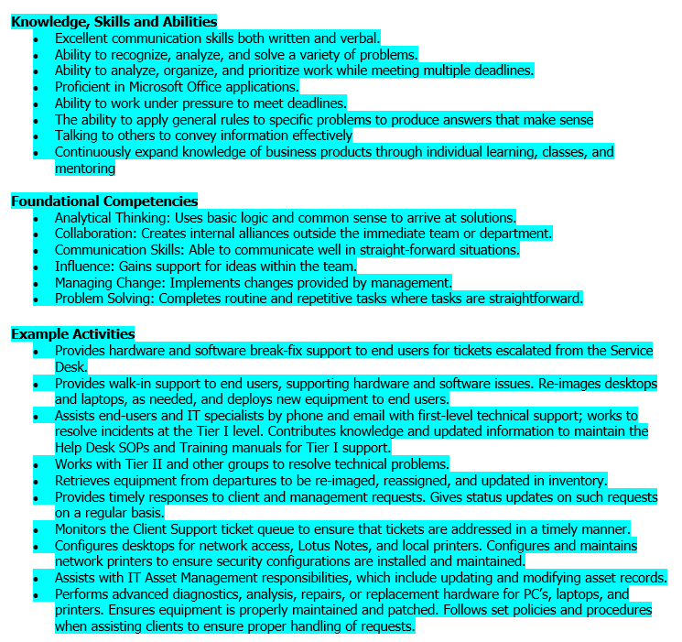
What To Do: Skills-Based Job Postings
Skills-Based Job Posting
Focus on KSAs and Competencies
Company Description
Job Summary
KSAs
(Foundational) Competencies
Example Activities (Essential Functions)
Licenses and Certifications
Physical Demands
Disclaimers
Notes:
Skills based recruiting -- taking a different approach to the Job Posting
-
-
-KSAs AKA Hard Skills – focus on candidates who have the actual skills needed to perform in the job
-Foundational Competencies – Soft Skills – Intrinsic capabilities that are transferable between Jobs and industries.
-
-
-
-
The same rules apply to Job Posting and Web page– you need to capture attention up top and keep it putting compelling items up front.
Also make sure that your ATS filters are not eliminating applicants

Slide 41
Recruiting Blueprint
Accurate & Up-to-date Job Descriptions
Address Expectations
Skills-based Recruiting
Team-scape Job Postings
1
More candidates
2
More diverse candidate pool
3
More successful hires
Notes:
All recruiting efforts require accurate/up-to-date job descriptions
Address labor market expectations like remote work, DE&I, Career Growth, and pay transparency
Apply Skills-Based Recruiting as appropriate
For Some Jobs Pedigree Postings are more appropriate
Skills-Based Recruiting casts a wider net
By focusing on candidates who have needed skills and competencies
By eliminating filters on Education and Experience
Resulting in more candidates in general
And a more diverse candidate pool
While hiring candidates who will be successful in their roles

Slide 42
Wrap Up
The economy is expected to contract in 2023; however, the long-term issue we need to confront is the labor shortage
Get your job descriptions in order so that they can address talents’ need for transparency, flexibility, career growth, fair compensation, engagement and relief of burnout
Use power tools to understand the work that people do and how it fits into your organization
Increase the effectiveness of your recruiting efforts by creating job postings that expand the talent pool with candidates who have the capacity for success

Slide 43
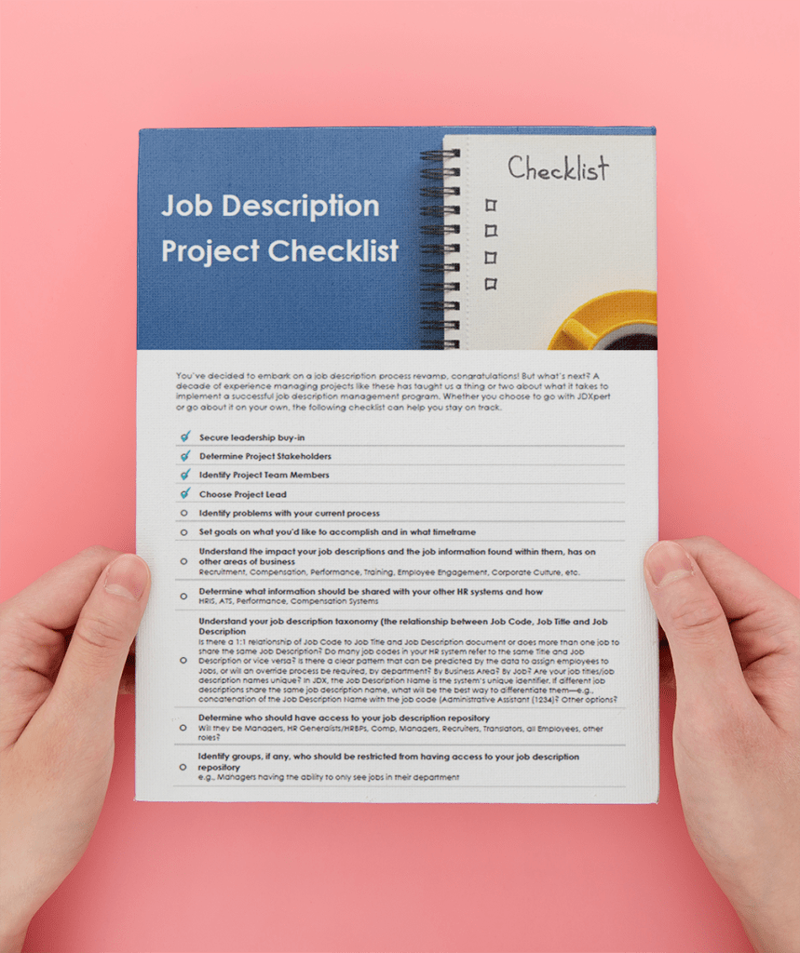
Thank you!
Job Description Project Checklist
DOWNLOAD
https://jdxpert.com/checklist/

Slide 44
Thank you!
Want to learn more about how JDXpert can help you get the most out of your job descriptions?
Schedule Your Demo Today!
https://jdxpert.com/contact/

